Slide 1
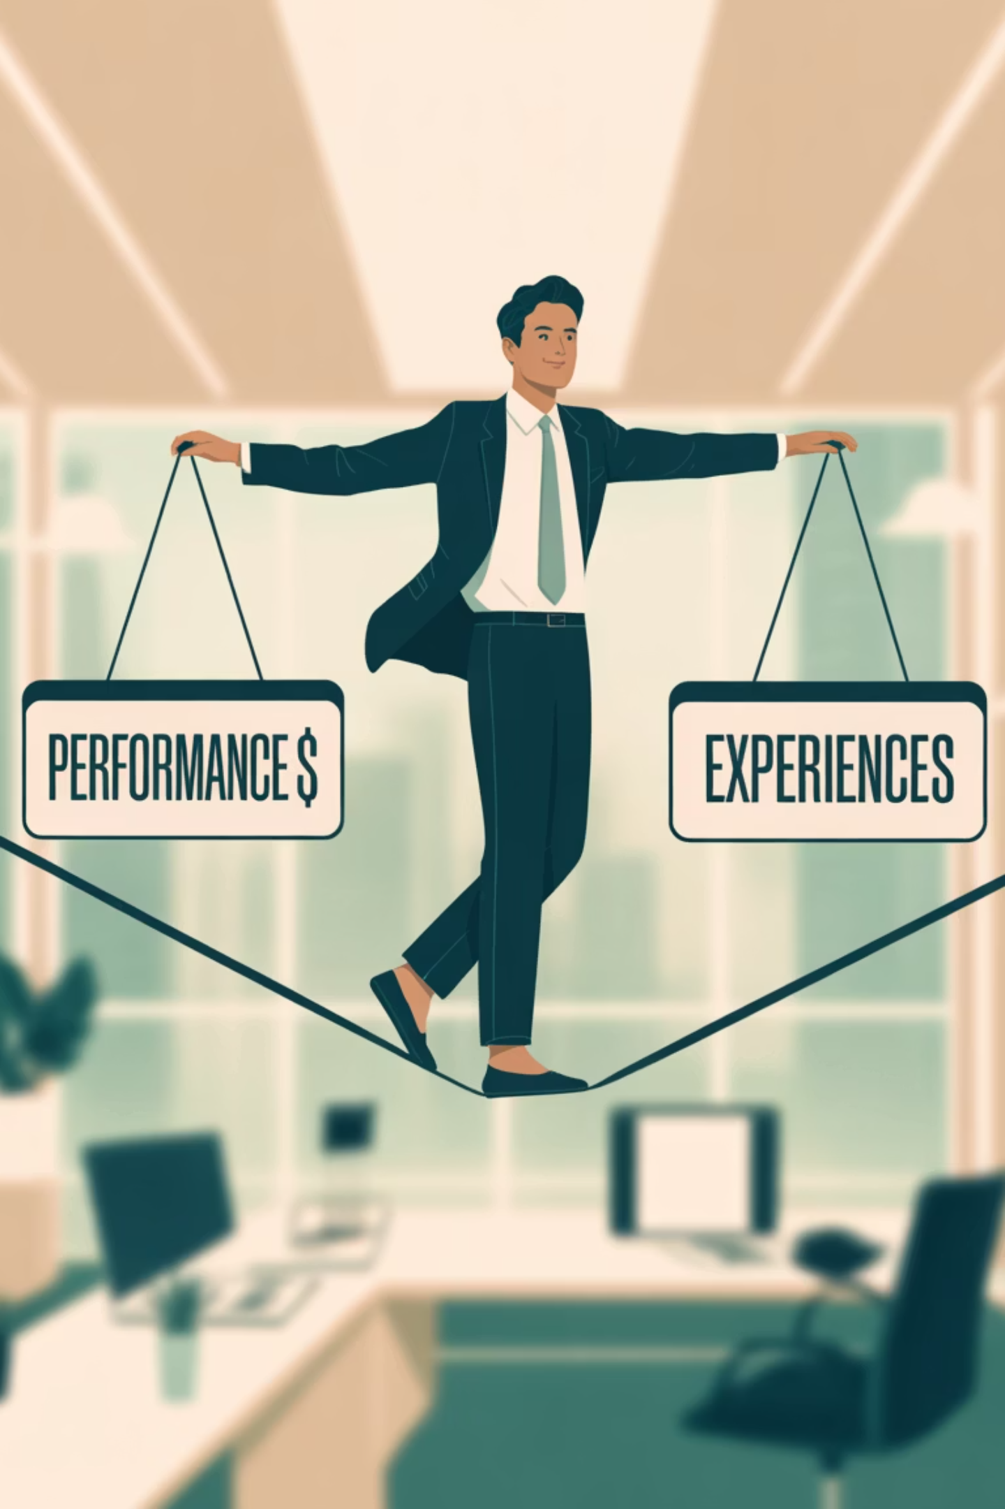

Talent Tightrope: Balancing Performance & Experiences
Today's professionals will hold 12 different jobs in their lifetime. The old model of lifelong loyalty is gone.
How do we attract, secure, and inspire individuals who will set our firms' direction?
GS
by G. T. "Toby" Stansell

Slide 2

The Uncomfortable Truth About Modern Talent
12
<4
77%
Average Jobs
Years Per Job
Partnership Goal
Today's professionals will hold 12 different jobs in their lifetime.
Average tenure is less than four years at any organization.
Young lawyers who want to become equity partners.

Slide 3

Our Roadmap: The Four Pillars of Talent Strategy
The New 'Total Reward'
The Revolving Door
Understanding what millennial and Gen Z lawyers truly value and how to build a workplace they won't want to leave.
Data-informed diagnosis of why our best young attorneys are leaving.
The Partnership Path
The Growth Imperative
Aligning ambition with opportunity to create the ultimate retention lever.
Leveraging mentorship and unique international opportunities to build careers worth staying for.

Slide 4

The Revolving Door: Why They Leave
Professional Growth
Financial Improvement
Work-Life Balance & Culture
Mobility is the Norm: 55% of respondents started their legal careers at a different firm. Only a quarter have never changed firms.
Conclusion: While money matters, attorneys are not just leaving for a better paycheck. They are leaving for a bigger future. They are actively seeking environments that invest in their holistic development.

Slide 5
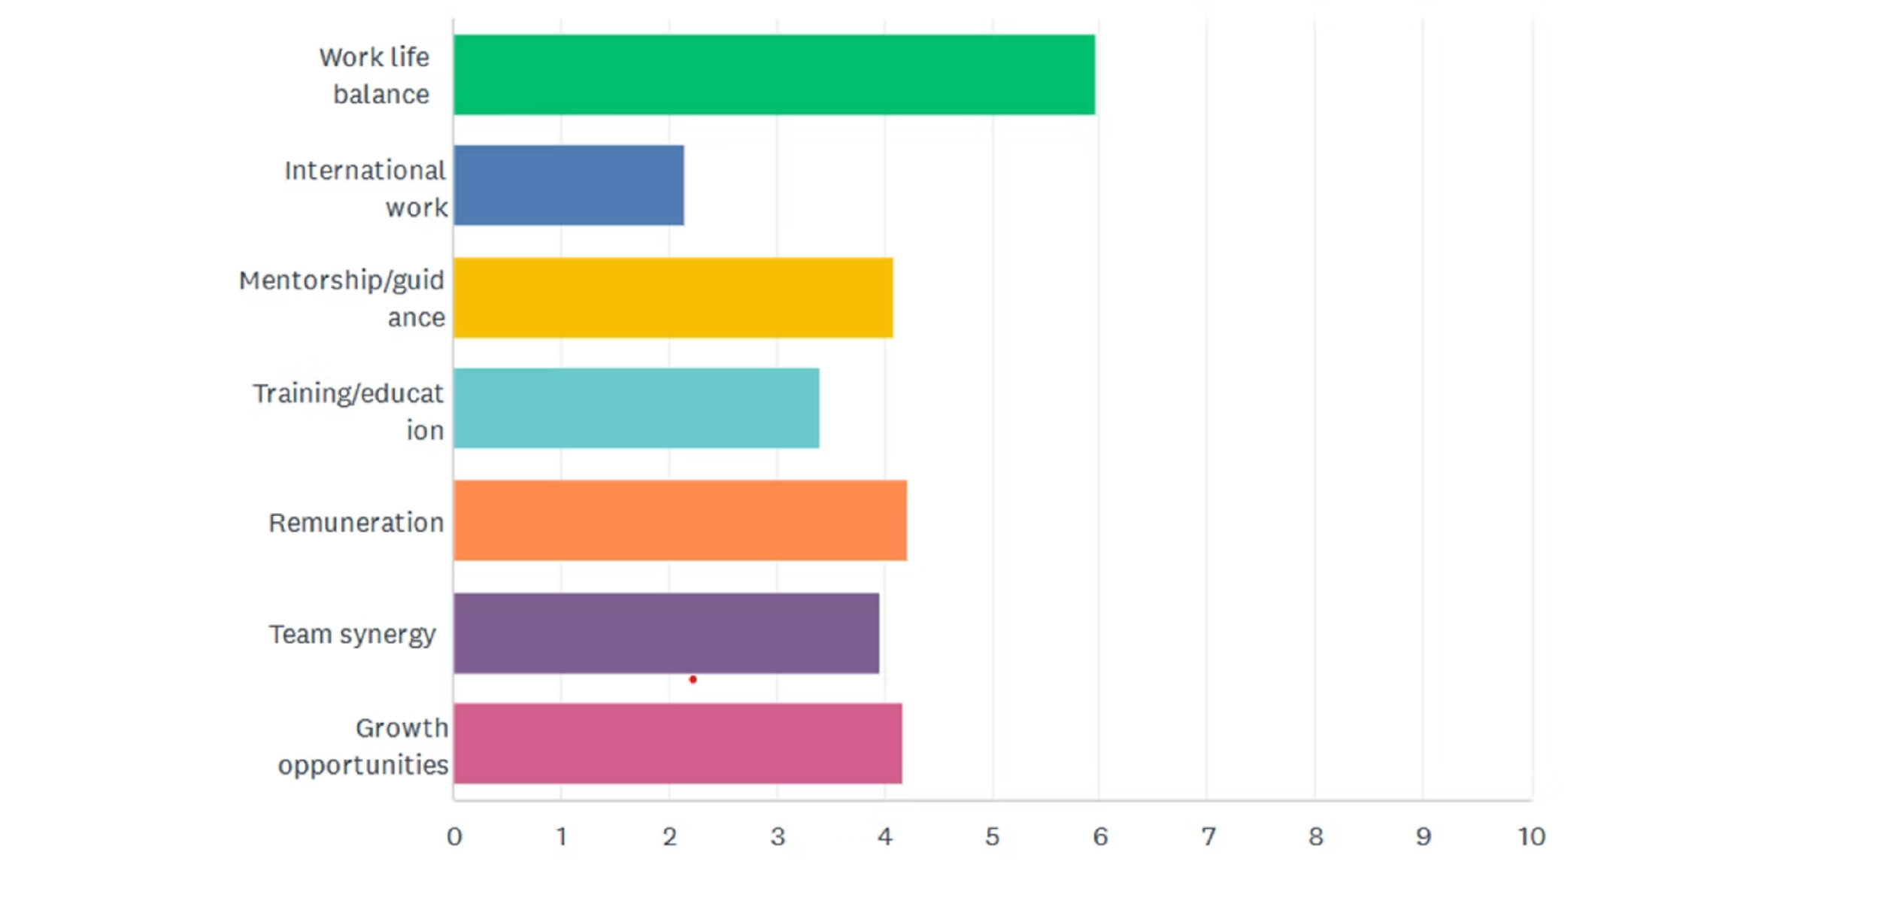
2. The New 'Total Reward': What They Value

Slide 6
What They Value Expanded…
100%
85%
Work-Life Balance
Growth Opportunities
This is not a nice-to-have; it's their top priority. Tangible policies, flexible hours, remote work options, burnout prevention.
Young lawyers want a clear path for advancement and professional development.
85%
70%
Fair Remuneration
Team Synergy & Culture
Fair, transparent compensation and clear bonus systems. They value fairness, transparency, and clarity almost as much as comp values!
Actively seeking a positive, collaborative, and non-toxic work environment. They want to be part of a supportive community.

Slide 7


3. The Growth Imperative: Building Careers Through Mentorship & Global Opportunities
International Interest
Long-Term Assignments
Global Collaboration
87%
80%
80%
Young lawyers interested in working abroad.
Prefer assignments of several months.
Eager to work with international colleagues.
Formalized Secondment Program
Structured exchanges with clear terms on duration, costs, and work continuity.
By offering these high-impact, career-defining experiences, you're providing a global career path that's difficult to walk away from.

Slide 8





4. The Partnership Path: Harnessing Ambition
1
Partnership
Business Development
2
Client generation skills
Leadership Skills
3
Management capabilities
Legal Expertise
4
Specialization and depth
Interpersonal Skills
5
Commitment to firm values
77% of young lawyers want to become equity partners. They're not job-hoppers by nature, but opportunity-seekers willing to commit when they see a viable future.

Slide 9





Your Action Plan for Tomorrow
Diagnose Your Leaks
Understand that top talent leaves primarily for growth opportunities.
Build Holistic Value
Redefine 'reward' to include a positive culture, work-life balance, and unique opportunities.
Leverage Your Global Advantage
Use international experiences and structured mentorship as key differentiators.
Make Partnership a Journey, Not a Mystery
Create a transparent, achievable path to leadership.

