Slide 1
The Changing Scope of Model Rule 5.5 and Multi-State Jurisdictional Practices
Legal Netlink Alliance
Greensboro, NC
September 2024
Micah U. Buchdahl mbuchdahl@kanghaggerty.com

Slide 2
What we will cover
Get a deeper understanding of the rules around where and how one practices, and how to navigate them
How to maximize the versatility of your license
Where you can safely market your practice, with the kaleidoscope of ethics rules in states
Learn about the proposed changes to RPC 5.5 and responses from states and organizations
Recent Opinions
Where Things are Heading
Notes:
Intro to pressures creating interest in change

Slide 3
Rule 5.5
Unauthorized Practice of Law; Multijurisdictional Practice of Law

Slide 4
What is Happening Here?
Market pressures from lawyers, competition and rules
Pressures from modernization, globalization, technology
Address “access to justice”
Drive for uniformity
Realities of today’s law practice
Notes:
CA plus co

Slide 5
History of RPC 5.5
20/20 Commission
APRL proposed RPC 5.5
April 2022
ABA Issues Paper
January 2024

Slide 6
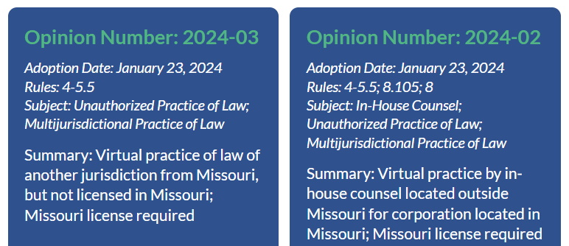
Missouri Ethics Opinions on 5.5 and 8.5 - no; no; no; and okay, but…
Notes:
No right for in house counsel lawyers
No right for virtual practitioners just practicing from their home office
No right for out of state lawyers to review
Right for an hour of state doing a deposition for a pending lawsuit in MO with pro hac vice only
Even revised 5.5 is strict. It has a foreign lawyer exception (5.5d), but only with one of two special licenses and this doesn’t apply for solely federal practitioners who, it says, are authorized under 5.5b1, but in comment 4 states no right to an actual office based on a 1950s case with little to say on the topic.
“Federal law, including but not limited to international treaties, may require that a lawyer be permitted to practice in this jurisdiction. Federal law that admits a lawyer to appear in a federal court or other tribunal does not authorize a lawyer to establish an office or other systematic and continuous presence to engage in other aspects of the practice of law in this jurisdiction. See In re: Page, 257 S.W. 2d 679 (Mo. banc 1953).”

Slide 7
STATE BAR OF GEORGIA FORMAL ADVISORY OPINION NO. 22-1
Under Georgia Rule of Professional Conduct 5.5, may a Domestic Lawyer or a Foreign Lawyer provide legal services by remote means from Georgia while residing in Georgia, when the services have no relationship with Georgia other than the lawyer’s physical location?
Yes, under certain conditions. A Domestic or Foreign Lawyer residing
and working in Georgia may provide legal services by remote means
that have no relationship to Georgia other than the lawyer’s physical
location if: (a) the lawyer does not hold out or otherwise represent that
they are licensed in Georgia; (b) the lawyer takes reasonable steps to
ensure that the lawyer’s Georgia location is not generally known; and
2 (c) the lawyer takes reasonable steps to correct any misunderstanding
about the lawyer’s licensure.1

Slide 8
State Variations on 5.5
Arizona
Montana
North Carolina
Ohio
New Hampshire
Oregon
Washington
Utah
Connecticut
Illinois

Slide 9
Where Lawyers Can Practice NOW
Notes:
Transition slide

Slide 10
Temporarily
Pro hac vice
Admission by motion
Pandemic exceptions extended
Exceptions for pro bono, UBE, military spouse, etc.
Notes:
CA + co

Slide 11
Military Spouse Attorney Exceptions
Military Spouse JD Network, a 1,000-member bar association created to help military spouses — of whom 92% are estimated to be women — with the unique professional challenges that other attorneys do not face.

Slide 12
Permanently
Federal only
In-house counsel
Related to a pending mediation or arbitration
Related to negotiations originating from own jurisdiction
Has local counsel
Pro bono
Authorized by local jurisdiction, with limitations
Notes:
CA + co

Slide 13
How To Maximize the Versatility of Your License
Look for states with UBE
Nuanced RPC 5.5 that work for your purposes [AZ, MN, NC, OH, NH]
Reciprocity with states you are interested in going to
Pick a federal practice area and only do that
Be in-house counsel
Notes:
CA

Slide 14
Hard and Fast Limits
Practicing in a different state than barred, but within the rules
Don’t dabble in state law
Identify where you are barred and why you can practice there – letterhead, sig block, website, etc.
Certificate to client about malpractice insurance in Oregon
Additional requirements: registration as entity in New Jersey
Notes:
CA

Slide 15
What Is Bar Reciprocity, and How Does It Work?
Only certain states with others—often neighbors—with a certain number of years practicing and an additional fee. Consider new CLE requirements also.
Quick list and resources (2021): https://www.americanbar.org/groups/young_lawyers/resources/after-the-bar/career-resources/what-is-bar-reciprocity-and-how-does-it-work/
Program (2024):
https://www.americanbar.org/events-cle/ecd/ondemand/436394086/

Slide 16
Bar Reciprocity – Adding New Jurisdictions
• What new obligations arrived with the addition of
your new jurisdiction(s)?
• What are some of the hidden costs?
• CLE requirements in each jurisdiction?
• State bar dues In every state

Slide 17
Safely Marketing Your Practice
Advertising
Marketing
Solicitation
RPC Nuances
MJP/UPL
Enforcement Mechanisms
Associating with local counsel
Notes:
MB

Slide 18
All legal matters. Anytime. Anywhere. Really?

Slide 19
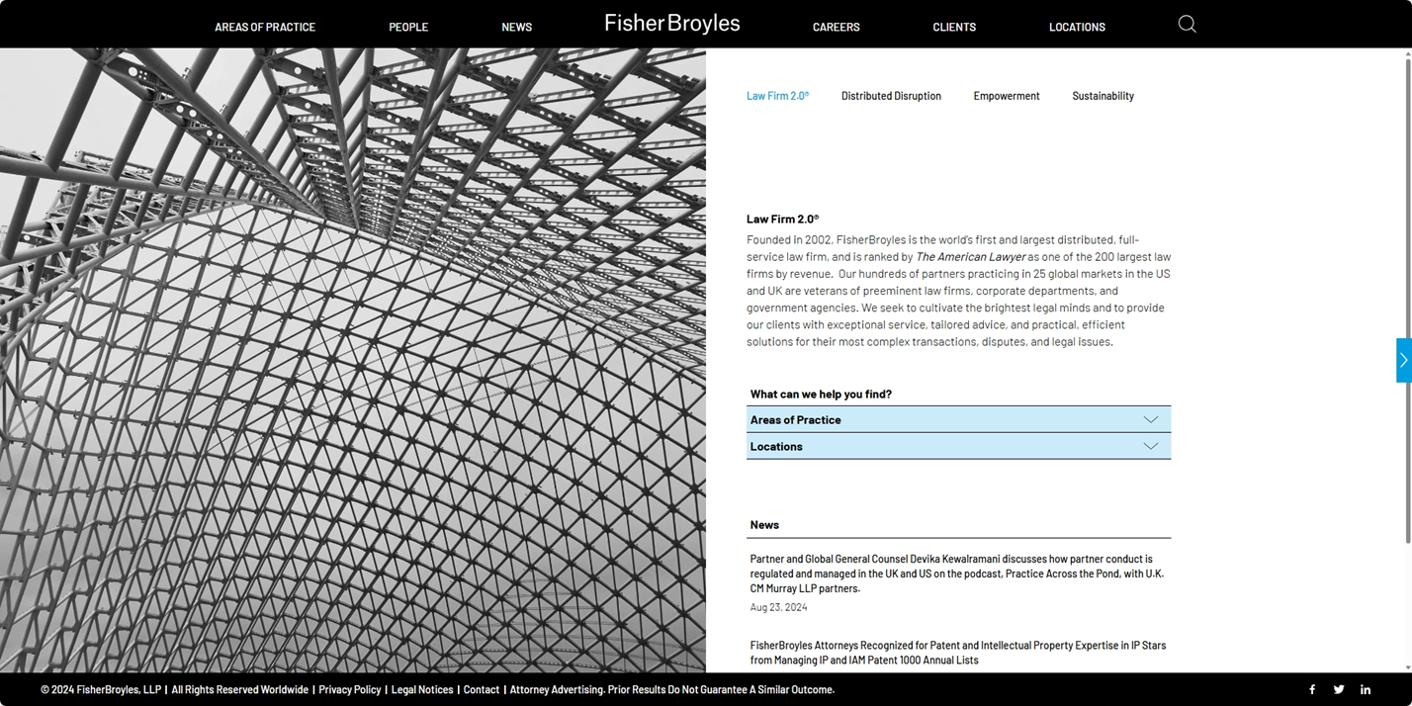
All 50 States / Virtual Law Firm

Slide 20
The Morgan & Morgan Effect

Slide 21
Discipline From Multiple States/Entities
Can’t practice anywhere in U.S. if disbarred or suspended in a state
Will affect federal practice areas also
Don’t presume they match up in time or procedure for reinstatement
This Photo by Unknown Author is licensed under CC BY-SA
Notes:
CA?

Slide 22
NC State Bar v Musinguzi

Slide 23
State by State
Variations of the ABA Model Rules of Professional Conduct
https://www.americanbar.org/content/dam/aba/administrative/professional_responsibility/mrpc-5-5.pdf
Jurisdictional Rules Comparison Charts
https://www.americanbar.org/groups/professional_responsibility/policy/rule_charts/

Slide 24
Analyzing What Law Applies: The Intersection of RPC 5.5 and RPC 8.5 (Choice of Laws)
Ask: Where barred? Where you did work? Where firm is? Where court is? Where client(s) are? Where dispute is?
Where court involved = where court says
Everything else, where action occurred
Unless there’s a predominant effect elsewhere
ABA Formal Opinion 504 - Spring 2023
Notes:
CA
Usu. jurisdiction where barred AND where offering legal services

Slide 25
New York – Physical Office Still Required
Judiciary Law 470
NJ lifted in 2013

Slide 26
Remote Practice Rule - Texas
New rule in 2024
Can be in-house if in good standing elsewhere.

Slide 27
What’s next?

