Slide 1



Panel: The Next Generation of LNA
Summary and insights of Next Wave questionnaire
Moderator: Marein Smits, Wintertaling, Amsterdam
Kandis Kovalsky, Kang Haggerty, Philadelphia
Lisette Oosterveen, Wintertaling, Amsterdam
20 June 2025

Slide 2

About the survey
SOME TECHNICAL INFORMATION
  97 people took the questionnaire;
  Participants ranged in age from 23 to 39, with experience levels spanning from under 1 year to nearly 14 years;
  Notably, 55% began their legal careers at their current firm.
The Next Wave survey was available for anonymous completion from December 2024 through mid-January 2025, targeting legal professionals in the EU under the age of 40 with less than 15 years of practice.
Designed to better understand its members, the survey gathered perspectives on career journeys, legal practice experiences, and involvement in LNA programs.
This presentation provides some relevant high lights.
            23-29 years: 40%
            30-35 years: 45%
            36-39 years: 15%

Slide 3
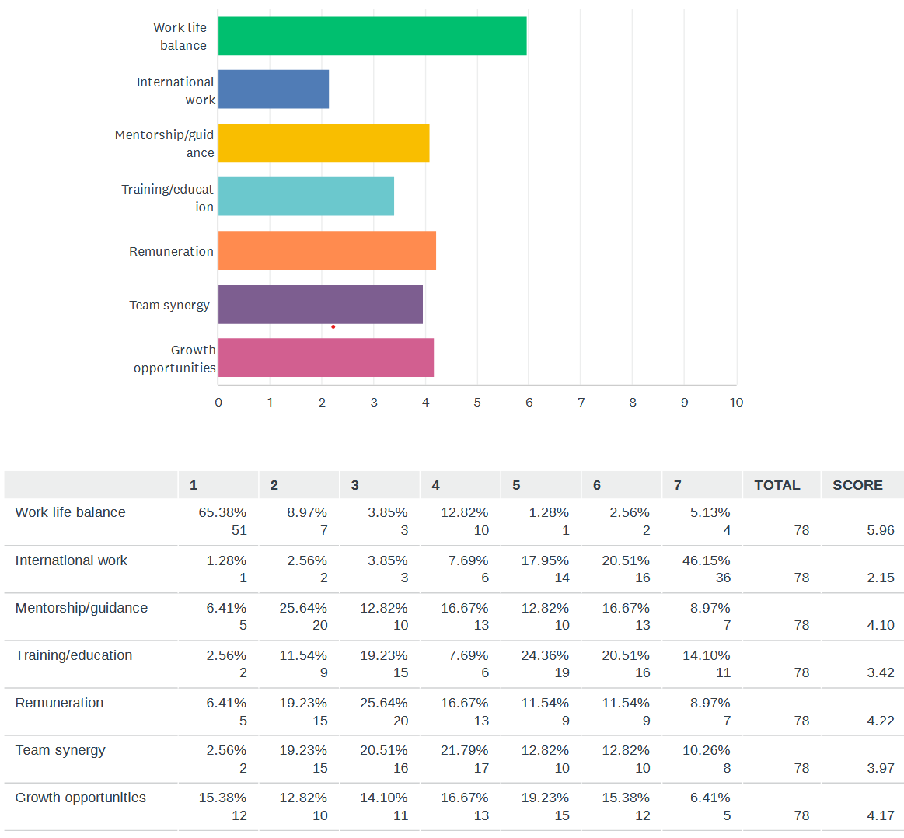
The ideal workplace according to young lawyers

Slide 4
What motivated your decision to join your current firm
    Quotes:
    “I wanted to work with and learn from my boss, who is well-known in the legal profession”
    “The team of the law firm”
    “The size of the firm provides me with the opportunity – and responsibility – as a young lawyer to take on significant duties and voice my preferences, both positive and constructive. It also affords me the chance to contribute to meaningful change withing the organization.”
    “What I valued the most when I first joined this firm was its very horizontal structure. I believe this setup allows me to learn a great deal, as I often get to work directly with the partners on various tasks.”
    “A prospect of good work life balance.”
    “Firm reputation”
    “The integrity and highly professional appearance at the market”

Slide 5
What Young Lawyers Value Most in Their Professional Roles
    What I currently value most is that as a young lawyer I have the opportunity to participate in many areas of the firm’s activities. This allows me to expand my knowledge in many fields.”
    Quotes:
    “The experience and guidance I’m getting”
    “The relationship with my colleagues”
    “The positive interaction with the team and the opportunities to continue acquiring professional know-how”
    “The freedom to grow”
    “Trust to handle high level complex mandates”
    “The growth opportunity in a mid size lawfirm as well as the guidance by my partner.”

Slide 6
Key reasons for Changing law firms
    Quotes:
    “I might consider changing law firms for a couple of key reasons. Firstly, I’m looking for better working conditions, which means finding a place with a better work-life, a higher salary, and more flexibility in my schedule, including the possibility of working remotely.[…]”
A majority of respondents have changed firms at least once, with some having done so up to five times.
The most common reasons include seeking:
professional growth
better financial terms
a more supportive and work environment
improved work-life balance
    “The reasons that led me to change my job have been the pursuit of my professional growth.”
    “Lack of independence, lack of humanity”
    “No opportunity to grow and further develop, and financial reasons.”
    No changes: 25%
    1 change: 30%
    2 changes: 20%
    “time limited contract”

Slide 7
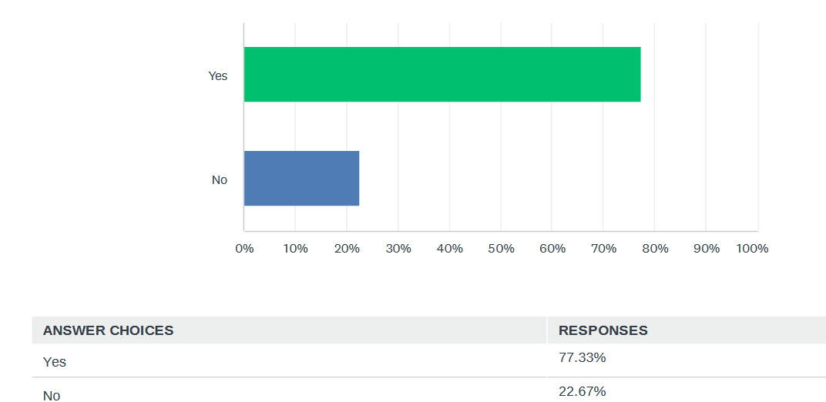
Becoming an equity partner

Slide 8
Young Lawyers’ Perspectives on Key Criteria for Partnership
    Quotes:
    “Dedication, consistency, integrity, experience.”
    “Ambition and ability”
    “Resilience, ambition, knowledge, network.”
  Business development and client generation
  Leadership and management skills
  Legal expertise
  Interpersonal and communication skills
  Commitment, loyalty and dedication
    “Entrepreneurial mindset, strong internal drive to succeed, being positive always.”
    “Experience, knowledge, organizational skills”
    “To be a hard working person that understands the business and the law, brings in clients and brings in enough money to have a responsibility for a team that can create value.”

Slide 9
Supporting Ambition: What Young Lawyers Need from LNA
    Quotes:
    “Providing mentorship, opportunity to work on projects with other international colleagues, organize meetings.”
    “Enabling you to gain additional experience in cross-border matters, provding a basis for starting your own business.”
The responses highlighted the following key benefits:
  Learning from the best: mentorship and guidance by experienced lawyers
  Stronger together: opportunities to connect across LNA member firms
  Smart Sharing: A Platform for Legal Knowledge and Innovation
  International Impact: Teaming up on international cases
  Expertise Elevation: Developing skills through training, seminars, and workshops.
    “Sharing experiences, career support, knowledge of abroad markets”
    “They can help me to connect with experienced lawyers who can provide guidance, feedback, and support. […]”
    “LNA can support me by hosting webinars where professional guidance and mentorship is provided for candidate attorneys. Additionally, LNknowledge sharing A can support by providing a platform for with other members of the network.”

Slide 10
Thank you!

