Slide 1

Diversity, Equity, & Inclusion
October 22, 2021
Wilmington, Delaware

Slide 2
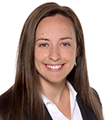
Master Molina
The Honorable Selena E. Molina is a Master in Chancery on the Delaware Court of Chancery.

Slide 3
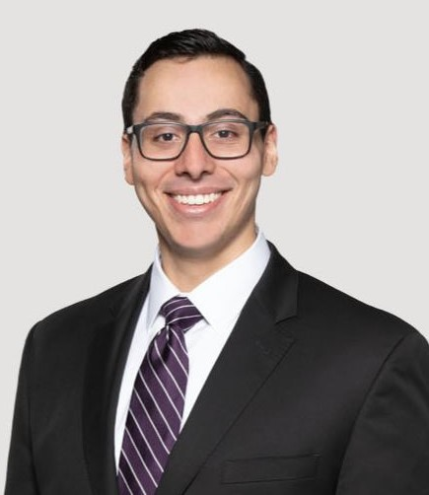
Alberto E. Chávez
Alberto is an associate at Delaware firm
Young, Conaway, Stargatt and Taylor.
Alberto is the Executive Chair of Public Relations for the Multicultural Judges & Lawyers Section of the Delaware
State Bar Association and the Treasurer
of the Delaware Hispanic Bar Association.

Slide 4
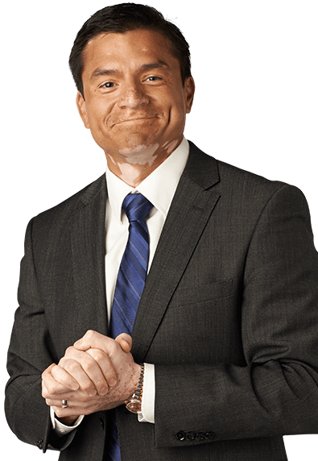
Brendon Friesen
Brendon is a shareholder at Mansour Gavin LPA in Cleveland, Ohio. Brendon focuses his practice on corporate law, including transactions and litigation. Brendon is the co-chair of his firm’s Diversity and Inclusion Committee.

Slide 5
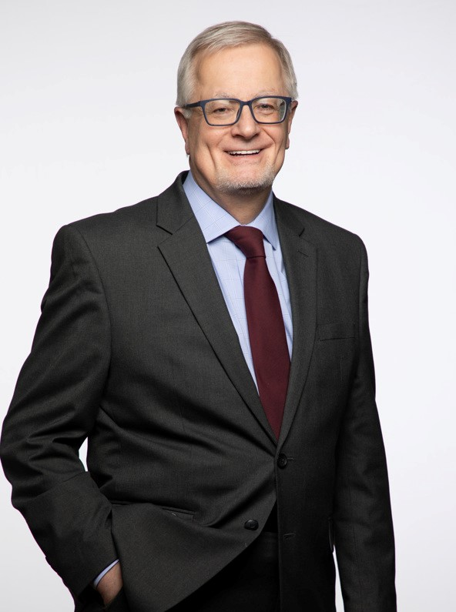
Jerry Holisky
Jerry is the co-managing member of the firm Aronberg Goldgehn out of Chicago, Illinois. Jerry’s practice focuses on business law, and more specifically, advising clients of closely-held companies and their owners.

Slide 6
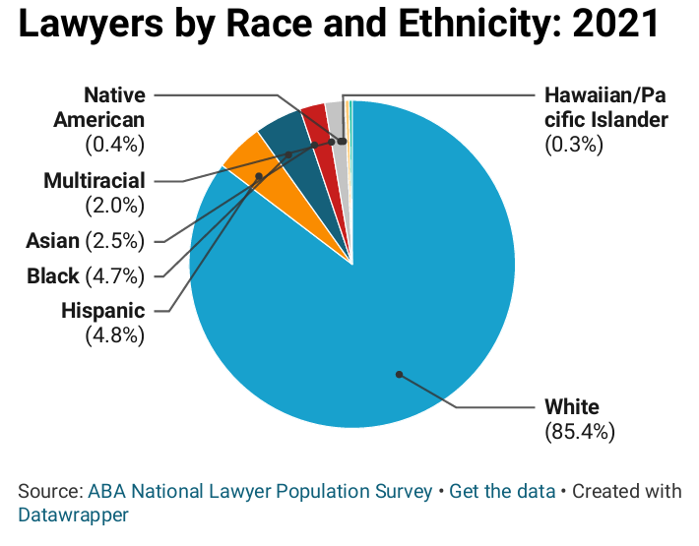
The Race Disparity

Slide 7
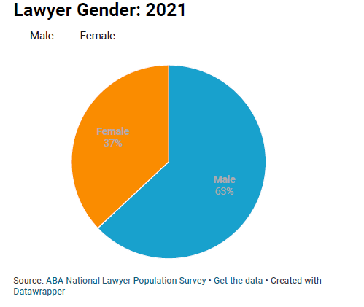
The Gender Gap

Slide 8
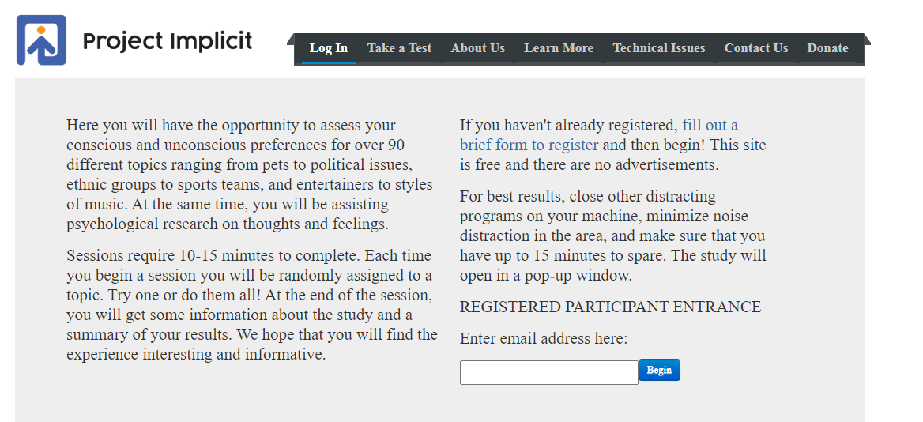
Implicit Bias Survey
https://implicit.harvard.edu/implicit/takeatest.html

Slide 9
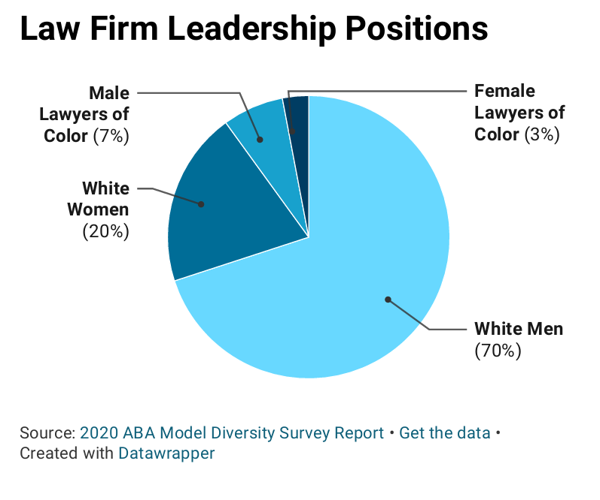
Lack of Diversity in Leadership Positions

Slide 10
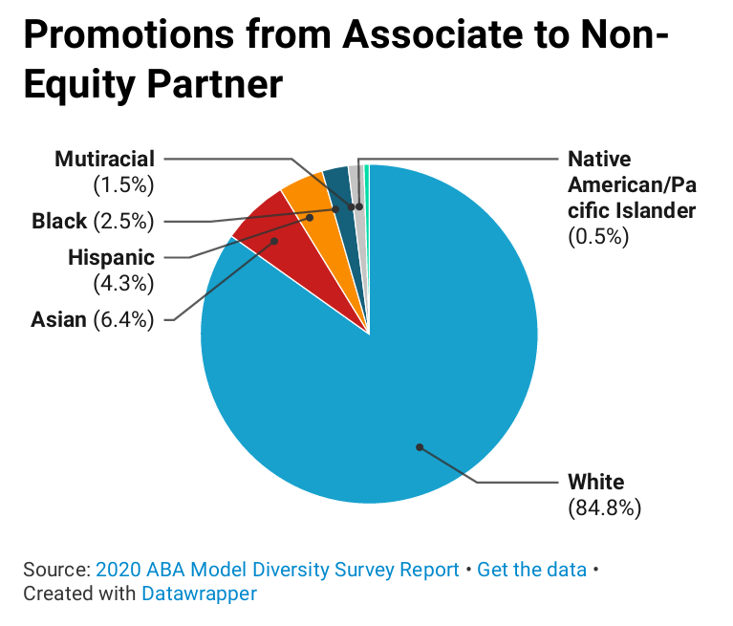
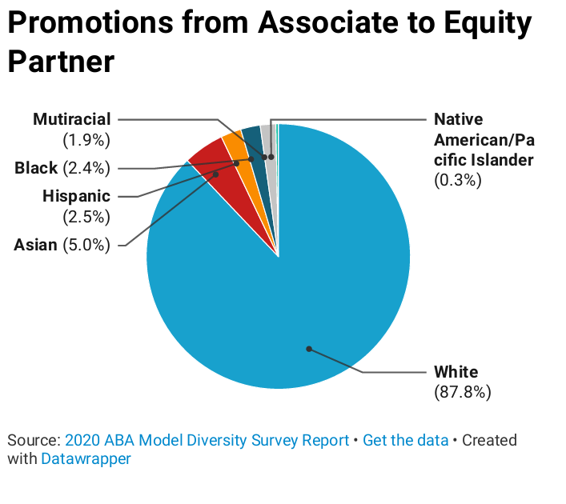
The Promotion Gap

Slide 11
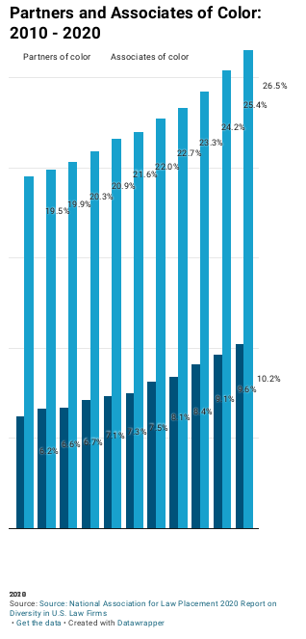
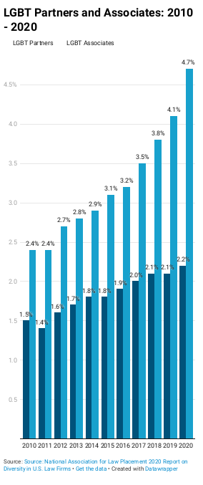
Lack of Inclusivity In Leadership Positions

