Slide 1
BLACK WHITE AND BROWN:
Parker v. University of Delaware, Belton v. Gebhart, and Bulah v. Gebhart
The Desegregation Decisions of the 1950’s in Delaware
Collins J. Seitz, Jr.

Slide 2
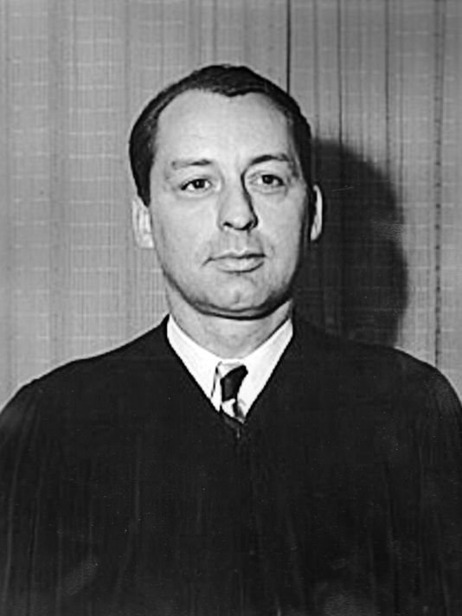
Collins J. Seitz, Sr.
1914-1998

Slide 3
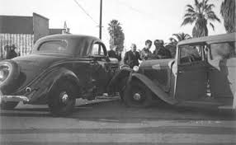

Slide 4
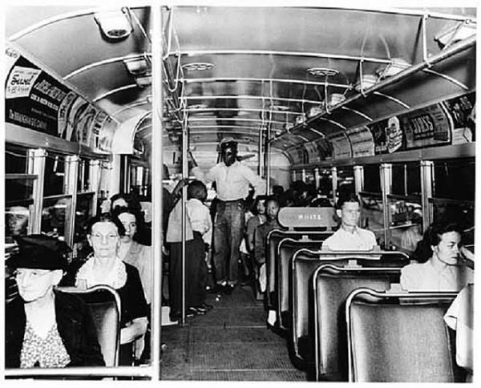
Segregated bus, Alabama 1955

Slide 5
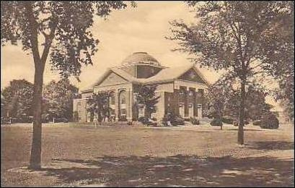
Parker v. University of Delaware
1950

Slide 6
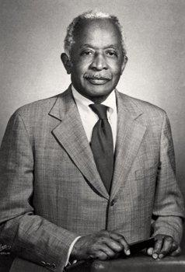
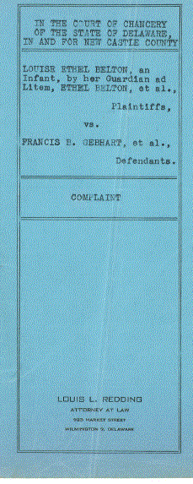
Attorney Louis L. Redding

Slide 7
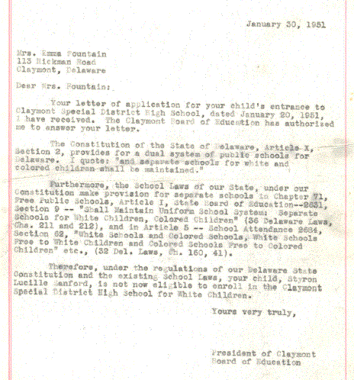
Exhibit 1
“…separate schools for white and colored children shall be maintained.”
-Letter from Claymont
Board of Education

Slide 8
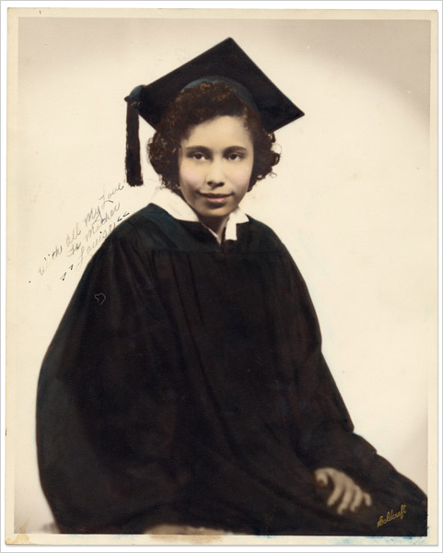
Ethel Louise Belton

Slide 9
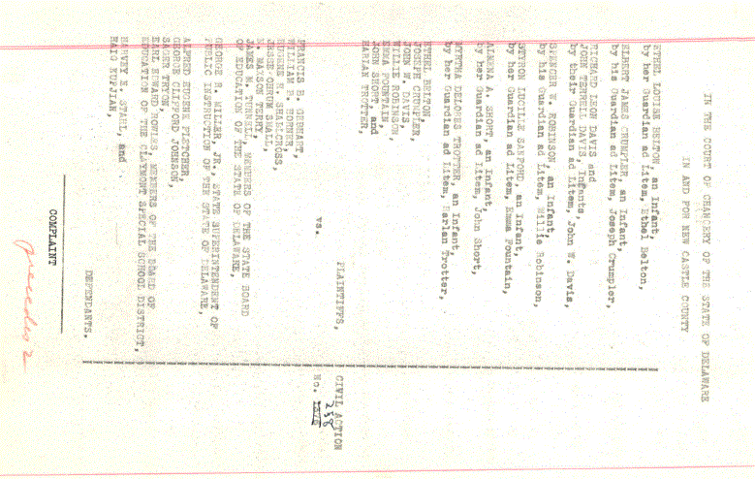
Original Belton v. Gebhart complaint
Filed July 13, 1951

Slide 10
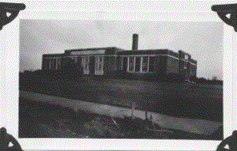
Claymont Public School No. 29
Built in 1932 for $55,000
Valued at $77,000 in 1952
Four classrooms, auditorium, basketball court, nurse’s office,
storage in basement,
several drinking fountains,
modern bathrooms, bus transportation
Delaware History Museum

Slide 11
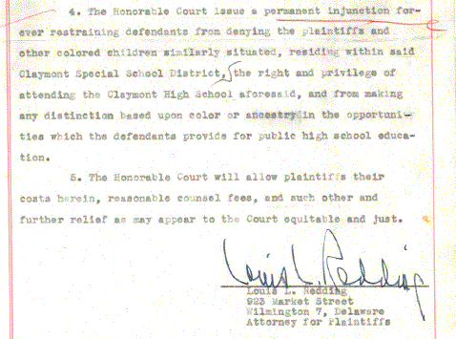
Original Belton v. Gebhart complaint

Slide 12
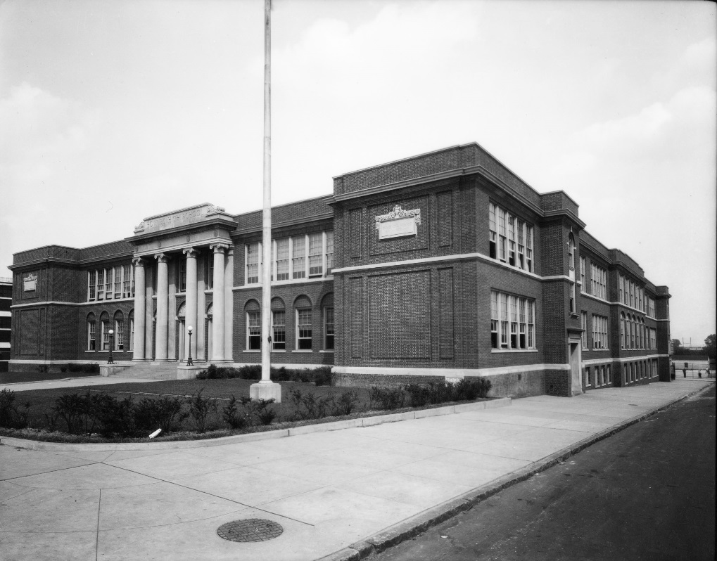
Because Ethel Belton was barred from attending Claymont High School she had to travel nine miles -- nearly an hour each way -- to Howard High School in Wilmington.
Howard High School, 1929

Slide 13
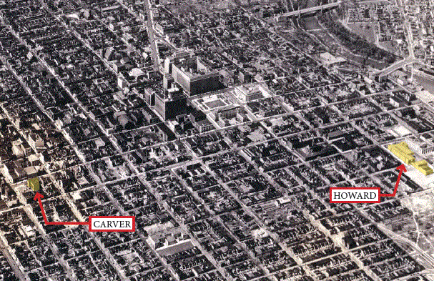
And because Howard High did not have the same classes and activities as Claymont High, she further had to walk across Wilmington to Carver Vocational School to take business classes, adding an additional two and a half hours to her school day.

Slide 14
“If she were white, she could attend Claymont High School which is about a mile and a half from her home. If she walked to Claymont High School she would have for other use, an extra half hour each afternoon, plus extra time in the morning otherwise spent on travel. If she took the bus to the Claymont school she would still have more time.”
-- Vice Chancellor Collins J. Seitz, Sr.

Slide 15
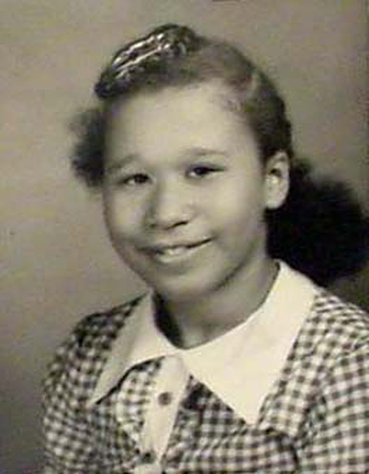
Shirley Bulah

Slide 16
Shirley Bulah had to walk to her segregated school, No. 107, every day from her family farm. And every day the bus carrying white children to their segregated school, No. 29, would pass directly by the Bulah farm. The family did not understand why, at the very least, their daughter was not allowed to ride the school bus and get dropped off at school No. 107, sparing her the walk.

Slide 17
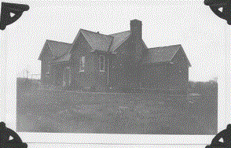
Hockessin Colored School No. 107
Built in 1922 for $21,000
Valued at $13,000 in 1952
One classroom, no auditorium,
no basketball court,
no nurse’s office (a first aid kit),
no storage space, no drinking fountains, one toilet in janitor storage room, no bus transportation
Delaware History Museum

Slide 18
Shirley Bulah’s mother on working with attorney Louis Redding
“He said he wouldn’t help me get a Jim Crow bus to take my girl to school, but if I was interested in sending her to an integrated school, why, then maybe he’d help. Well, I thanked God right then and there.”
-- Sarah Bulah

Slide 19
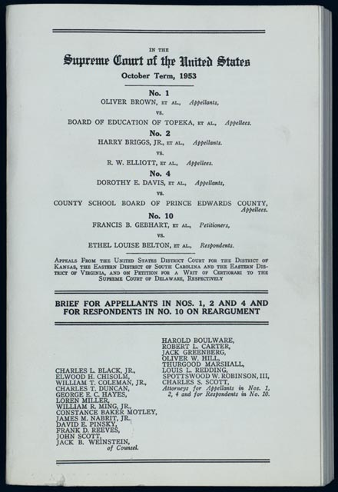

Slide 20
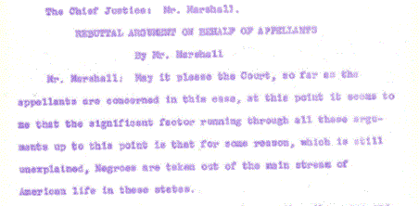
Rebuttal argument Briggs v. School District 22, Clarendon County, S.C. Dec. 9, 1952

Slide 21
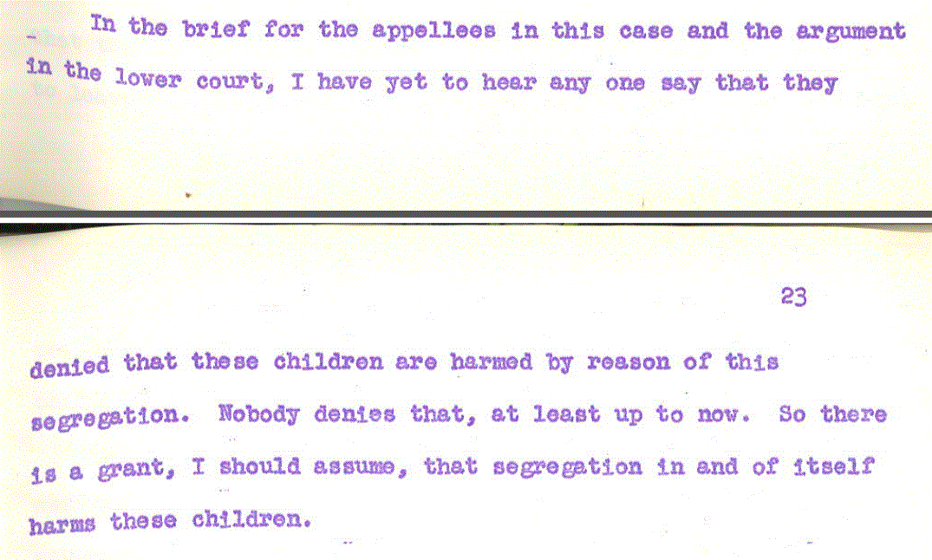
Rebuttal argument Briggs v. School District 22, Clarendon County, S.C.

Slide 22
Chief Justice Warren quoting Vice Chancellor Seitz in Brown v. Board of Education
“State-imposed segregation in education itself results in the Negro children, as a class, receiving educational opportunities which are substantially inferior to those available to white children otherwise similarly situated.”

Slide 23
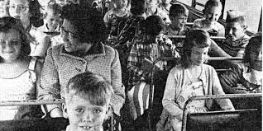
Shirley Bulah (left) riding the bus to school in 1954

Slide 24
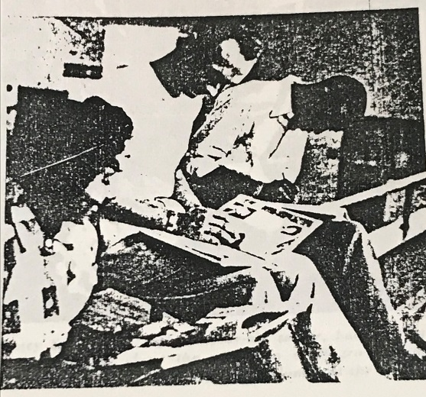
At graduation, Claymont High School students signing each other’s yearbooks

Slide 25
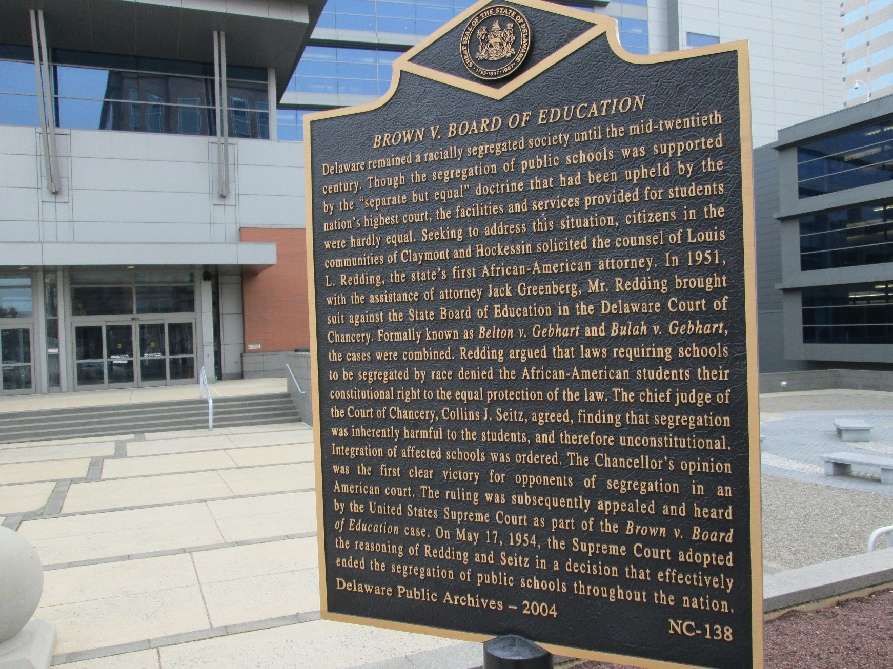

Slide 26
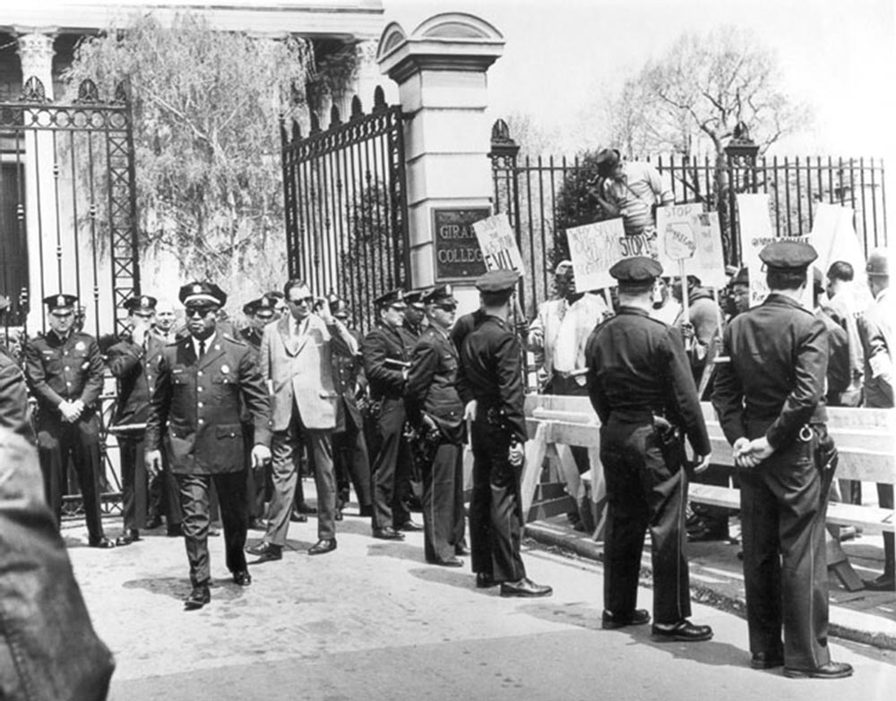
Girard College

Slide 27
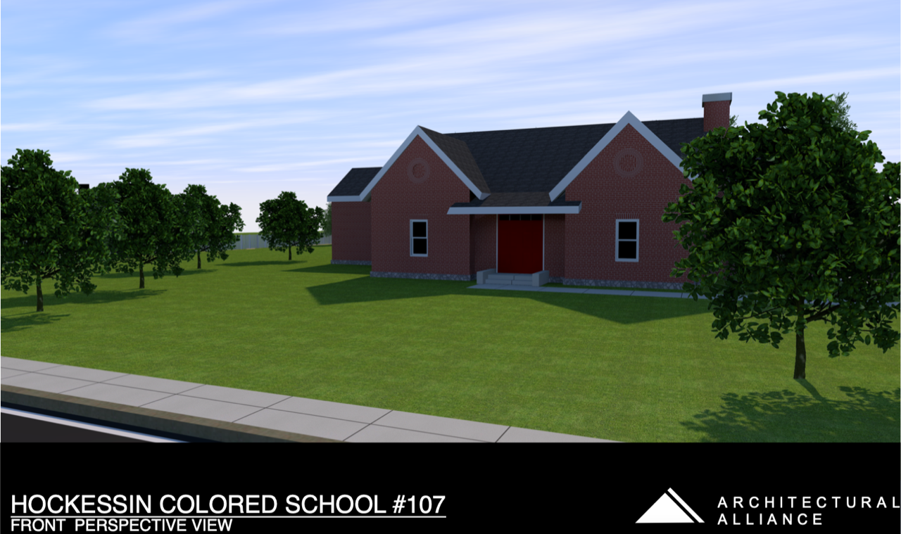
HCS 107 Restoration

Slide 28
HCS 107 Restoration

Slide 29
“Man’s reach should exceed his grasp, or what’s a heaven for?”
- Robert Browning

