Slide 1
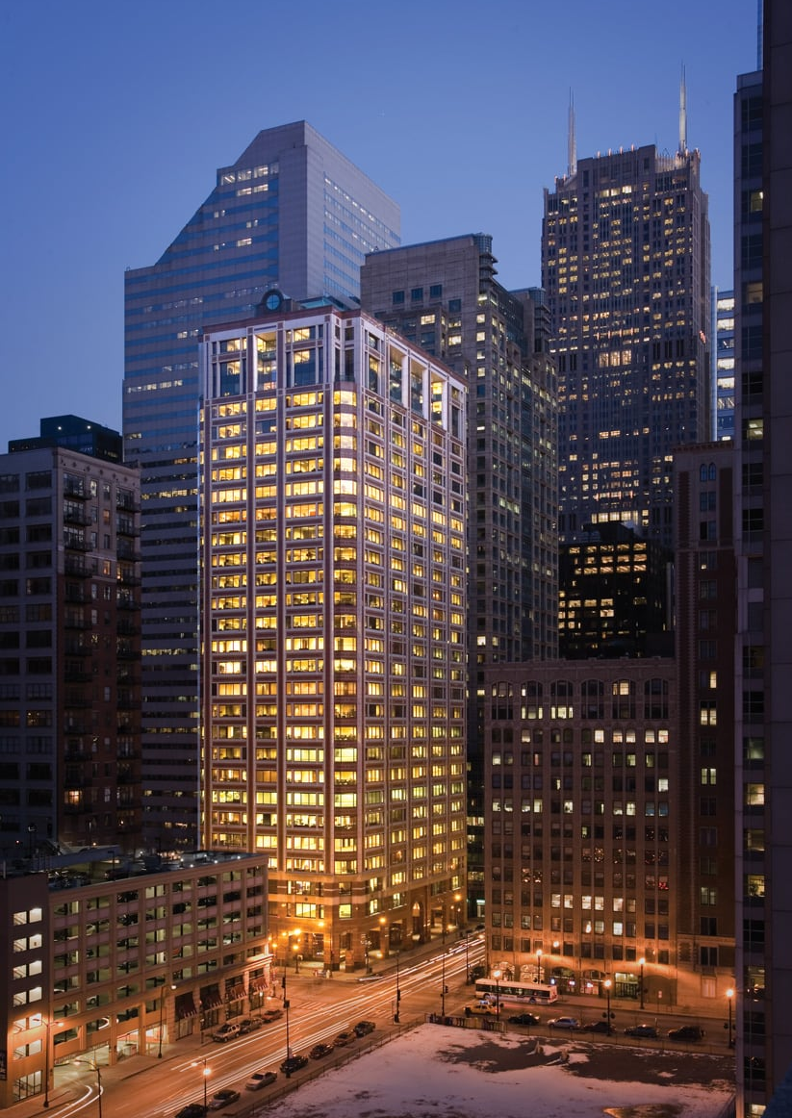

Welcome to
ARONBERG GOLDGEHN
225 W. Washington, Suite 2800, Chicago, Illinois 60606

Slide 2


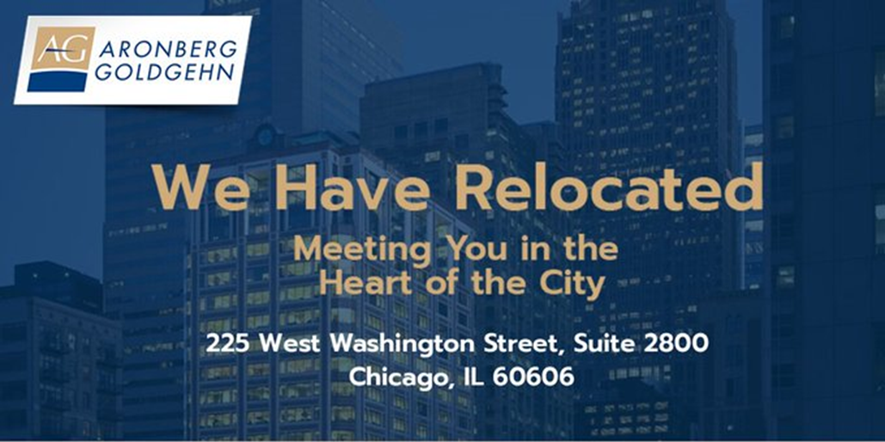
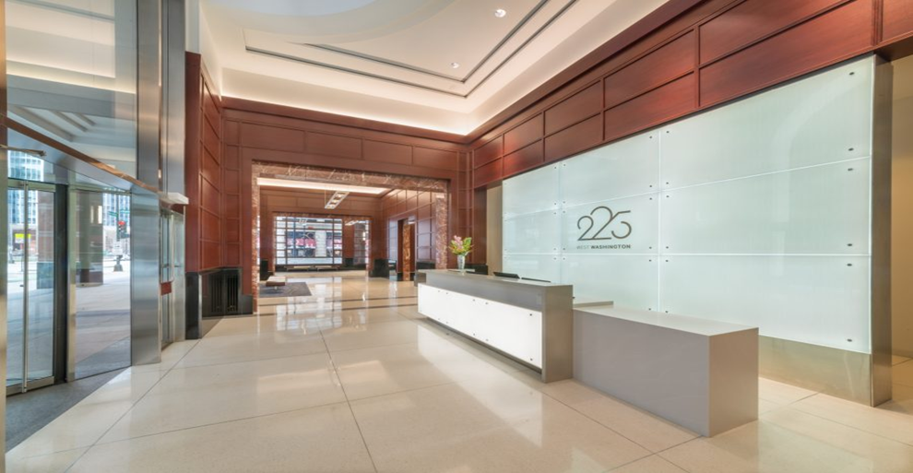

Aronberg Goldgehn Relocates to Chicago Loop
Aronberg Goldgehn has officially changed its Chicago residence, moving away from the firm’s River North location to a new Loop office located at 225 West Washington Street, Suite 2800, effective May 1, 2023.
The firm’s fresh space is situated in the city’s center — close to courthouses and government buildings, as well as transportation options like Union Station, Ogilvie and CTA.

Slide 3
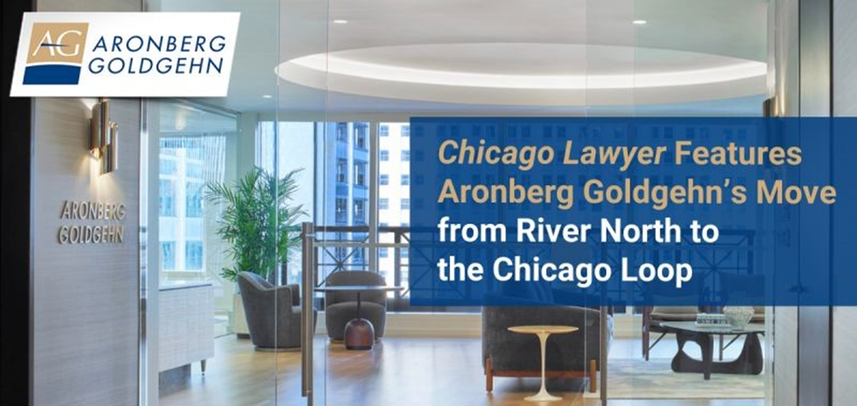

Chicago Office Featured in Chicago Lawyer Magazine
Chicago Lawyer Magazine spoke with the firm to discuss the Chicago office’s recent move from River North to the Chicago Loop and what drove their decision-making for the new space.

Slide 4
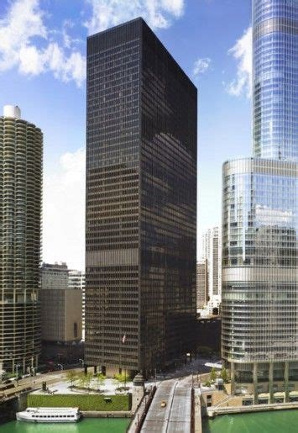
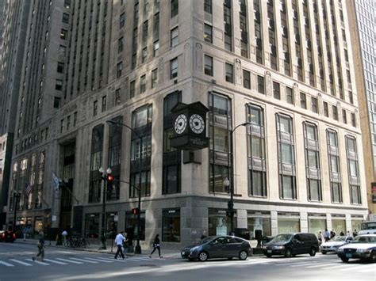
100 YEARS – TWO LOCATIONS:
One North LaSalle Street
330 North Wabash Avenue

Slide 5

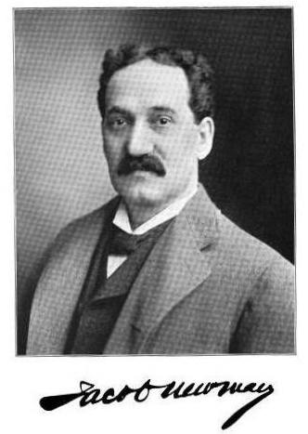
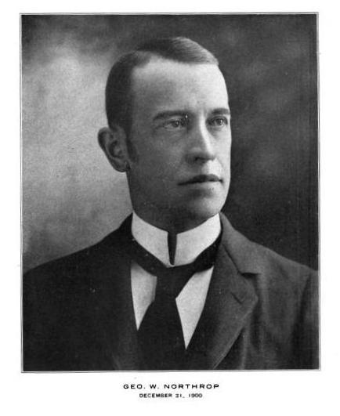
Newman & Northrup
1892-1895
“Mr. Newman is one of those lawyers who may with truth be said to be a specialist in all branches of law, so wide is his knowledge of each of them. He has been identified with many important cases, but is remembered most prominently, perhaps, with the litigation of the Chicago Gas Trust.”
“He was an expert common law and chancery pleader, and a brief writer of marked ability, and had made a specialty of municipal law, particularly the law of trusts and illegal combinations. He had inherited from his distinguished father a mind of rare grasp and analytical power, and he was never more happy than when engaged in working out some difficult and intricate legal problem.”

Slide 6

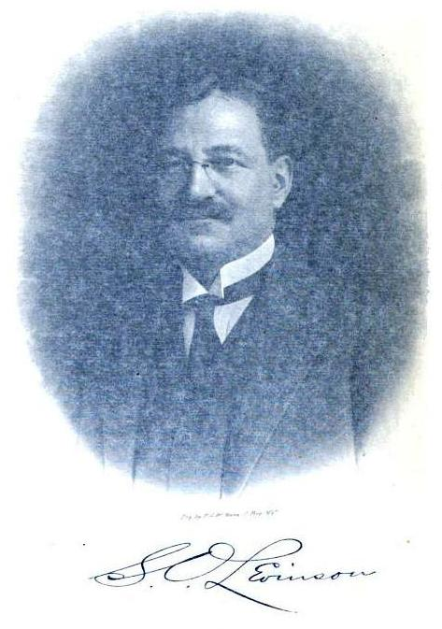
Newman Northrup & Levinson
1896-1902
Salmon Oliver Levinson was made partner and the firm became known as Newman Northrup & Levinson in 1896.
“He has a wide and extended acquaintance with the best writers of English and reads them with keen discrimination and appreciation. He has one of the largest and best selected private libraries in Chicago.”
“He is a man of unimpeachable integrity and of high character. Probably no firm in Chicago stands better or is more implicitly trusted by the bankers generally of this city than is his firm.”

Slide 7
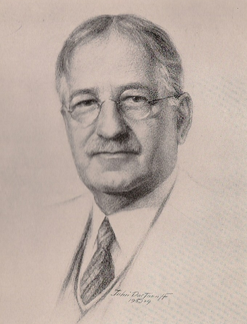
Salmon Levinson
(1865-1941)
Corporate & Banking Lawyer
After WWI focused on International Peace Efforts
Draftsman of the Kellog-Briand Pact of Paris of 1928
Made resort to War a violation of International Law

Slide 8

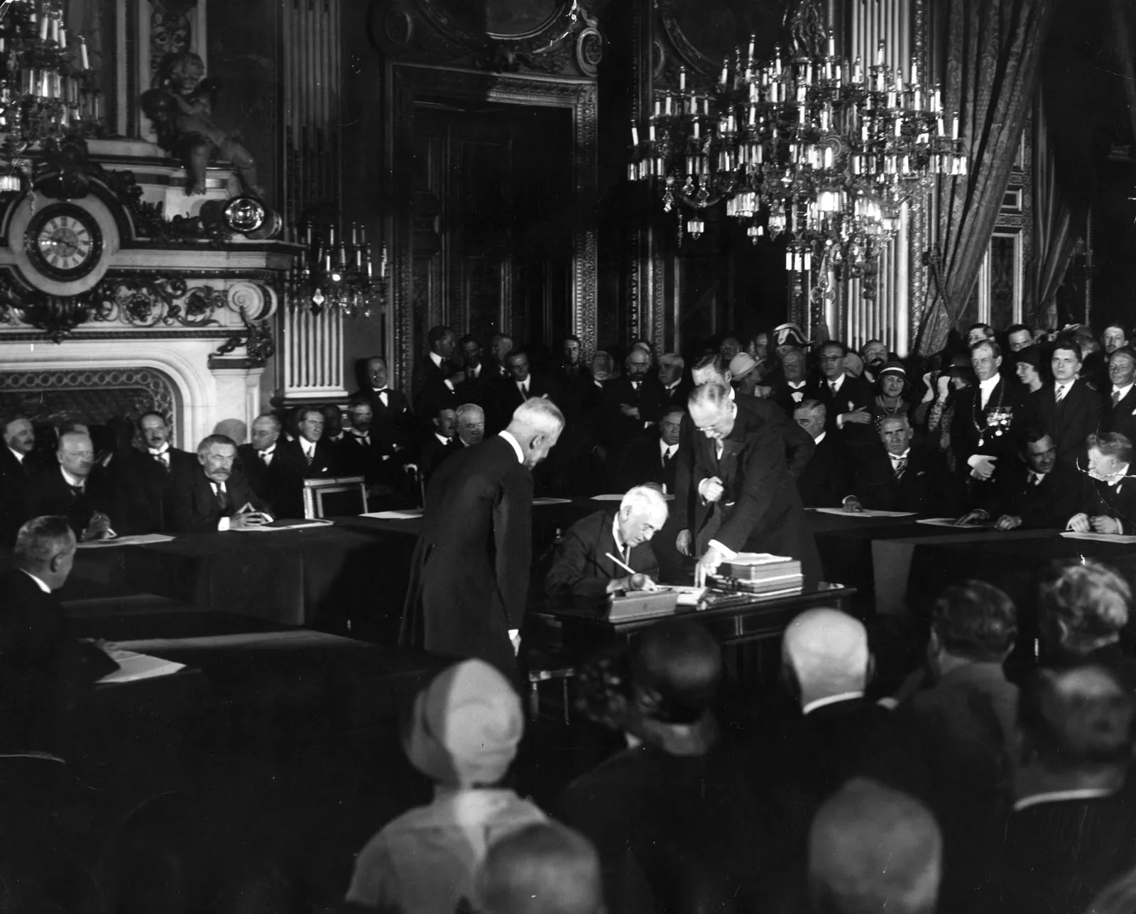
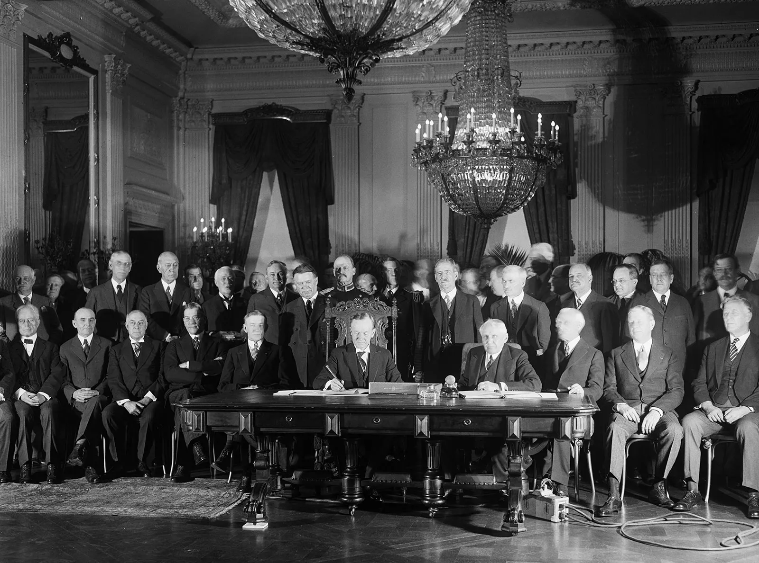
Kellog-Briand Pact of Paris
Named After US Secretary of State & French Foreign Minister
Independent International Agreement (Not thru League of Nations)
France, Germany & US original signatory countries
Ridiculed as ineffective in preventing WWII

Slide 9

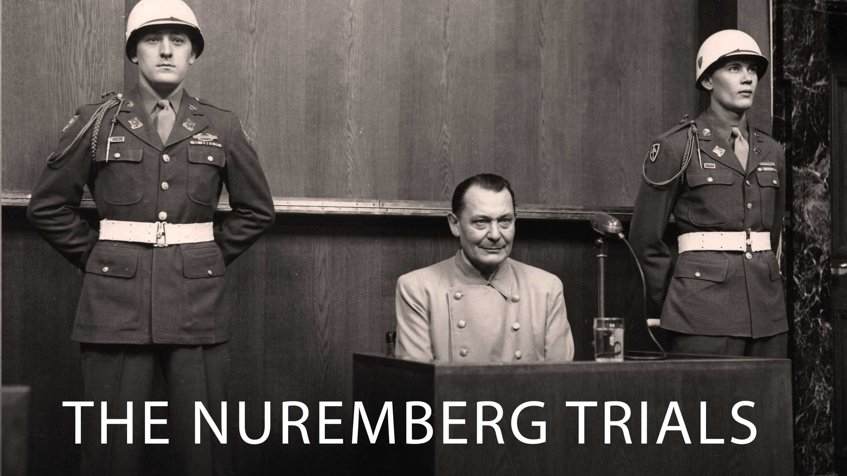
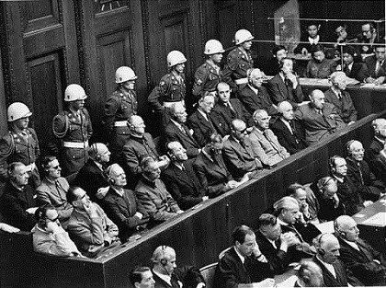
Nuremburg & Tokyo
War Crime Tribunals:
Kellog-Briand Pact Provides Legal Basis for Prosecution and Execution of Many Nazi Leaders

Slide 10
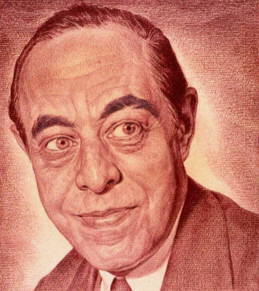
Jerome Frank
(1889-1957)
In March 1913, Jerome Frank became a member of the firm, which had changed its name to Levinson, Becker, Cleveland and Schwartz. The firm specialized in corporate reorganizations and in corporate financial problems.
Jerome Frank, National Portrait Gallery
Smithsonian Institution

Slide 11
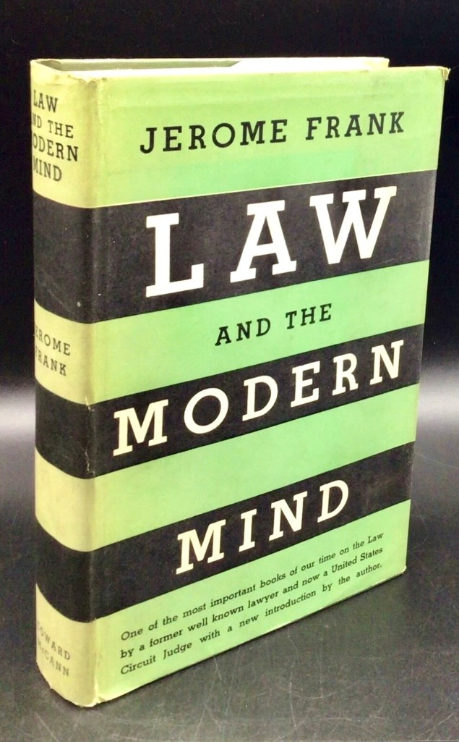
Jerome Frank
1929: A Consequential Year
Lived in New York while working on a legal case
Underwent Six months of Psychoanalyis
Returned to Chicago
Finished "Law & The Modern Mind"
Published in 1930
The book was a sensation
Resigned from the Firm
Moved to New York

Slide 12
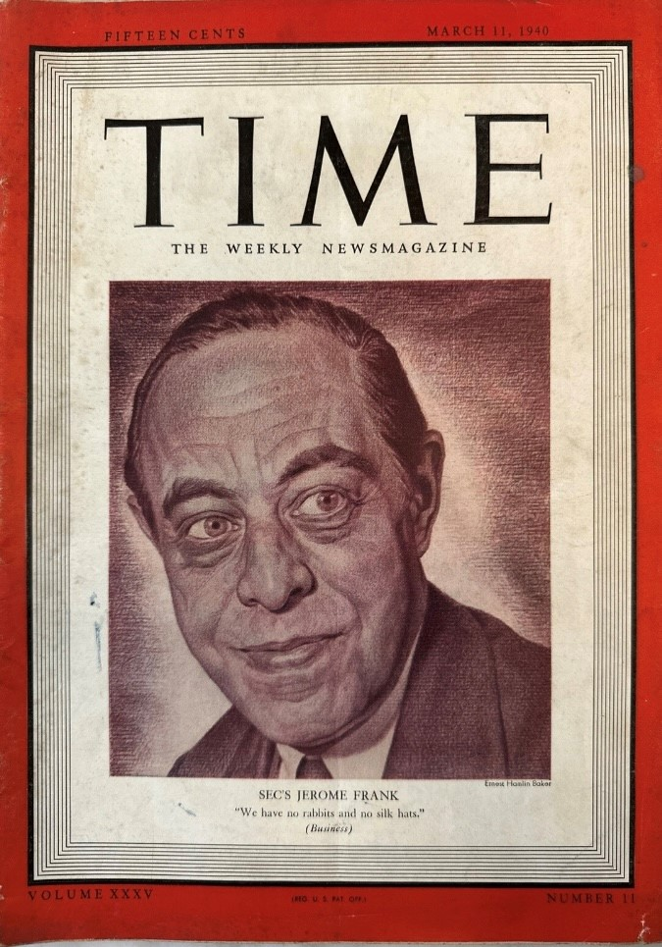
Jerome Frank
1933-1957: Public Life
1933: Joined FDR's New Deal Administration, as General Counsel of the Agricultural Adjustment Administration
1935: Fired as part of purge of Leftist and suspected communist lawyers in the New Deal
1937: Appointed to the Securities Exchange Commission
1939: Replaced William O. Douglas as SEC Chairman
1941: Appointed by Roosevelt to the 2nd Circuit Court of Appeals in New York

Slide 13
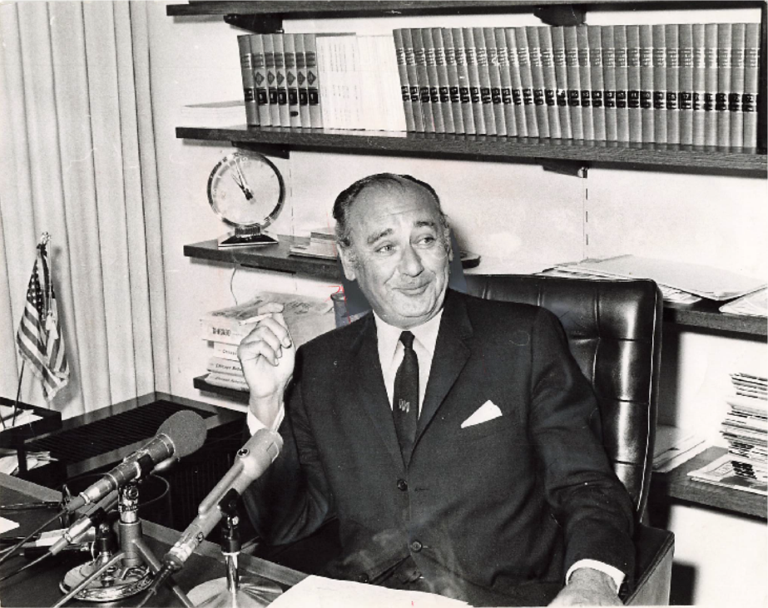
Frank Greenburg
(1911-1984)
In 1969, allegations of judicial malfeasance by a citizen activist were made against two Illinois Supreme Court justices
The allegations were that the two judges held stock in small Chicago bank when they both voted to affirm the dismissal of state contract fraud charges against an officer of the bank. People v Isaacs.
A flurry of media coverage prompted the Court to appoint a special commission to investigate, to be led by the incoming presidents of the Chicago Bar Association, Frank Greenberg, and the Illinois State Bar Association, Henry Pitts.
Greenburg and Pitts named three other members to the Commission. When Frank Greenburg was elected Chairman of the Commission (and Pitts the Vice Chair) the investigation was thereafter referred to in the press and as the “Greenberg Commission”
The Illinois Supreme Court set a short deadline for the Commission to complete its work – just six weeks during the sweltering summer of 1969.

Slide 14
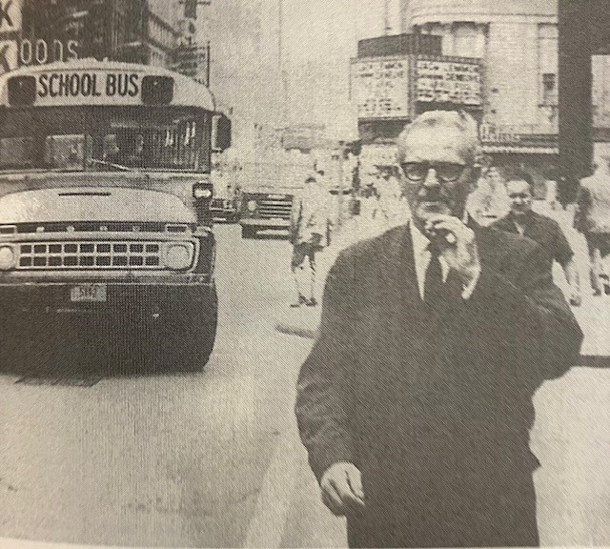
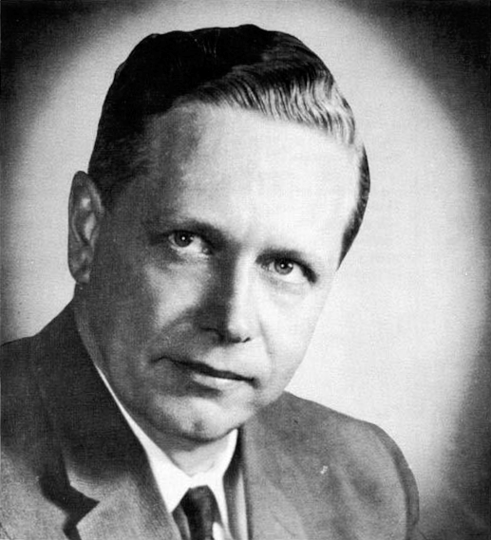
The Justices
Associate Justice Ray Klingbiel Chief Justice Roy Solfisberg

Slide 15
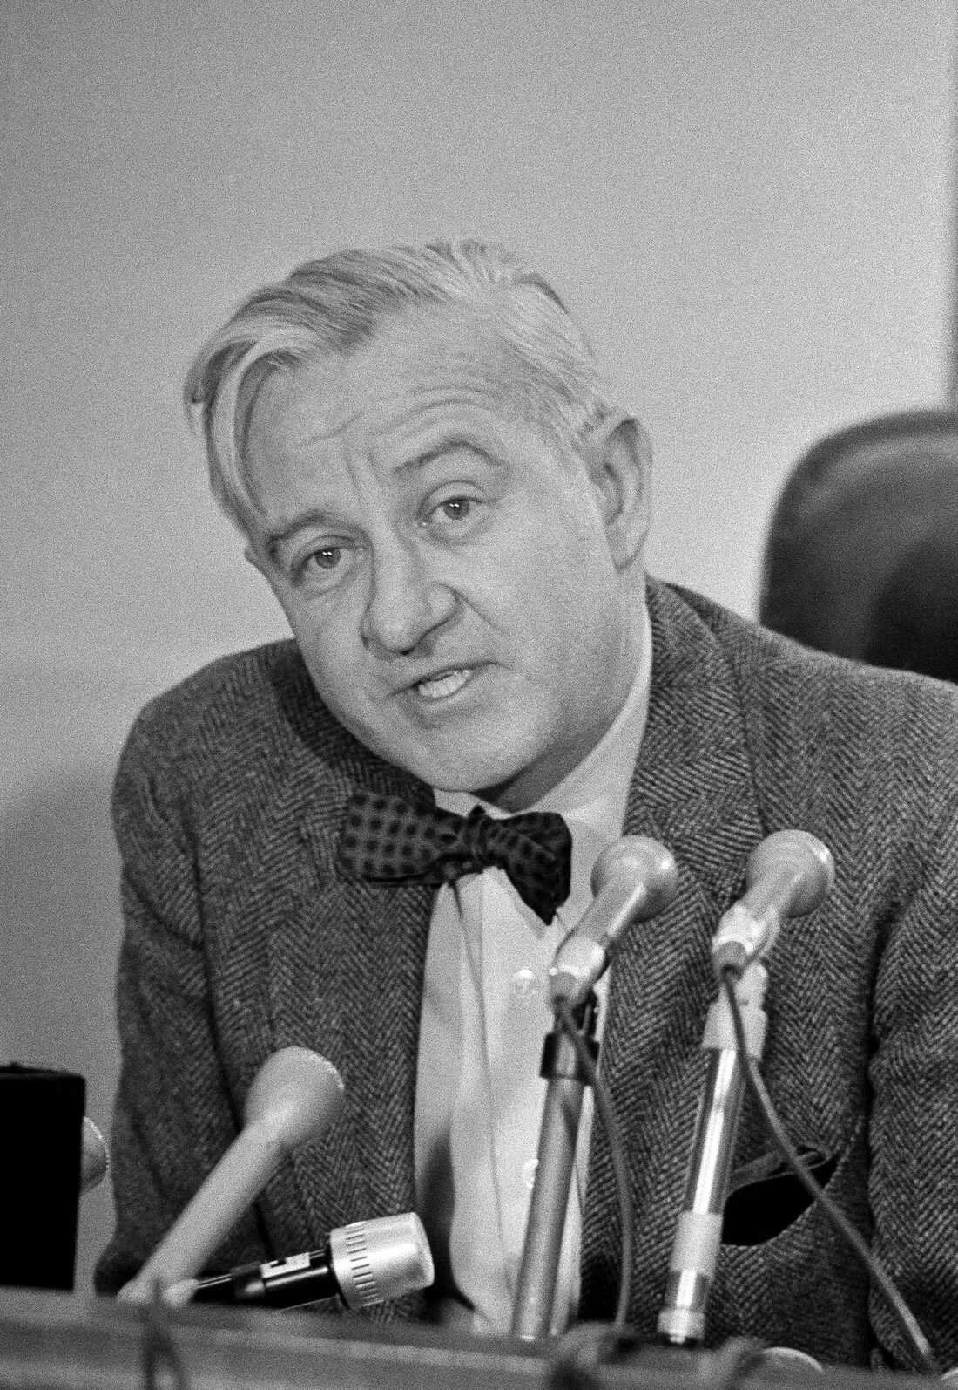
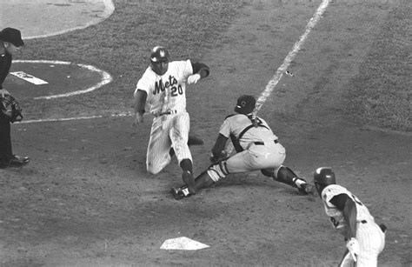
Summer in the City
Chicago Cubs lose division title to eventual world champion New York Mets
John Paul Stevens, Counsel to the Greenburg Commission

Slide 16
Final Report
FINDINGS OF FACT:
Roy Solfisburg bought his shares of bank stock
Ray Klingbiel was gifted his shares
The justices did not disclose their ownership
CONCLUSIONS:
"The integrity of the judgment in the Isaacs case is affected by what we have found to be the appearance of impropriety on the part of two of the Justices … who participated in that decision."
"The Commission believes that the confidence of the public and the Bar in the Court … has been severely shaken by the facts disclosed in this record."
"The Commission believes that such confidence can best be restored by the prompt resignation of the two justices."

Slide 17
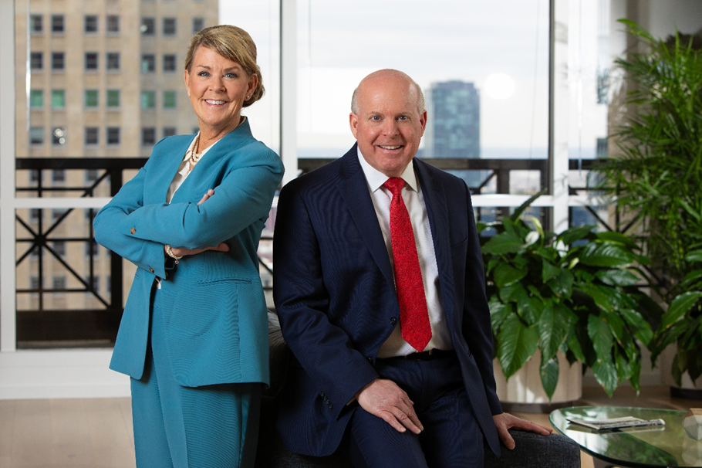
2024 – 2025
CBA President and DCBA President
Aronberg Goldgehn made history as two firm partners are sworn in as Presidents of leading bar associations.
Congratulations Karen R. Mills on becoming the DuPage County Bar Association President and John C. Sciaccotta on becoming the
Chicago Bar Association President.

