Slide 1
the LEGACY OF
Beau Biden- the beau biden Foundation for the protection of children
Patricia Dailey Lewis, Esquire
Executive Director
Beau Biden Foundation for the Protection of Children
© Beau Biden Foundation, 2021

Slide 2
Joseph Robinette Biden, III
Joseph Robinette "Beau" Biden III was born in Wilmington, Delaware on February 3, 1969, the first child of Joseph R. Biden, Jr. and Neilia Hunter Biden.
Beau graduated from Archmere Academy in Claymont, Delaware in 1987, the University of Pennsylvania in 1991, and Syracuse University's College of Law and 1995.
Following graduation from law school, he began his legal career as a federal law clerk for the Honorable Steven McAuliffe in Concord, NH.
Biden served in the U.S. Department of Justice's Office of Policy Development in Washington, DC. From 1997-2002, Biden was an Assistant U.S. Attorney in Philadelphia during which he also volunteered to serve on a joint task force with the U.S. Departments of Justice and Defense to assist Kosovo in establishing a criminal justice system and promoting the rule of law.

Slide 3
Early career
Beau was married to Hallie Olivere in 2002. In 2004 Beau and Hallie they welcomed their first child, Natalie Naomi, and in 2006 they welcomed their son, Robert Hunter.
In 2004 Beau’s legal career brought him home to Delaware where he joined the firm of Bifferato, Gentilotti, Biden and Balick. Beau loved the opportunity to work with lawyers he had been friends with for many years- some since grade school- in a small firm in Wilmington, Delaware.

Slide 4
ATTORNEY GENERAL
JOSEPH R. BIDEN III
In November 2006, Biden was elected Delaware's 44th Attorney General, where he served with distinction for two terms.
Beau was as an outspoken advocate for the protection of children, and vulnerable victims of violence. He was a fierce consumer advocate, particularly in the area of housing and was a national leader in holding the financial institutions accountable, receiving national recognition for his work.

Slide 5
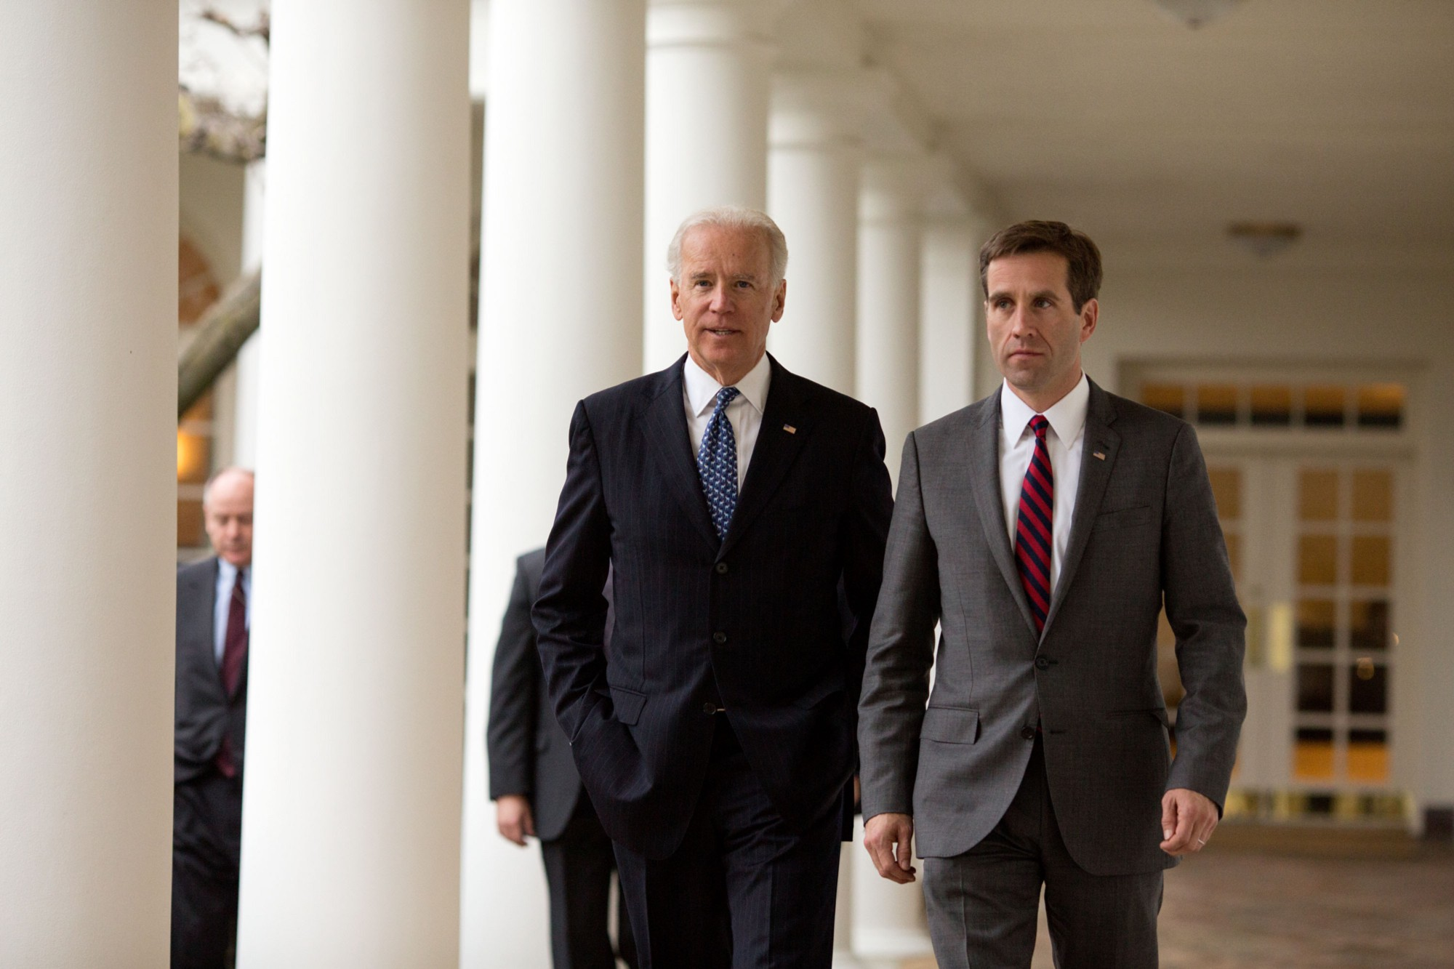
ATTORNEY GENERAL JOSEPH R. BIDEN III WITH (THEN)
VICE-PRESIDENT JOSEPH R. BIDEN JR.

Slide 6
Military service
Beau Biden's military service began in 2003 when was commissioned as a first lieutenant in the 261st Signal Brigade as part of the Judge Advocate General Corps.
During his tenure as Attorney General, he deployed to Iraq with the Delaware National Guard's 261st Signal Brigade in September 2008.
Following his return from Iraq in 2009, Biden remained in the Guard, was prom Biden attained the rank of Major, and actively served in the State Staff Judge Advocate's office until his passing on May 30, 2015.

Slide 7
Military career
Major Biden was awarded several honors including:
the Legion of Merit Medal,
the Bronze Star Medal,
the Delaware Conspicuous Service Cross,
the Army Achievement Medal,
the Army Reserve Component Achievement Medal (2 oak leaf clusters),
the National Defense Service Medal,
the Iraq Campaign Medal,
Global War on Terrorism Service Medal,
the Humanitarian Service Medal,
the Army Service Ribbon, the Armed Forces Reserve Medal (with M device),
the Army Overseas Service Ribbon,
the Army Meritorious Unit Commendation Ribbon,
And several other awards and commendations

Slide 8
The life’s passion of attorney general biden
As Attorney General Beau Biden’s Guiding Principles
Fighting for the most vulnerable.
Standing up for those who cannot stand up for themselves.
Giving a voice to voiceless victims.
Protecting the public’s safety is the government’s most important priority.
Protecting Children

Slide 9
Established Child Predator Task Force – first of its kind in Delaware – to track down those seeking to hurt our kids. The task force’s work has led to the conviction of more than 200 predators and the rescue of over 100 children.
Successfully prosecuted Earl Bradley – one of the worst pedophiles in history – and secured a sentence of 14 life terms plus more than 160 years in prison for the former pediatrician who abused dozens of very young patients. The office also actively participated in the civil lawsuit, ensuring the rights of all children on video received the maximum award, providing and coordinating implementation of the settlement where nearly 1000 claimants were found entitled to settlement benefits.
Made Delaware a national leader in protecting children from sexual predators by imposing strict registration and notification requirements for sex offenders (Adam Walsh Act, 2010).
Successfully fought for new tough, mandatory prison sentences on child pornographers and fought for state laws to better protect children against predators lurking online and better protect children from physical abuse, especially very young children and children with disabilities.
Brought child abuse prevention training to Delaware to teach adults to spot the signs of child abuse and report the abuse to authorities because only 1 in 10 victims will report their abuse even though 9 out of 10 victims are hurt by someone who claims to love them – more than 14,000 trained during the administration. (**The Beau Biden Foundation has picked up this mantle, training thousands of people in 23 states. Reports to the child abuse hotline have increased from approximately 5000 to more than 20,000 since this training has been implemented in Delaware.)
Beau spoke to approximately 30,000 Delaware school children about staying safe online and bullying.
Successfully worked to change state law to increase the reporting of bullying incidents in schools and helped develop a statewide policy to protect kids from cyberbullying.
Drafted and implemented the first Child Abuse law to focus special attention, and in consideration of the special circumstances of the crimes committed against children,

Slide 10
“As adults, we have a legal and moral obligation to stand up and speak out for children who are being abused. These children cannot speak for themselves.”
-BEAU BIDEN (February 3, 1969—May 30, 2015)
BEAU BIDEN FOUNDATION 2021

Slide 11

Prevalence of Child Sexual Abuse
One in 10 children will be the victim of sexual abuse before their 18th birthday.
90% of children know their abuser.
Certain children may be more vulnerable to sexual abuse.
35% of reported child sex abuse victims are 11 years old or younger.

Slide 12
Vulnerable children affected by sexual abuse
Children in foster care
Children with intellectual and/or developmental disabilities
Children without verbal skills
Children in military families
Children living in single parent households
Notes:
Children living without either parent (foster children) are 10 times more likely to be sexually abused than children who live with both biological parents. Children who live with a single parent that has a live-in partner are at the highest risk: they are 20 times more likely to be victims of sexual abuse than children living with both biological parents

Slide 13
Child Sexual Abuse
Happens in many settings
Homes-Foster or Family
Schools
Youth-Serving organizations like youth sports and social centers for children.

Slide 14

Who are the Perpetrators
90%+ perpetrators of child sexual abuse are known to the victim and/or the family.
The majority of perpetrators are people who are respected and trusted.

Slide 15
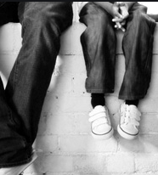
Youth Serving
Professions
Any organization that relies on adults to provide care, mentorship, education, medical care to children:
Educators
Faith Leaders
Coaches
Doctors/Nurses/Therapists
Mentors
Arts (music/dance/theater)

Slide 16
Choosing Caretakers
Predators mask as helpful caretakers and enter organizations every day.
Organizations must take special care to prevent these individuals from having access to children.
Vigorous background checks required:
    Fingerprinting
    National Database Criminal History Search
    Child Protection Registry
    Adult Abuse Registry
    Personal Interviews
    Careful checking of all references and past history

Slide 17
The Beau biden foundation shield of protection
The Shield of Protection™ is a unique program designed by the Beau Biden Foundation’s experts in law, education, and law enforcement to help ensure schools and youth-serving organizations have the best policies, procedures, and programming in place to help protect children from all forms of child abuse and neglect.

Slide 18
                Participating Partner Organizations
                Work Directly with the
                Beau Biden Foundation
A complete assessment of existing child protection procedures and policies.
A best practice, stand-alone child protection policy built with the organization to suit their program delivery model whether in-person, remote, or hybrid.
An annual review and policy/procedure updates.
BBF trainings by well experienced experts in legal, law enforcement and education.
Access to all BBF resources.
At completion – the Shield of Protection to display letting parents, caregivers, the community and funders know that the protection of children in your care is your primary objective, that you have the policies, procedures and skills to carry out the responsibility.

Slide 19
Recognizing and Reporting
Child Abuse
A state specific review of the laws which require the reporting of suspected child abuse, including the penalties for failure to report.
An explanation of reasonable suspicion.
Education on the system, how to make a report and what to include in the report in order to provide child protective services the necessary information.
A thorough training including fact based scenarios on the various types of child abuse and neglect with specific examples, signs and symptoms.

Slide 20
PROVIDE THE TOOLS TO Organizations to PREVENT
RECOGNIZE and report child abuse
Every member of the organization must be carefully vetted and fully background checked BEFORE hiring to minimize risk within the organization- EMPLOYEES, MENTORS, VOLUNTEERS, regardless of source.
Every person must understand the policies and procedures in place to protect children, including individual obligations to protection children first and foremost.
Every person must understand WHAT child abuse is, physical sexual, emotional, neglect and dependency.
Every person must know how to respond, including accepting disclosures, taking care of the child and making the required reports .

Slide 21
Protecting children in virtual learning environments
Part One: Policies for a Virtual Environment
  One-on-one interactions must be observable and interruptible
    Solutions for One-On-One interaction in Zoom, Google Meets, Teams
  Professional Boundaries
    Including social media and online gaming
  Recording Children
  Online Communication- emails, texts, phone calls
Part Two: Recognizing and Reporting Abuse
  Hotline number and mandatory reporting
  Totality of Observations you might observe
  Indicators of Abuse
  How to respond to a disclosure
  Reporting to a Hotline is a request for services
  What about Domestic Violence
  Resources by state

Slide 22
Grooming Children, Families, and Organizations
Children living without either parent (children in foster or kinship care) are 10 times more likely to be sexually abused.
Children who live with a single parent that has a live-in partner are 20 times more likely to be victims of sexual abuse.

Slide 23
One-on–One unobservable uninterruptible time
The perpetrator begins to have free unobservable, uninterruptible one-on-one time with the child.
      Allows for further control of the child.
      Isolates the child from others who might be able to help.
One-on-one uninterruptable, unobservable time is perhaps the greatest single danger.
Most cases of sexual abuse occur under these circumstances.

Slide 24
The Grooming Process is Careful and Deliberate-
NOT ACCIDENTAL
Gain access through a variety of channels:
  Employment in child serving organizations
  Volunteer with organizations with access to children
  Befriend adults who have children, often in vulnerable situations
  The Internet
  Almost ALWAYS a graduated process

Slide 25
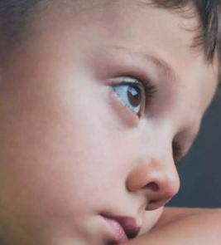
The Grooming Process
Victim, Family, Organization Identification- vulnerabilities of various victims- Families that are overwhelmed, disorganized, need assistance with children.
Children that are in need of adult interaction/attention, children that are uneducated in SAP skills, children with vulnerabilities
Organization lack of standards, policy, procedures.
Perpetrator Gains Trust of Targets- the person who is needed and always helps.
Perpetrator Becomes valued by Targets- financial, emotional, child care, etc. .

Slide 26
Online Grooming:
The Internet is one of the easiest settings for child predators
At any given time, there are 500,000 child predators online….
with our children, with have a 24/7 reach.
No verification process for true identity (i.e. name, age, profile pic). Detection is incredibly difficult.
Often, no monitors in place on platform to police inappropriate language or material.
Parents/caregivers have not established clear rules for use, child’s devices lack adequate monitoring software, or child has open access elsewhere.
Bad actors use false pictures, current adolescent language, and popular topics of conversation to further convince their target(s).
More efficient than ever before for a predator to reach dozens of children, or more at one time.

Slide 27
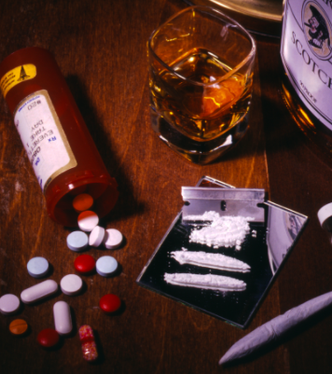
Drugs, Alcohol, Pornography
Once sexual contact begins it becomes more frequent.
Drugs/alcohol/pornography are often utilized.
Often perpetrators are using photography/video. This allows both for financial gain and for blackmail/extortion.

Slide 28
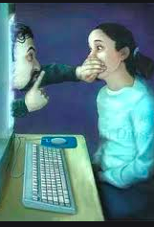
Child Pornography And
Sexual abuse
Vast majority of child pornography is created by sex offenders with their victims.
In online enticement cases it may actually be produced by the victim ( child produced child pornography).
It is a common means to control and threaten victims…”everyone will know what you’ve done.”

Slide 29
What do organizations need to DO to protect children
The Beau Biden Shield of Protection®
Mandatory Reporting Laws
Policies and Procedures that protect children
Predator Awareness Education
Facility Code of Conduct

Slide 30
intervening
When boundary crossing behaviors are observed and not addressed, the behavior is condoned. The inappropriate behavior is ignored.
Action Steps
If you see or learn of inappropriate conduct, you must: stop the behavior, recite policy guidelines/notify supervision, and implement barriers to reoccurrences.
If you see criminal behavior, report immediately!
Remember – child predators are counting on complicity by children and adults.

Slide 31
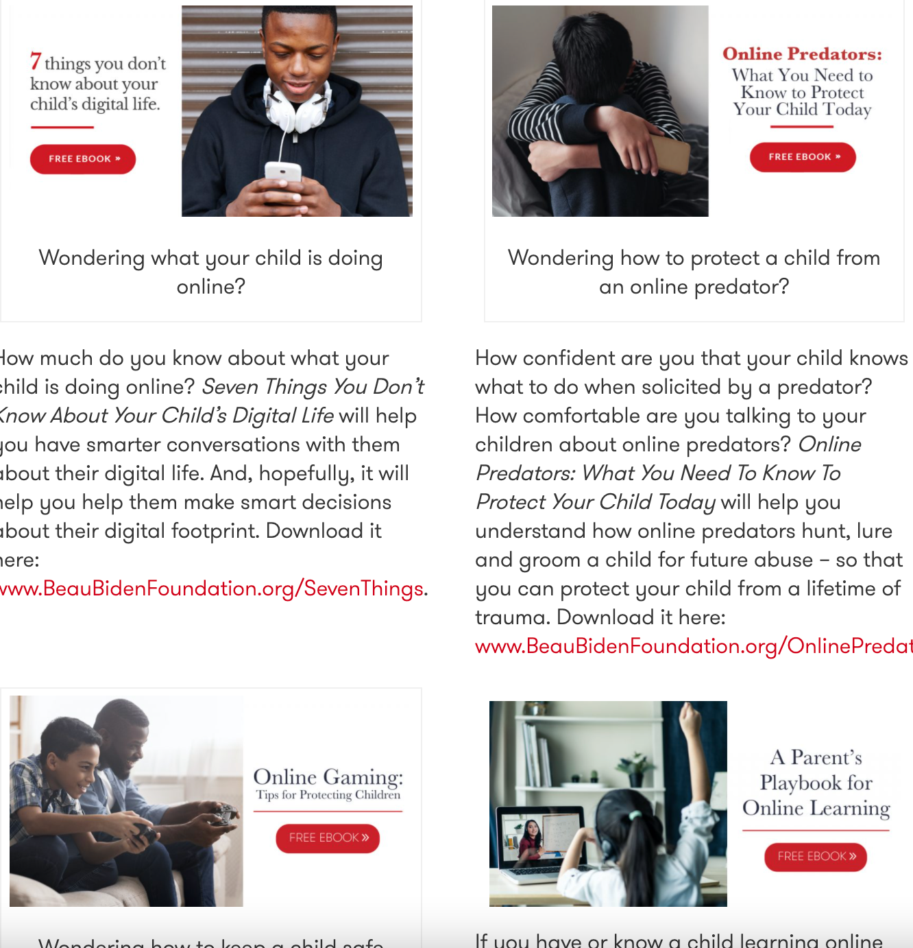
BBF eBooks
Beau Biden Foundation E-books: https://www.beaubidenfoundation.org/ebooks-2/

Slide 32

Prevention is Necessary
Teaching children-before they are likely victims-about predators
Educating parents/foster parents/ those in youth serving organizations
Online safety skills/sharing with unknown people
Appropriate screen time

