Slide 1


Slide 2
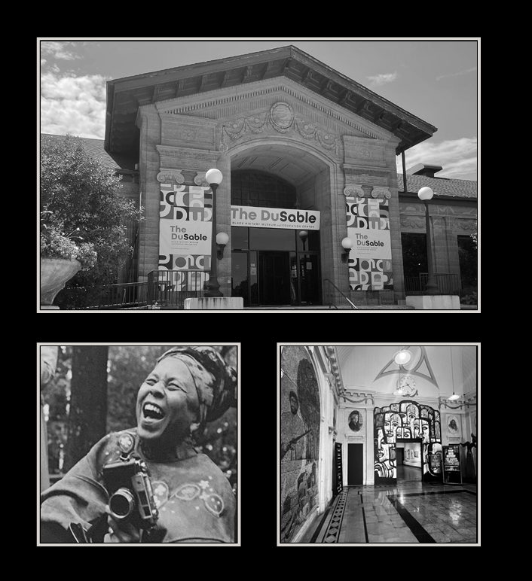
ABOUT THE DUSABLE
History and Mission
The oldest independent Black history museum in the United States
Smithsonian Institution affiliate
A cultural and educational beacon
15,000+ pieces in our collection

Slide 3
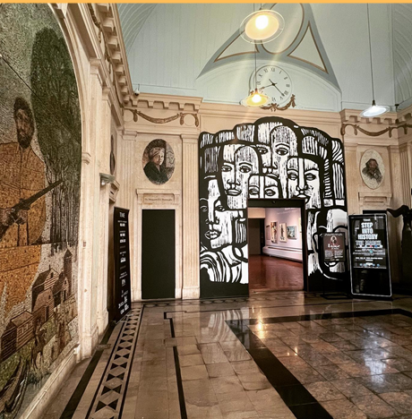

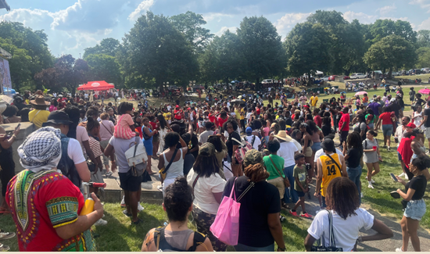

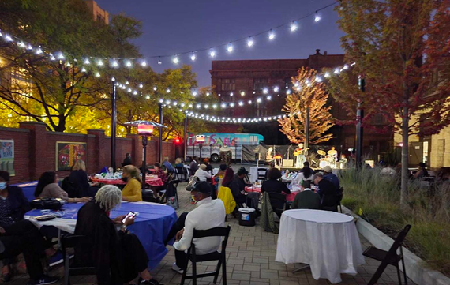
SUPPORT THE DUSABLE
Exhibitions and Programming
The DuSable celebrates Black excellence and explores the African American experience through exhibits, programs, archives and special events.
Signature events and programs include:
Observances
Education
Community Engagement

Slide 4
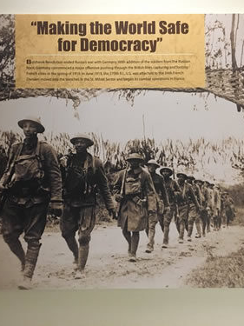
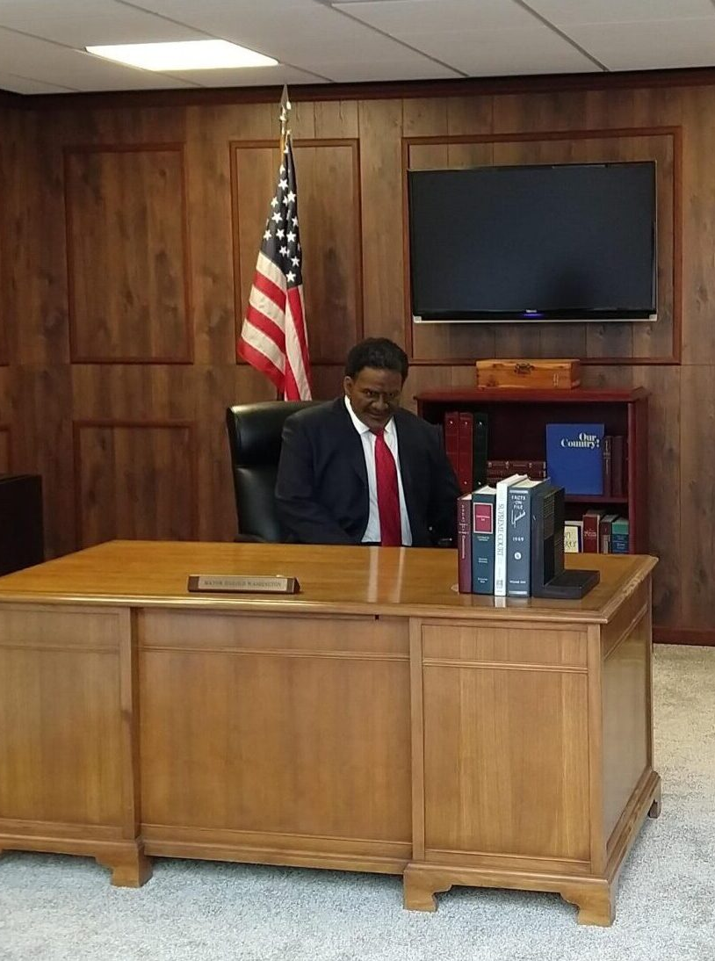
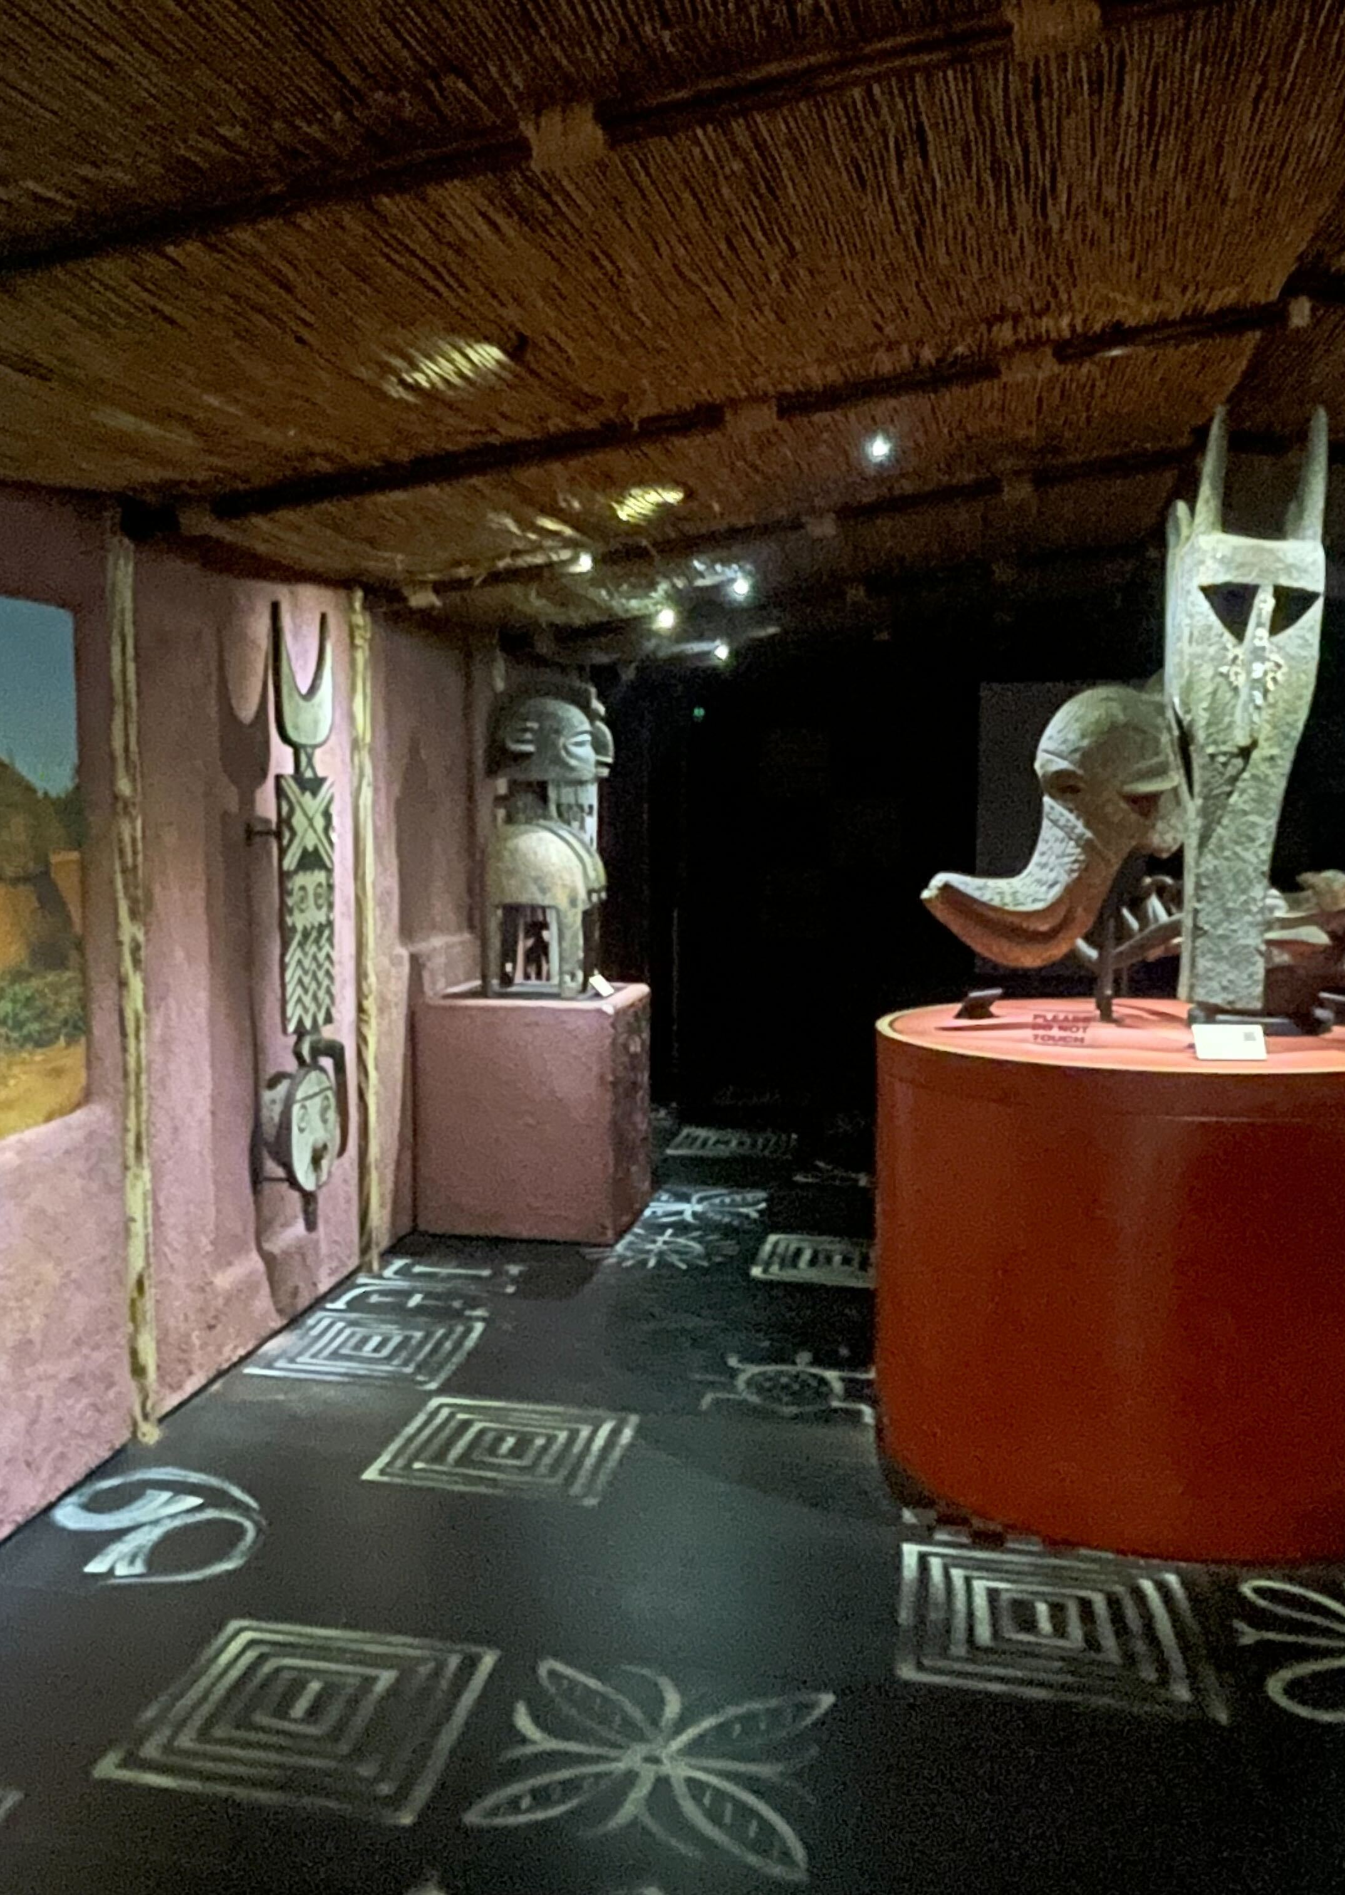
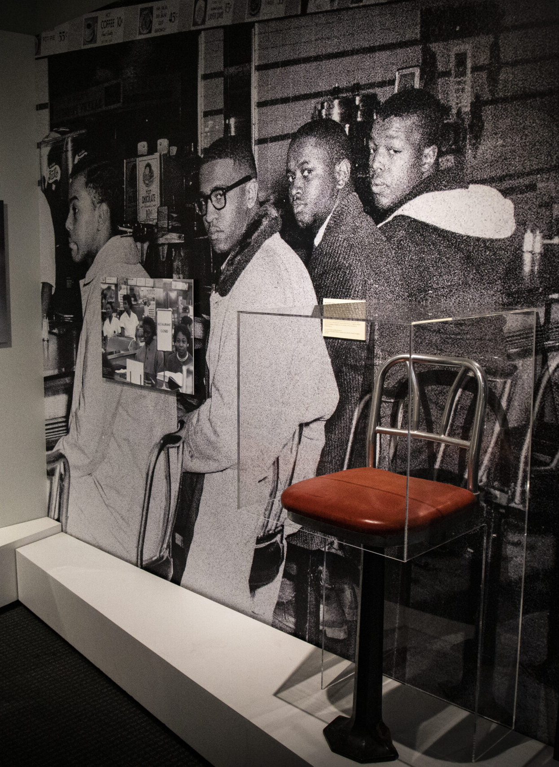

EXHIBITIONS

Slide 5
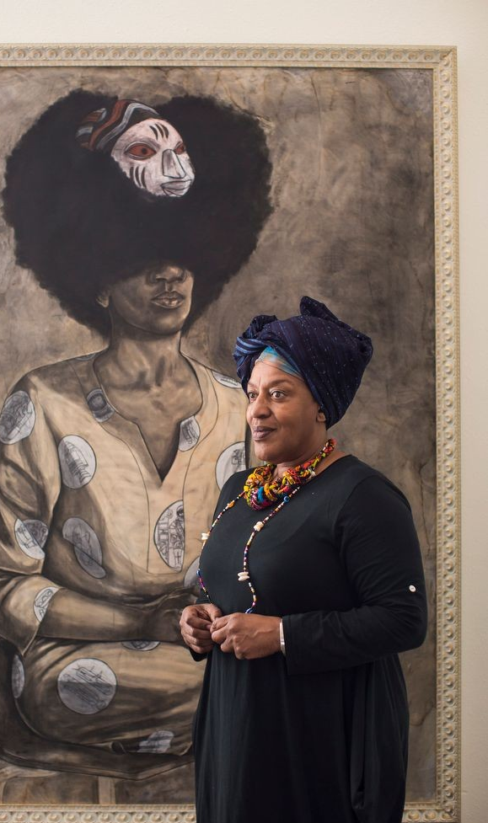
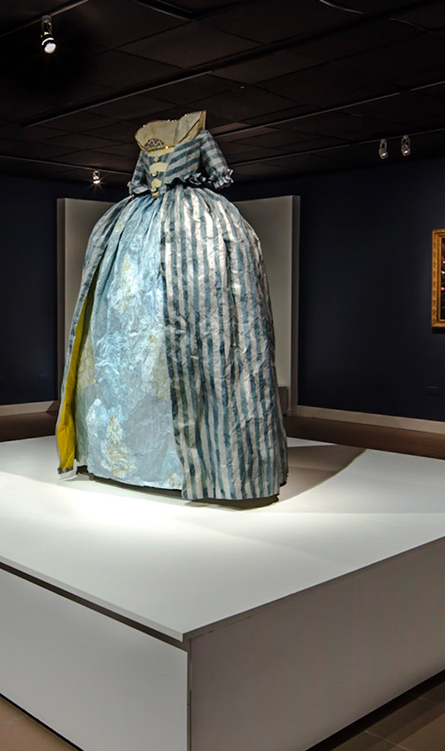
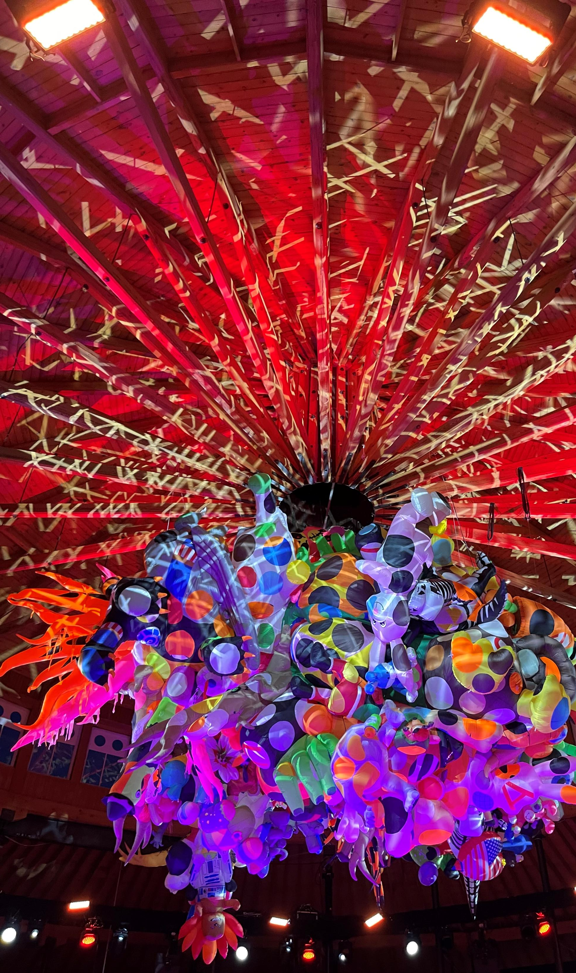

Slide 6



EDUCATION & PARTNERSHIPS

Slide 7

BLACK HISTORY IS AMERICAN HISTORY

Slide 8
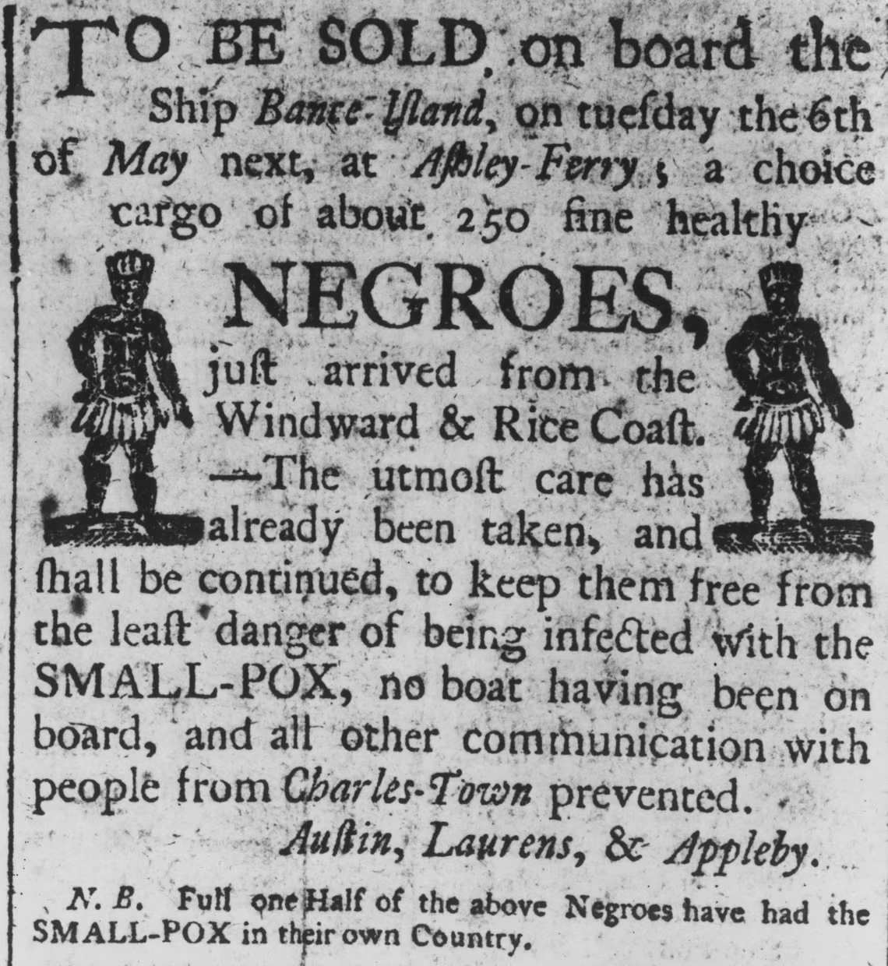

Slide 9
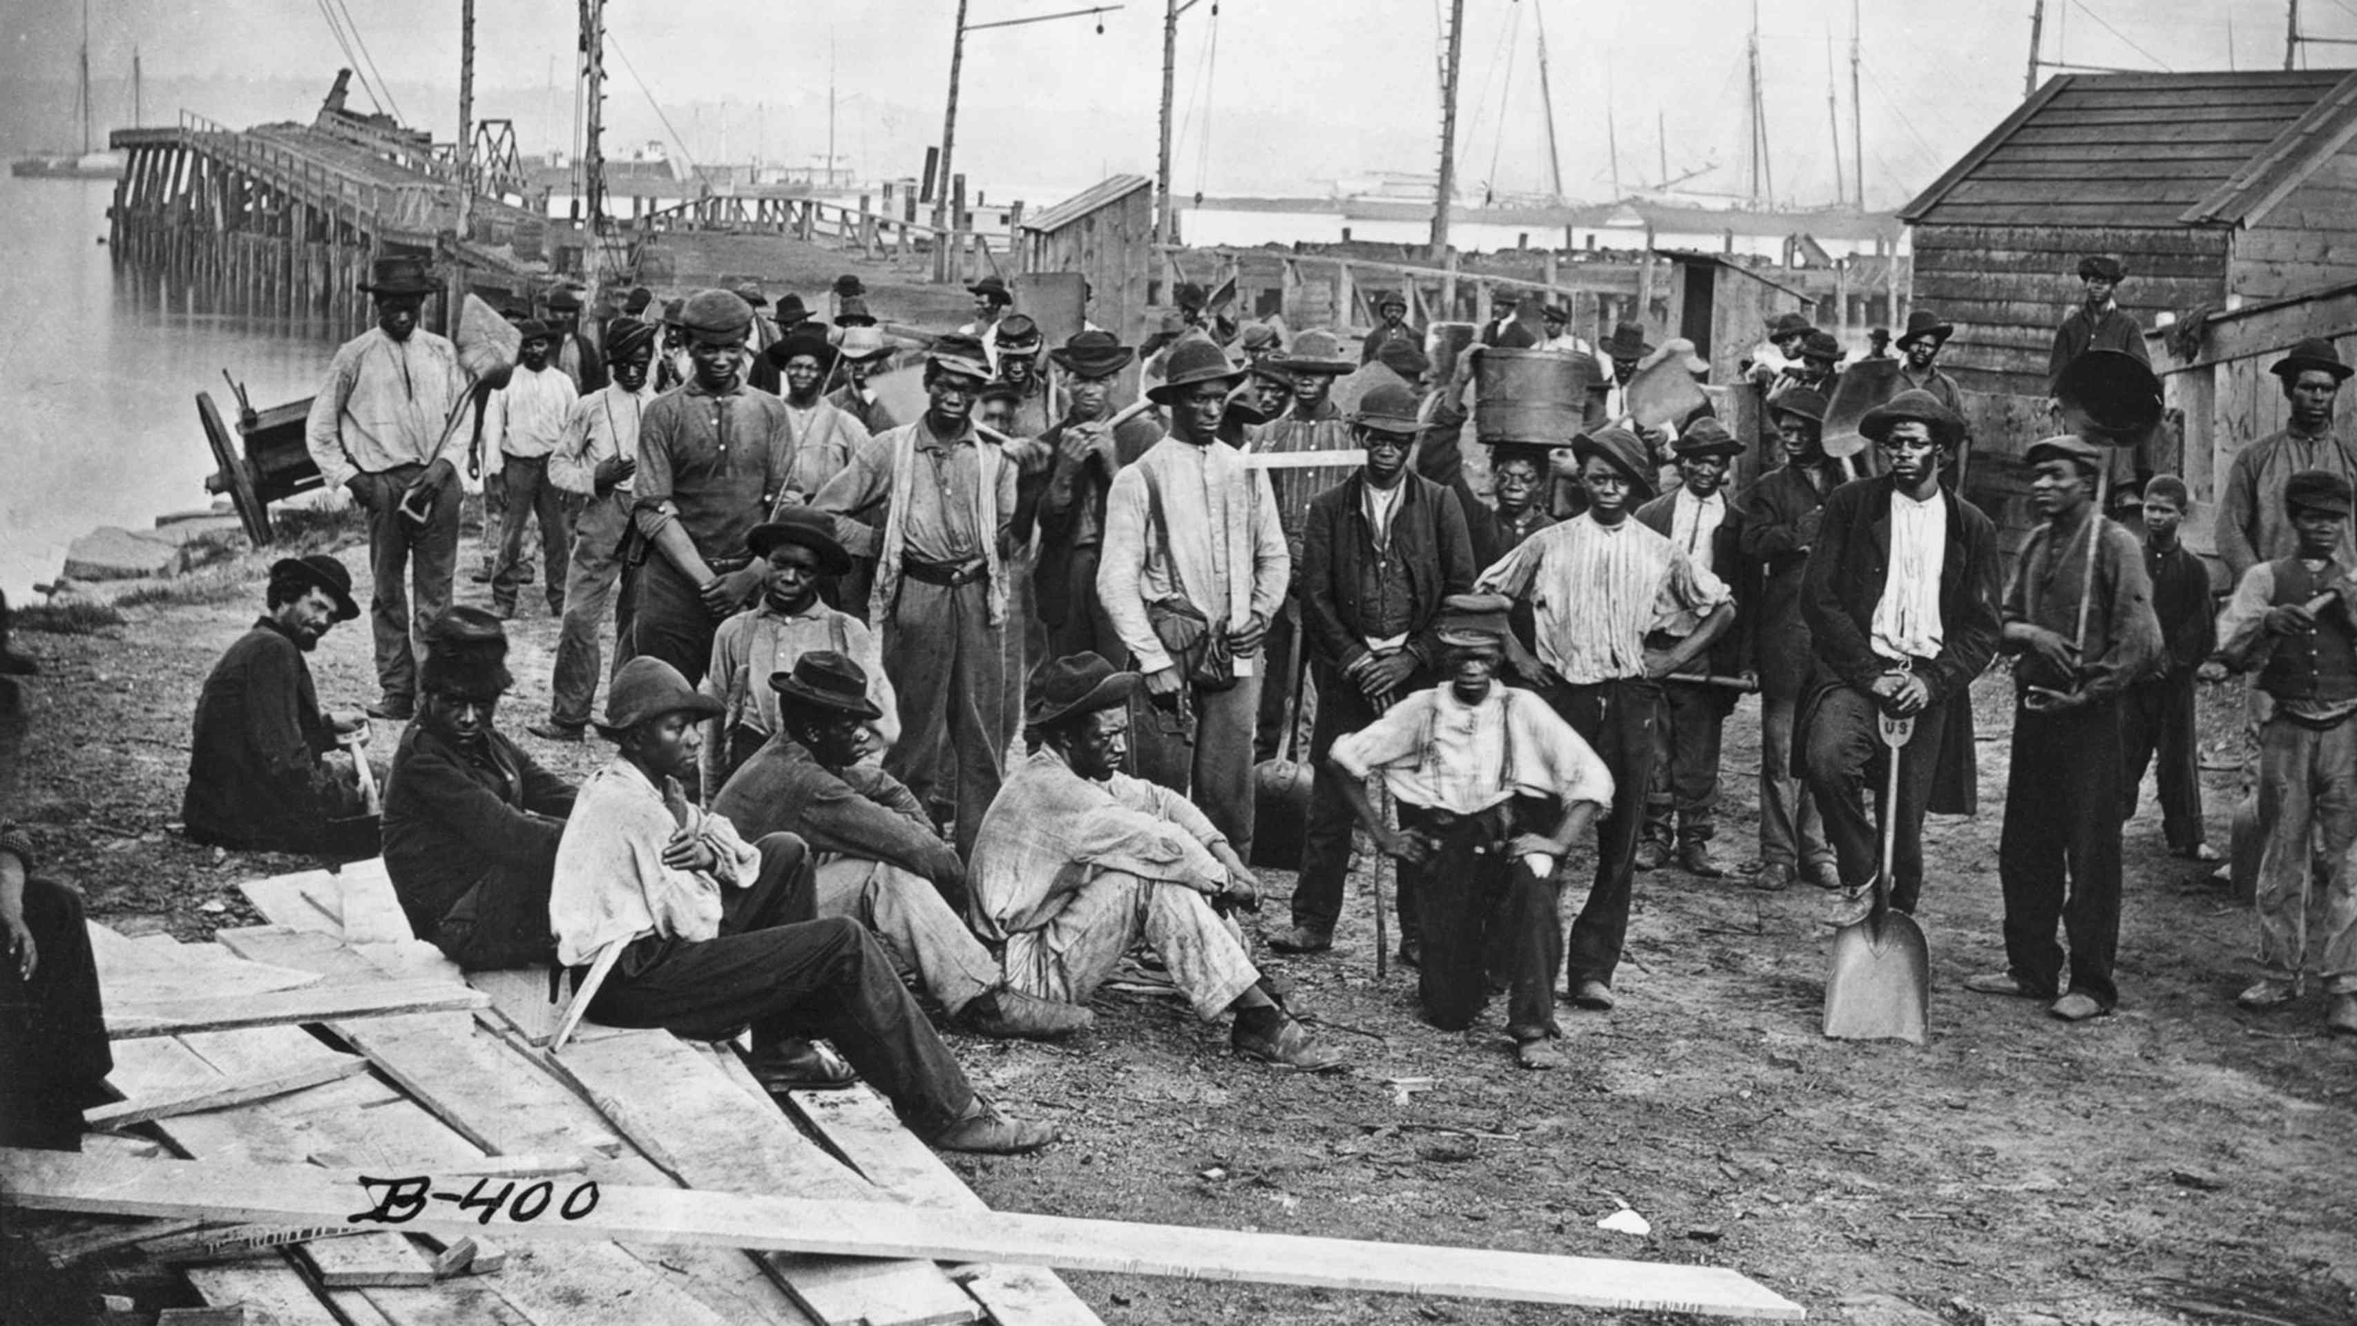
THE ORIGINS AND IMPORTANCE OF JUNETEENTH

Slide 10
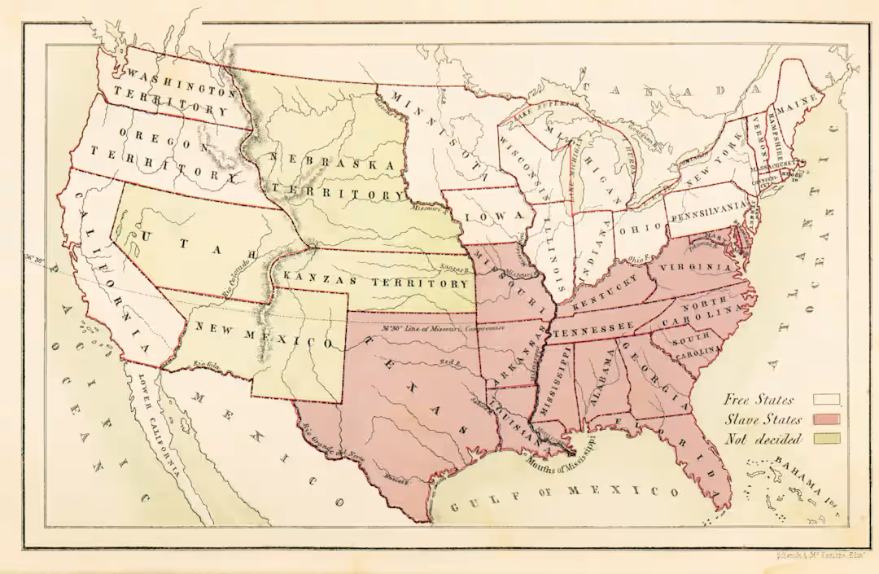

Slide 11
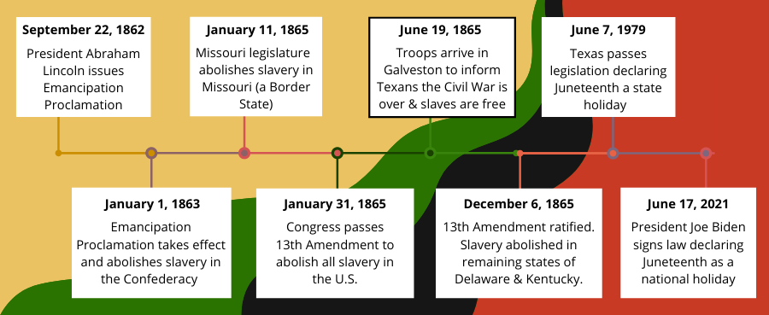

Slide 12
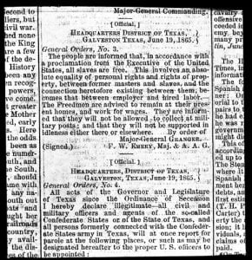
GENERAL ORDERS, NUMBER 3
“The people of Texas are informed that, in accordance with a Proclamation from the Executive of the United States, all slaves are free. This involves an absolute equality of personal rights and rights of property between former masters and slaves, and the connection heretofore existing between them, becomes that between employer and hired labor. The Freedmen are advised to remain at their present homes, and work for wages. They are informed that they will not be allowed to collect at military posts; and that they will not be supported in idleness either there or elsewhere.”

Slide 13
FREEDOM DAY
Juneteenth is a powerful day of remembrance and joy in Black communities.
Freedom
Tradition
History

Slide 14
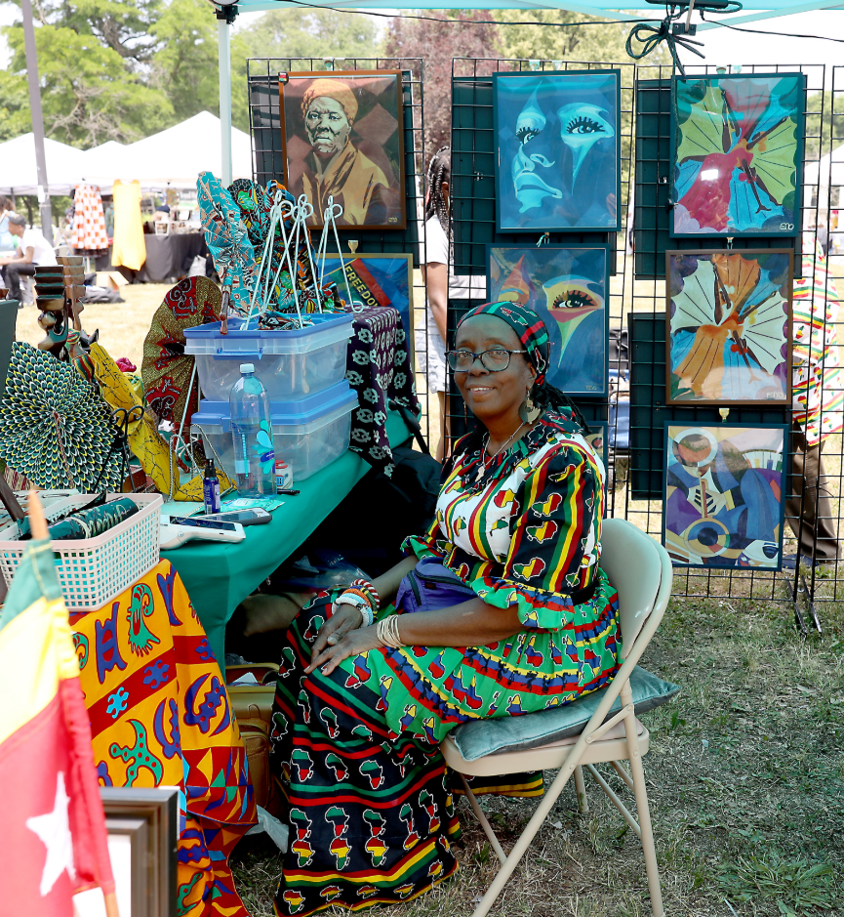
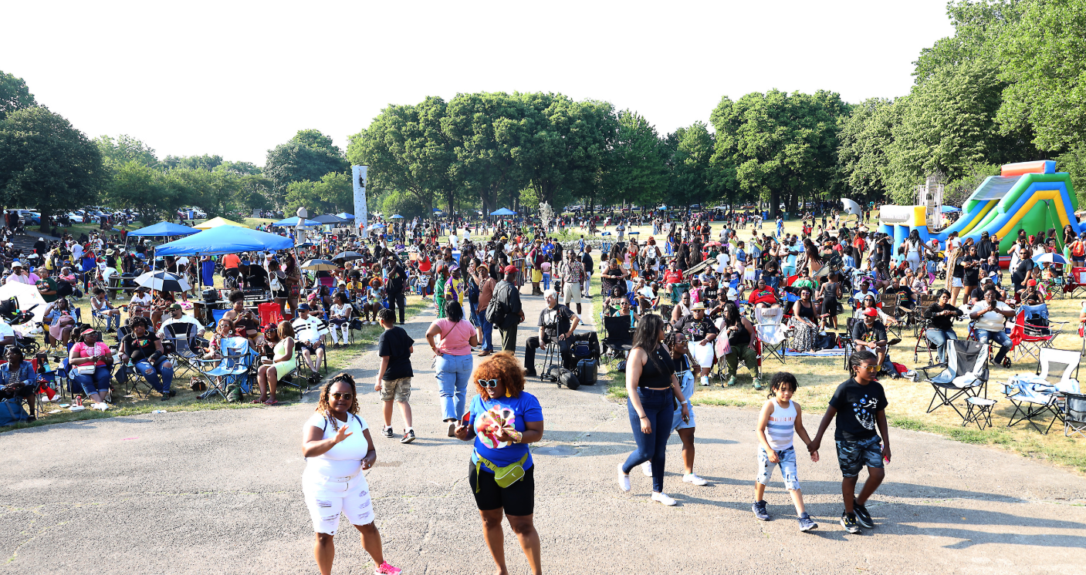
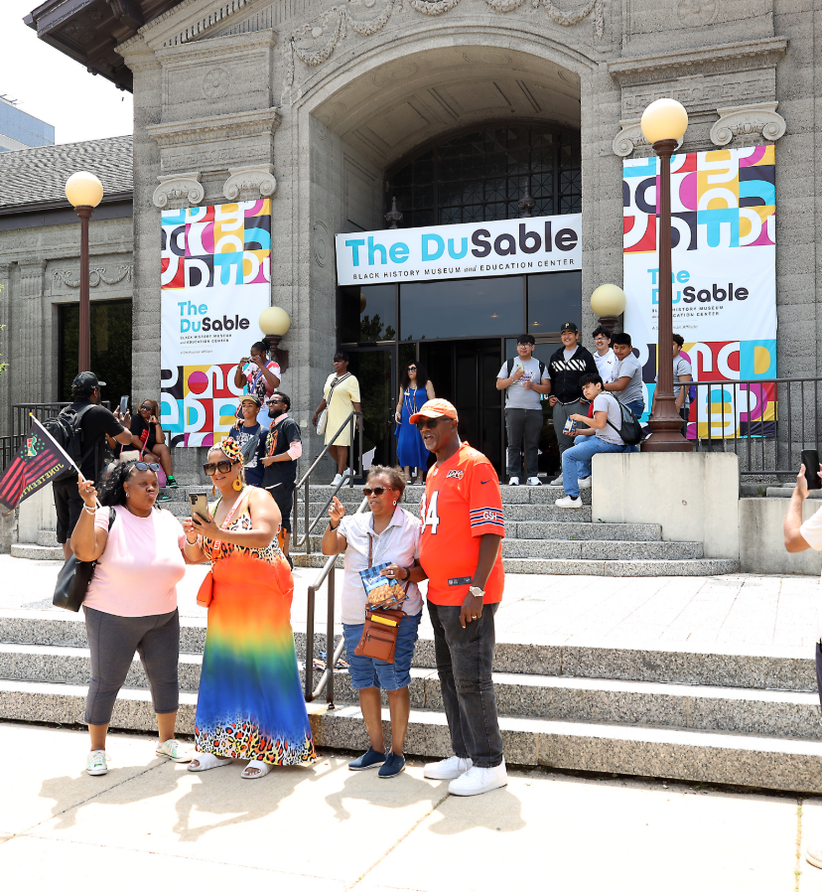
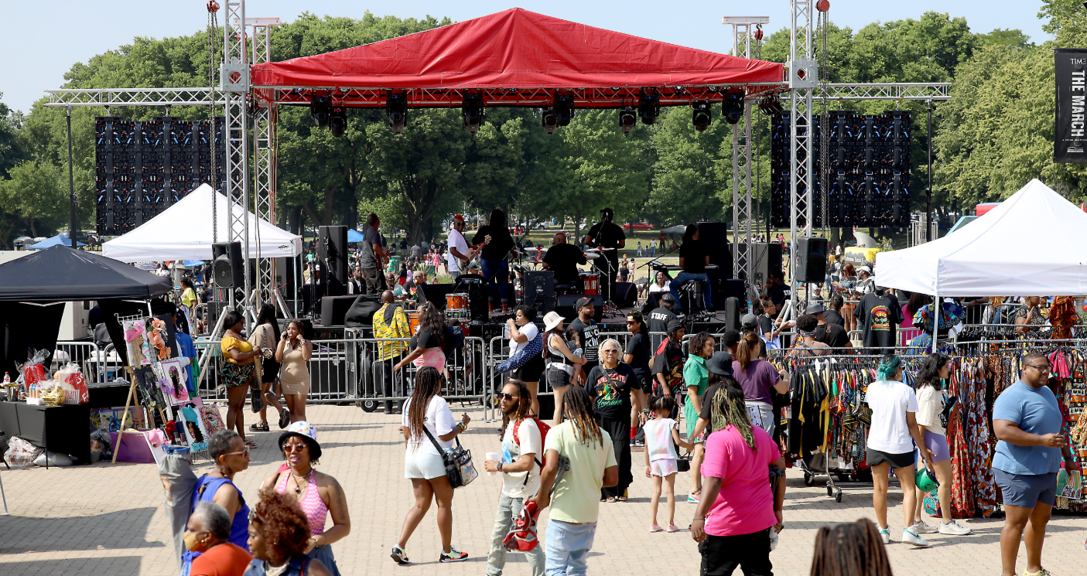
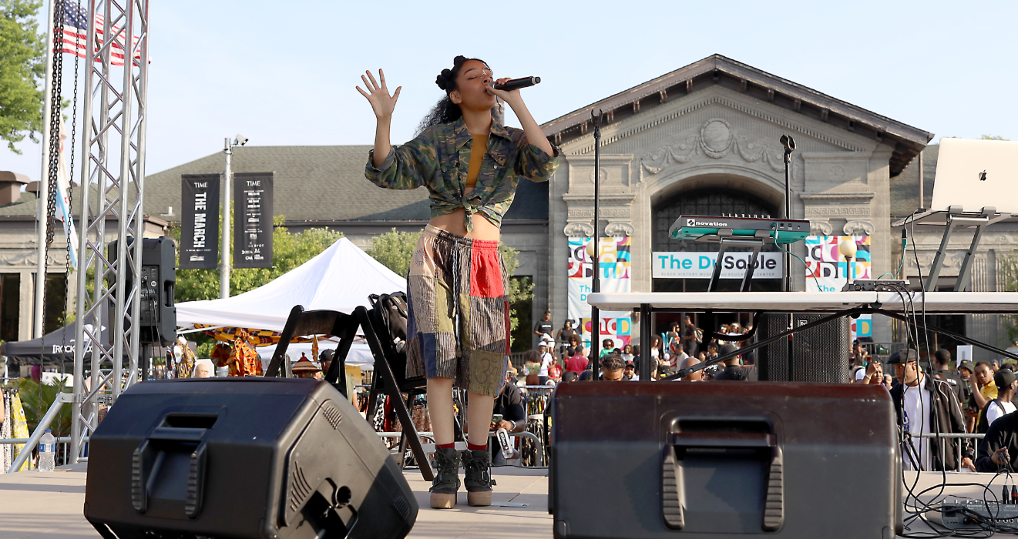
JUNETEENTH AT THE DUSABLE

Slide 15


Slide 16
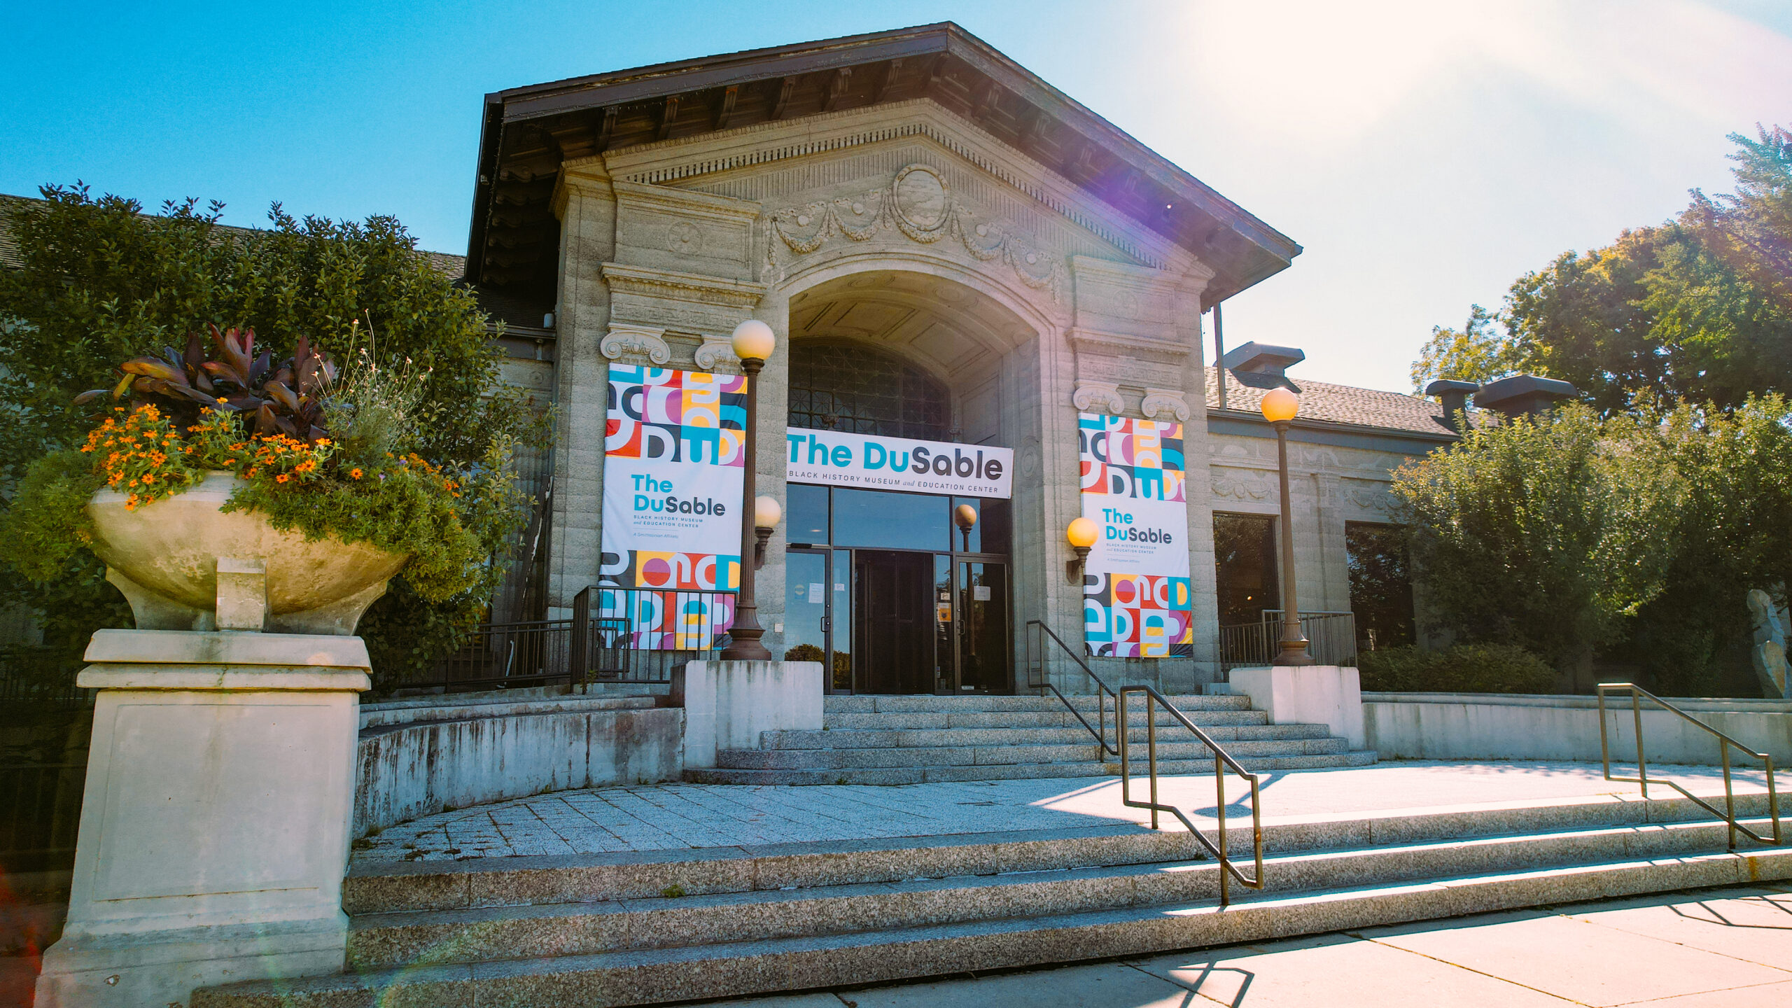
COMING THIS FALL

Slide 17


Slide 18


