Slide 1
From the Courtroom to the boardroom: Winning big by utilizing emotional intelligence knowledge and strategies

Slide 2


Speakers
Aimee Schleizer
LMSW Candidate
Former CFO
Nick Roide
Associate Attorney,
Kessler Collins

Slide 3


What is Emotional Intelligence?
Emotional Intelligence (Emotional Quotient or EQ)
  The ability to both manage your own emotions and to recognize and influence the emotions of others
  Self-awareness and conscious knowledge of another’s strengths, weaknesses, and triggers

Slide 4
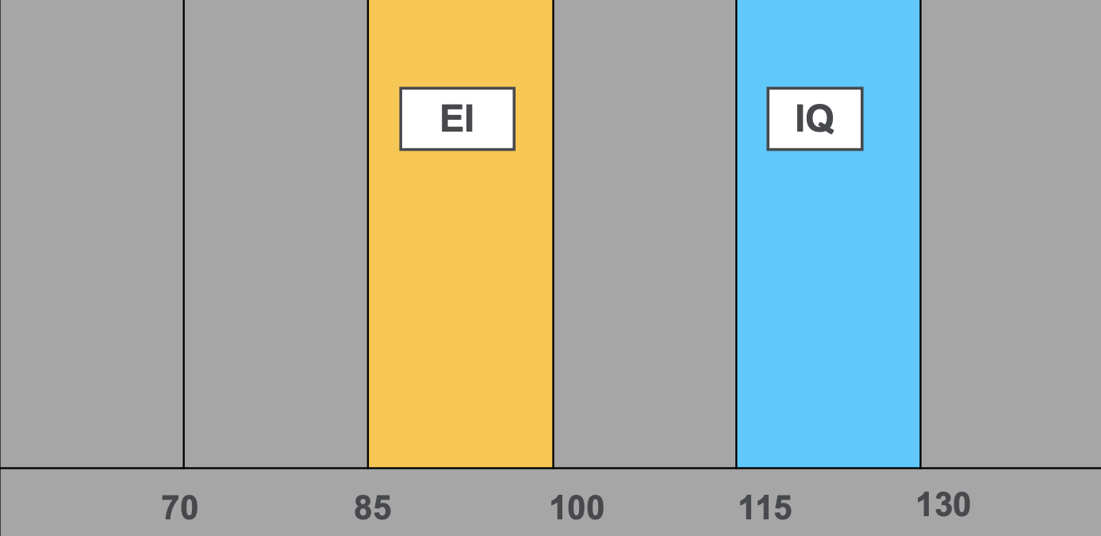


Lawyers and EQ - the Why
  Lawyers rank high in IQ, low in EQ
  Emotionally intelligent lawyers are:
    Smarter
    Stronger practitioners in the
boardroom and the courtroom
    Make more money,
get and keep more clients
    Healthier and happier

Slide 5


Lawyers and EQ - the Why
  The Business Case from
the Client Perspective
  Empathy and Self-Awareness

Slide 6

Empathy
  WHAT is Empathy?
  WHEN is Empathy?
  What is NOT Empathy?

Slide 7

Self Awareness and
Active Listening
  OARS
    Open-ended Questions
    Affirmations
    Reflections
    Summarizing

Slide 8
EQ and Office Relationships:
Lessons in Leadership

Slide 9
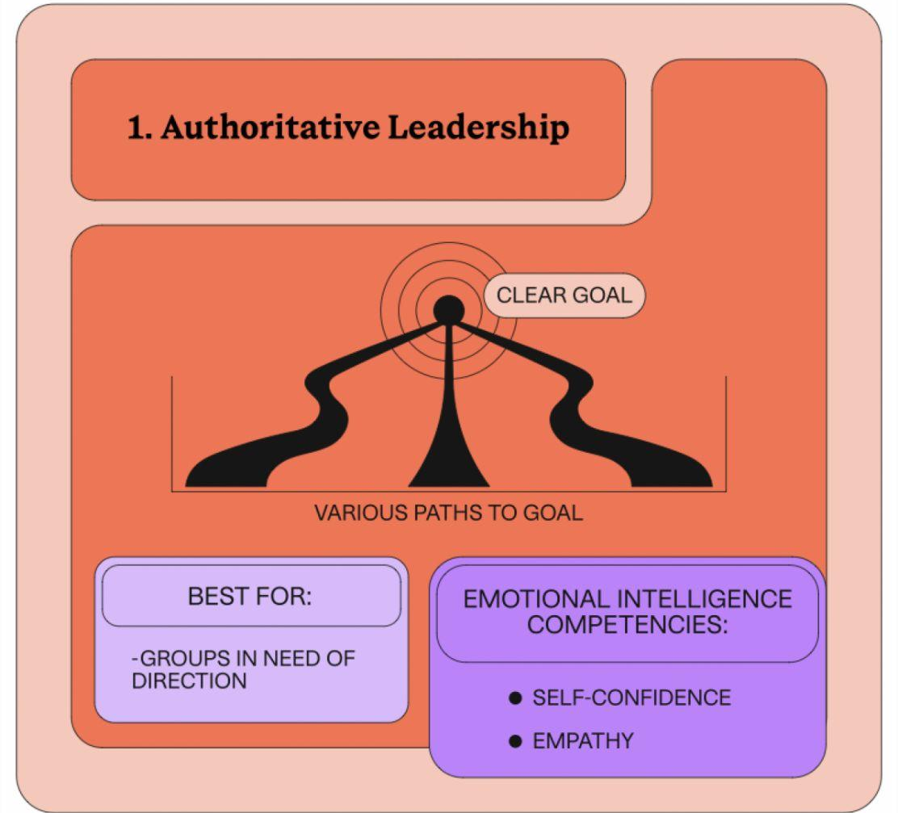
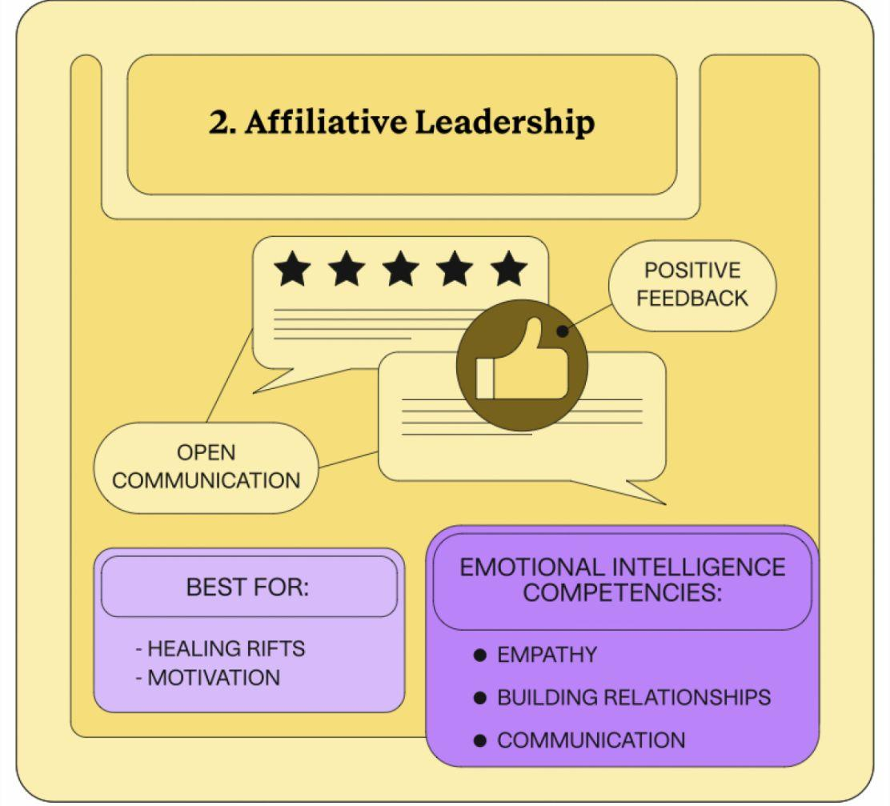
SOME INTRO TEXT HERE AND HERE AND HERE
Some subtitle text to go here

Slide 10
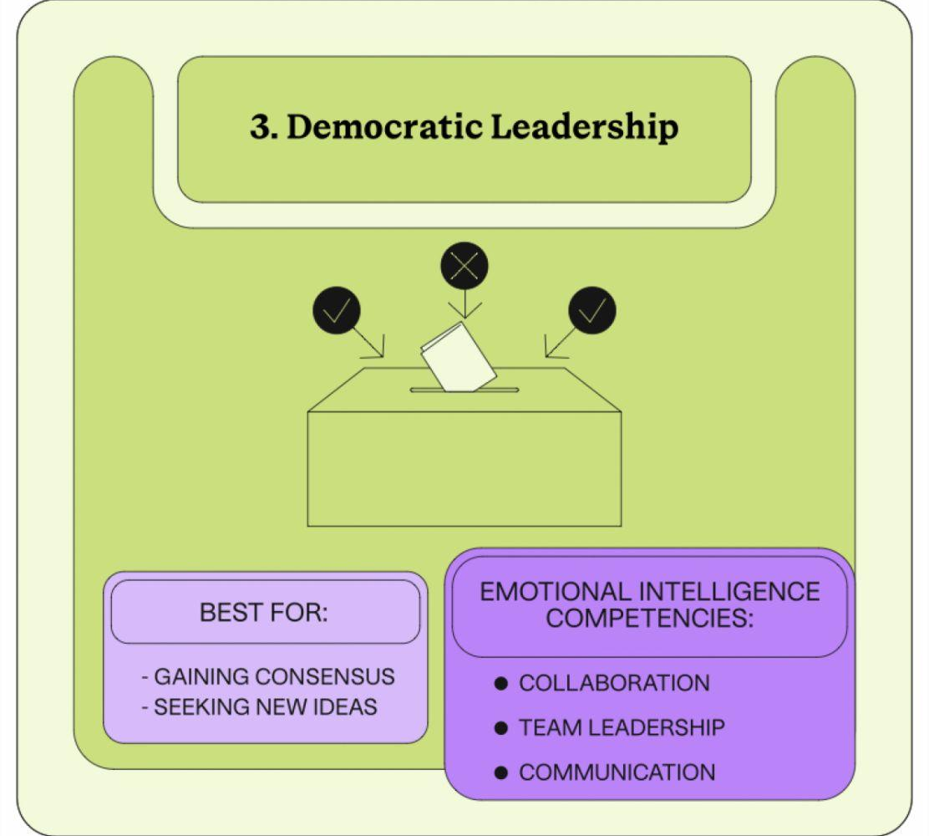
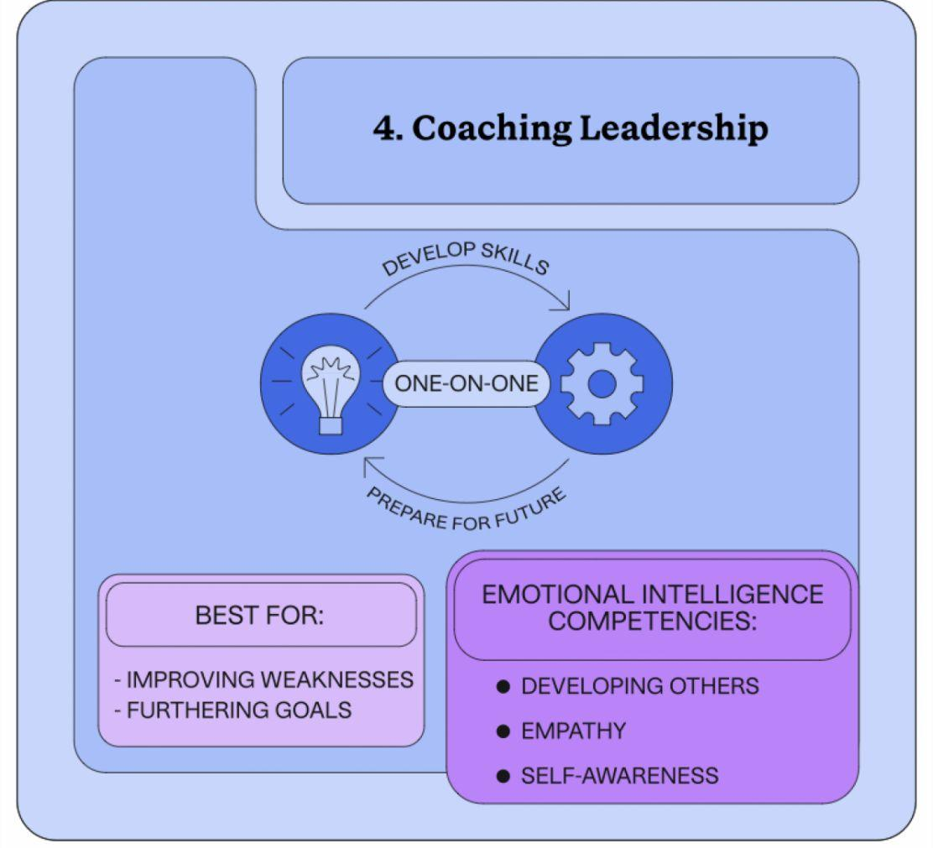
SOME INTRO TEXT HERE AND HERE AND HERE
Some subtitle text to go here

Slide 11
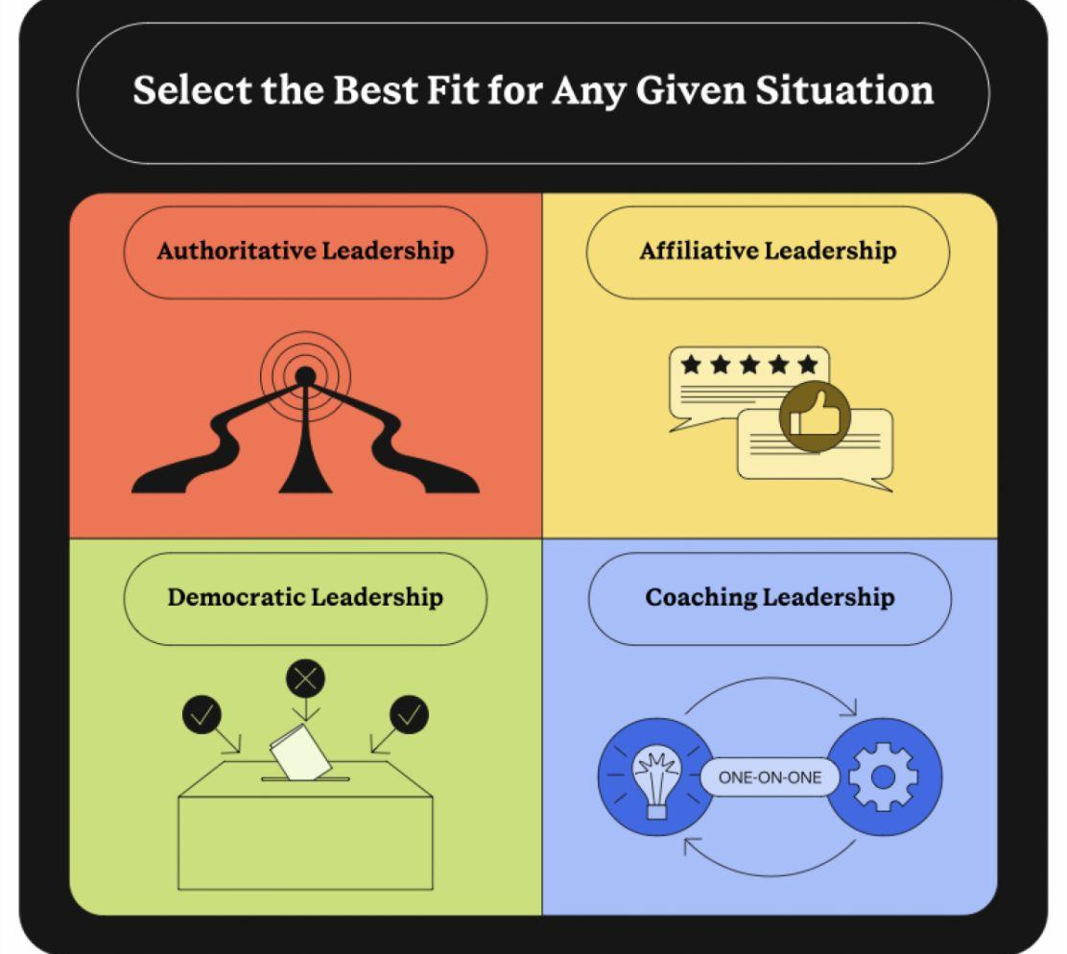

Slide 12
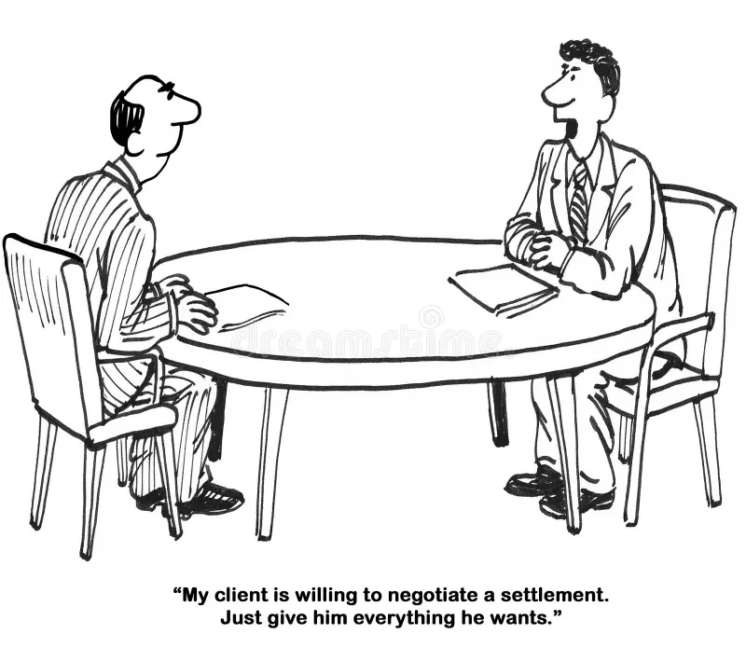
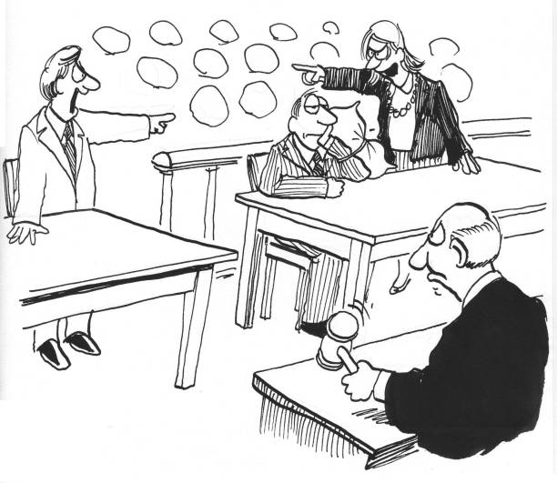
EQ in Relationships with Other Lawyers
In the Boardroom
(at the Negotiating Table)
In the Courtroom

Slide 13


Becoming a More Emotionally Intelligent Lawyer
  Introspection
  Mindfulness
  Expanding Emotional Awareness
  Persevere

Slide 14


Becoming a More Emotionally Intelligent Lawyer
  Leadership
  Hiring and Talent Acquisition
  Developing EQ Internally
  EQ Assessments
    Mayer-Salovey-Caruso Emotional Intelligence Test
    Emotional Quotient Inventory 2.0 (EW-i 2.0)
    Emotional and Social Competence Inventory

Slide 16
What is new in employment law
Legal Update for Law Firms and Their Clients

Slide 17
Ali Hinckley
&
Charmaine Becken
Legal Netlink Alliance
2023 US Fall General Meeting
Dallas, Texas

Slide 18

“OFF Table Topics” – Holiday Dinner Edition
Income, Religion, Gender
Notes:
As we start closing out the 2023 year, get up to speed on “off-table topics” covering income, gender, and religion before heading to your holiday dinners!

Slide 19
Overview
Income – Leave and Pay Transparency Policies
Religion – Religious Accommodation Requests Under Title VII
Gender – Expanded Protections For Pregnant and Nursing Workers
Bonus – Limitations on Noncompete Agreements
Notes:
We will provide an overview of recent developments in employment law spanning hot topics such as…. leave and pay transparency policies, religious accommodation requests under Title VII, limitations on noncompete agreements, and expanded protections for pregnant and nursing workers.
We realize that each of these topics alone could have easily been their own 1-hour presentation, but we endeavor to give you a broader view of a variety of issues because employment law is very rarely singular in nature.
Bear with us as we move through the issues. At the conclusion of the presentation, we will offer some concluding thoughts to wrap this all up.

Slide 20
Leave and Pay
Transparency Law

Slide 21
Employment During the “Great Resignation”
Workers—particularly young workers—are coming to expect transparency from employers regarding pay and leave policies
40% of U.S. job postings now include employer-provided salary information (Hiring Lab, 2023)
A recent survey found that 4 out of 5 workers are unlikely to apply for a job when the listing does not disclose a pay range (ResumeLab, 2023)
Notes:
We currently find ourselves in a worker movement, referred to by some at the Great Resignation, where workers who have switched jobs have clocked larger pay gains than those who stayed with the same employer. This movement has particularly impacted certain fields, such as caretaking, retail, and hospitality. Pay transparency is adding fuel to the fire.
Many workers are angry about how little they are paid—and who is making more, if they can even find out. The Economic Policy Institute reports that chief executives outearn their workers by a ratio of 399 to 1. A survey by the Pew Research Center found barely one-third of the nation’s employees described themselves as satisfied or very satisfied with their pay, with women and Blacks more likely to say they were unhappy. Many have come to believe that the American tradition of secrecy around pay makes such inequities possible.
As a result, American workers have come to expect transparency from prospective employers. A recent survey from ResumeLab found that 4 out of 5 workers are unlikely to even apply for a job when the listing does not disclose a pay range. As a result, Hiring Lab estimates that approximately 40% of U.S. job postings now include employer-provided salary information.
This trend is particularly seen among Gen Zers and other young workers. Adobe’s Future Workforce Study, released late last year, found 85 percent of college students and recent graduates would be significantly less likely to even apply for a position if salary data wasn’t included.

Slide 22
Employment During the “Great Resignation”
By contrast, a recent survey found that only 17% of North American employers disclose pay and salary ranges to prospective employees even when not required to do so by law
31% of companies surveyed reported that they were not ready for pay transparency
62% of companies surveyed reported that they planned on disclosing pay information in the future (WTW, 2022)
Notes:
Despite the growing demands for transparency from workers, many employers’ pay policies remain stagnant. Only 17% of North American employers disclose pay and salary ranges to prospective employees even when not required to do so by law. 31% of companies surveyed reported that they were not ready for pay transparency. However, the good news is that 62% of companies surveyed reported that they planned on disclosing pay information in the future.

Slide 23
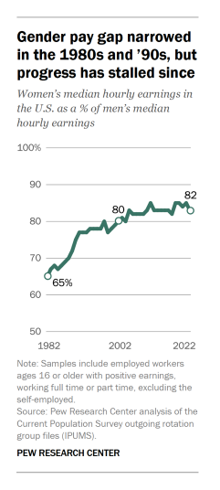
The Pay Gap
In 2022, American women typically earned 82 cents for every dollar earned by men
The gender pay gap was barely closed in the last two decades
In 2002, women earned 80 cents to each dollar earned by men
In 1982, women earned just 65 cents to each dollar earned by men (Pew Research Center)
Notes:
Many view this move toward pay transparency a good change—a change necessary to cure pay inequality along gender and racial lines.

Slide 24
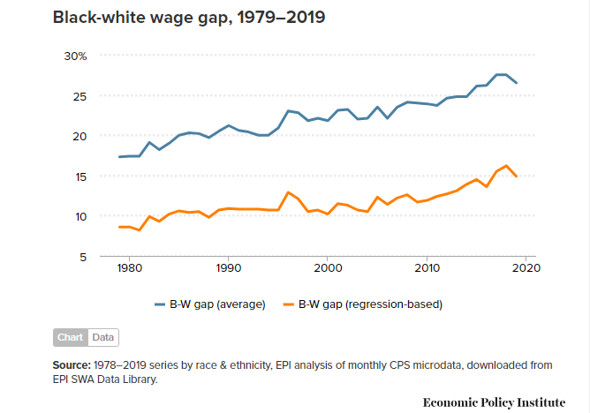
The Pay Gap
In 2019, the median black workers earned 24.4% less per hour than the median white worker
In 1979, this wage gap was only 16.4%
The gap is even larger for black women. In 2019, black women were paid 33.7% less than their white male counterparts (Economic Policy Institute, 2022)
Notes:
The racial pay gap has only worsened in recent years…

Slide 25
Pay and Leave Transparency Laws
Under the National Labor Relations Act, employees have the right to communicate with other employees at their workplace about their wages and benefits
An increasing number of states and municipalities are adopting pay and leave transparency laws
California: Employers in California have long been required to provide applicants with the pay scale for a position upon reasonable request. However, last year SB 1162 was signed into law, which now requires employers with 15 or more employees to include a pay scale for job postings, including internal and external postings and job postings through third parties. SB 1162 also establishes new annual pay data reporting requirements for employers with 100 or more employees.

Slide 26
Pay and Leave Transparency Laws
Colorado: Employers with one or more employees are required to disclose the hourly or salary compensation, or a range of the hourly or salary compensation, that the company would pay for the role, in each posting for a job opening. Employers must also provide a general description of all employment benefits.
Connecticut: Employers with one or more employees must provide a wage range to current employees and applicants upon the receipt of either: (1) the applicant's request or (2) the communication of an offer of employment, whichever comes first.
Maryland: Employers must provide the wage range for a position at the applicant's request, and employers are prohibited from refusing to interview or hire an applicant because they requested the wage range for the position.

Slide 27
Pay and Leave Transparency Laws
Nevada: Employers must provide the wage or salary range or rate of pay for a position to applicants who have completed an interview for the position.
New York: As of September 17, 2023, employers with four or more employees are required to list compensation ranges for designated job opportunities, promotions, and transfers.
  NYC has its own Salary Transparency Law, which became effective November 1, 2022.
Rhode Island: Beginning January 1, 2023, employers with one or more employees must provide the wage range for a position to an applicant on request or at the time of hiring, whichever is earlier.

Slide 28
Pay and Leave Transparency Laws
Washington: Since 2019, employers in Washington state with 15 or more employees have been required to disclose the minimum wage or salary, as well as a general description of all benefits, for a position on an applicant's request if an offer of employment has been made. However, beginning January 1, 2023, employers must disclose the wage scale or salary range for an opening in any job posting.
Other cities with pay transparency ordinances: Cincinnati, Toledo and several in New York and New Jersey

Slide 29
Pay and Leave Transparency Laws
Coming down the pipe: Hawaii (Jan. 1, 2024), Illinois (Jan. 1, 2025)
States considering pay transparency: Alaska, District of Columbia, Kentucky, Maine, Massachusetts, Michigan, Missouri, Montana, New Jersey, Oregon, South Dakota, Vermont, Virginia, and West Virginia
Notes:
Hawaii and Illinois have also passed pay transparency laws that will go into effect in 2024 and 2025, respectively.
There are also several states that have considered pay transparency laws in recent legislative sessions or are currently considering such laws, including Alaska, District of Columbia, Kentucky, Maine, Massachusetts, Michigan, Missouri, Montana, New Jersey, Oregon, South Dakota, Vermont, Virginia, and West Virginia.

Slide 30
Practical Guidance for Employers
Many of the pay transparency laws affect large and small employers alike
Noncompliance penalties ranging from $300 to $250,000 per violation
Trends toward remote work
  New York’s pay transparency law applies to postings for remote jobs that will be physically performed in New York
  Under Colorado law, an out-of-state employer advertising a position that could be performed by a remote worker in Colorado must comply with the state’s pay transparency law
Notes:
Many of the pay transparency laws affect employers of all sizes….some, such as Colorado’s law, pertains to employers who employ just one or more employees in the state. Many such laws extend to employers employing 15 or more workers in the particular state. In other words, it’s not just the large employers who should be mindful of these developments in pay transparency law.
And failure to comply with such laws can come at a steep prices. Noncompliance penalties are across the board, ranging from $300 in the case of a first violation in the State of Maryland to $250,000 for an uncorrected first violation of repeat violations under New York City ordinance.

Slide 31
Practical Guidance for Employers
Employers should recognize that pay transparency is the “new normal”
Employers should consider a pay audit to identify instances of pay inequality
Employers should familiarize themselves with the law in the states and cities the employers operate
Finally, multi-state employers or employers hiring remote workers should consider uniform pay policies to ensure compliance

Slide 32
Religious Accommodation Requests Under Title VII
Notes:
To understand where we are today, let’s take a look at the previous standard…. [next slide]

Slide 33
Title VII of the Civil Rights Act of 1964
Title VII, as adopted in 1964, made it unlawful for covered employers “to fail or refuse to hire or to discharge any individual, or otherwise to discriminate against any individual with respect to his compensation, terms, conditions, or privileges [of] employment, because of such individual's ... religion.” 42 U.S.C. § 2000e–2(a)(1) (1964 ed.)
EEOC interpreted Title VII to obligate employers “to make reasonable accommodations to the religious needs of employees” whenever that would not work an “undue hardship on the conduct of the employer's business.” 29 C.F.R. § 1605.1 (1968).
In 1972, Congress amended the statute to make clear that “religion” includes all aspects of belief, observance, and practice, and that an employer must “reasonably accommodate” such observances and practices where it can do so “without undue hardship on the conduct of its business.” 78 Stat. 253, as amended, 42 U.S.C. § 2000e(j)
Notes:
For background….
Bullet #1:
As originally enacted, Title VII did not spell out what it meant by discrimination “because of ... religion,”
Bullet #2:
Shortly after the statute's passage, the EEOC interpreted that provision to mean that employers were sometimes required to “accommodate” the “reasonable religious needs of employees.” 29 C.F.R. § 1605.1(a)(2) (1967).
After some tinkering, the EEOC settled on a formulation that obligated employers “to make reasonable accommodations to the religious needs of employees” whenever that would not work an “undue hardship on the conduct of the employer's business.” 29 C.F.R. § 1605.1 (1968).
Between 1968 and 1972, the EEOC elaborated on its understanding of “undue hardship” in a “long line of decisions” addressing a variety of policies.
Ultimately, EEOC decisions did not settle the question of undue hardship
Bullet #3:
Responding to court decisions rejecting any duty to accommodate an employee's observance of the Sabbath, Congress amended Title VII in 1972.
Example of one such decision is Dewey (6th Circuit case which held Title VII did not require an employer to “accede to or accommodate” religious practice because that “would raise grave” Establishment Clause questions.)
In this amendment, Congress tracked the EEOC’s regulatory language
Courts have interpreted “undue hardship” for years… [next slide]

Slide 34
Prior Standard of “Undue Hardship” for Religious Accommodations
Supreme Court addressed the “undue hardship” inquiry in Trans World Airlines, Inc. v. Hardison, 432 U.S. 63 (1977).
  “Undue Hardship” existed when there was more than a de minimis (minimal) cost to the employer, such as:
    Negative impacts on productivity or quality
    Personnel or overtime costs
    Increased workload for other employees
    Reduced employee morale
Notes:
Bullet #1:
In 1977, US Supreme Court Trans World Airlines looked at what “undue hardship” means.
[Brief facts on the case]
Larry Hardison was an employee at Trans World Airline.
Hardison was a member of the Worldwide Church of God and refused to work on Saturdays which was his sabbath.
TWA transferred him from the night shift to the daytime on Saturdays.
However, his seniority was affected by the shift change, and the union did not allow him to take Saturdays off.
TWA declined a proposal for him to work a four-day week and ultimately discharged him for refusing to work on Saturdays.
While “undue hardship” sounds familiar, as used under the Americans with Disabilities Act (ADA), the interpretation by most of courts of the standard for establishing an undue hardship under Title VII has been far less than under the ADA
Bullet #2:
According to previous Supreme Court precedent interpreting the prior “Undue Hardship” standard…
Bullet #3:
That “minimal cost” to the employer was not necessarily economic…
Next, we will look at the current state of the standard…. [next slide]

Slide 35
Current “Substantial Burden”
Standard from Groff v. Dejoy
Unanimous U.S. Supreme Court ruled that religious accommodations under Title VII must be provided to employees or prospective employees unless the employer is able to demonstrate that the burden is “substantial”
Implications:
  Clarifies nearly 50 years of precedent
  Dismantles the “de minimis” framework
  Heightens the burden on employers to defend against such claims
Notes:
Intro: June 29, 2023 the Groff v. Dejoy opinion came out.
At issue in Groff is whether the de minimis standard is a correct reading of Title VII, and how undue hardship should be defined in practice, as it pertains to religious accommodation claims.
[brief facts on the case]
Facts…..
Gerald Groff is a Christian and U.S. Postal Service worker.
He refused to work on Sundays due to his religious beliefs.
USPS offered to find employees to swap shifts with him, but on numerous occasions, no co-worker would swap, and Groff did not work.
Groff resigned in 2019 fearing his eventual termination
Groff sued USPS under Title VII of the Civil Rights Act of 1964, claiming USPS failed to reasonably accommodate his religion because the shift swaps did not fully eliminate the conflict.
Read 1st point on slide
Next, implications of the ruling… “Right off the bat, this opinion did several things….
“clarifies” without overruling Hardison
“de minimis” – US Sup Ct says lower courts improperly latched onto this standard following Hardison
De minimis was mentioned in a single sentence in Hardison
Was not intended to outweigh the “Substantial costs or expenditures” discussion mentioned 3 times in Hardison
Burden – In essence, the Court in Groff explains that the continued emphasis of de minimis over time modified the undue hardship standard in such a way that it strayed from the original intent of Title VII, as well as the intent of the Court in issuing the Hardison decision.
Plain meaning of the words “undue” and “hardship” in Title VII’s text mitigates using de minimis as the standard because “in common parlance,” a “hardship” is “something hard to bear,” and, under any definition, the use of the word “hardship” indicates something greater than a “mere burden.”
For those of us who are visual learners, next slide shows a quick comparison at how that burden has changed…. [next slide]

Slide 36
Undue Hardship v. Substantial Burden
Undue Hardship (1977)
Substantial Burden (2023)
If more than a de minimis cost was required, then the request was deemed to cause an “undue hardship” on the employer’s business and the employer could lawfully deny the request.
If the “burden of granting an accommodation would result in substantial increased costs in relation to the conduct of its particular business[,]” then the employer could lawfully deny the request.
Notes:
Quick visual side by side comparison of the prior and current standards….
Now, we will take a look at examples of “Substantial Burden” …. [next slide]

Slide 37
What Constitutes
“Substantial Burden”?
  The heightened standard requires employers assessing religious accommodations requests to deny such requests only if there is evidence that providing the accommodation would result in “substantial increased costs in relation to the conduct of [an employer’s] particular business.”
  Conduct of Business:
    Pre-Groff: impacts on coworkers had more significance
    Post-Groff: how other employees are impacted → how that impact affects the “conduct of its business” + whether such impact constitutes a “substantial increased cost”
  Substantial Increased Costs:
    Currently undefined but will differ depending on employer’s size and operations.
Notes:
Conduct of Business, Post-Groff:
Employers demonstrate that any impact on other employees must directly relate to the “conduct of [its] business” and their analyses must “examin[e] whether that further logical step is shown in a particular case.”
Substantial Increased Costs:
It is reasonable to surmise that this decision may impose a greater obligation on larger employers because demonstrating “substantial increased cost” may be more difficult when there is a large workforce with talent presumably available to perform others’ work tasks and significant revenues or profits where the ability to bear the costs of accommodations are presumed.
Examples of what details to look for:
How a business is impacted
which operations cannot run with a person absent,
how a store may not open during business hours,
how certain processes or work cannot be performed,
lost revenues as a result,
impact on customer expectations – failure to complete orders or increased customer complaints, impact on coverage for patients needing vital care, inability to meet certain regulatory requirements, and
How other employees are impacted
inability to have adequate rest between shifts,
inability to provide days off,
increased errors,
potential departures
Applying this new standard is going to be key for employers…. [next slide]

Slide 38
Applying Substantial
Burden Standard Post-Groff
  No clear guidance on how to apply this new standard:
    Court concedes the application of the “clarifying” standard requires case-by-case factual analysis
    Court declined to apply the “significant expense or difficulty” analysis and precedent established in cases decided under the Americans with Disabilities Act
  Stay apprised of cases following Groff.
    Hebrew v. Texas Dept. of Criminal Justice (9/15/23) – Fifth Circuit reversed SDTX, held TDCJ failed to show an undue hardship if it were to grant requested religious accommodation of Hebrew keeping his hair and beard
Notes:
Bullet #1
However….. There is no clear line for how the US Sup Ct will apply the “substantial burden” standard.
Bullet #2:
Employers should stay apprised of cases following Groff for further guidance.
Just last month, we’ve already seen 1 Fifth Circuit case reverse and remand the US District Court for the Southern District of Texas, citing to Groff…
Hebrew v. TDCJ –
summary judgment case, originally granted in favor of TDCJ
Plaintiff is a devout follower of the Hebrew Nation religion working as a correctional officer
the employer terminated him for refusing to cut his hair and beard in violation of his religious vow.
Although it provided beard exemptions from its grooming code for medical reasons, it stated that the employee’s beard prevented him from properly wearing a gas mask on the occasions when chemical agents were being utilized on the unit, and that his long hair could be used by an offender to overpower him, while also preventing the easy detection of contraband that could be hidden in his hair.
At the conclusion of this presentation, we will offer some final takeaways

Slide 39
Expanded Protections For Pregnant and Nursing Workers
Notes:
We’ll go over two new employment laws:
1) Pregnant Workers Fairness Act (“PWFA”) and
2) the Providing Urgent Maternal Protections for Nursing Mothers Act (“PUMP Act”).
Notably, the PWFA and the PUMP Act do not preempt state or local laws that provide greater protections to pregnant and nursing workers.
First, let’s look at the Pregnant Workers Fairness Act (“PWFA”)…. [next slide]

Slide 40
Pregnant Workers Fairness Act (PWFA)
PWFA went into effect June 27, 2023.
Administered and enforced by the EEOC.
The PWFA covers public and private sector employers of 15 or more (as well as employment agencies, labor organizations, Congress, and Federal agencies).
Pursuant to the PWFA, covered employers must provide: “reasonable accommodations to the known limitations related to the pregnancy, childbirth, or related medical conditions of a qualified employee” unless the accommodation “would impose an undue hardship on the operation of the business.”
Notes:
At the tail end of the last legislative session, Congress passed the Pregnant Workers Fairness Act (“PWFA”) and the Providing Urgent Maternal Protections for Nursing Mothers Act (“PUMP Act”).
Bullet #1
Read, then
On that date, the EEOC will start accepting charges for alleged PWFA violations occurring on or after June 27, 2023.
Bullet #2:
EEOC has committed to issuing PWFA regulations by December 27, 2023.
Bullet #3 [read]
Bullet #4
[read], then:
The PWFA requires covered employers to offer reasonable accommodations to pregnant workers.
Although the PWFA adopts a framework similar to the ADA,PWFA accommodations are available to pregnant workers regardless of whether they are disabled within the meaning of the ADA.
We’ll look at the key terms and what is required on the next slide… [next slide]

Slide 41
Reasonable Accommodations Under PWFA
Reasonable accommodations under the PWFA include, but are not limited to:
flexible work hours,
the ability to sit or drink water,
closer parking,
appropriately sized uniforms and safety apparel, and
exemption from strenuous activities.

Slide 42
Known Limitations Under PWFA
Known Limitations as defined by the PWFA are:
mental or physical conditions the pregnant employee communicates to the employer—which need not amount to a disability.

Slide 43
Arising Out of Pregnancy, Childbirth or Related Medical Conditions
Pregnancy-related conditions meriting accommodation under the PWFA include:
the normal physical changes of pregnancy and childbirth,
complications of pregnancy and childbirth (e.g., diabetes, depression, preeclampsia), and
related medical conditions like lactation, miscarriage and pregnancy loss, fertility treatment and menstruation.

Slide 44
Qualified Employee Under PWFA
Aligns with language of the Americans with Disabilities Act (ADA):
a qualified employee under the PWFA is an individual who can perform essential job functions with or without accommodation.
Departs with the ADA, because an individual who cannot perform essential job functions is still qualified under the PWFA if:
the individual’s inability to perform essential functions is temporary,
the essential job functions can be performed in the near future, and
the inability can be reasonably accommodated.
Notes:
Bullet #1 [read]
Although the PWFA adopts a framework similar to the ADA, PWFA accommodations are available to pregnant workers regardless of whether they are disabled within the meaning of the ADA.
Pregnancy by itself is not a disability under the ADA… Pregnancy related conditions (gestational diabetes, preeclampsia) can be disabilities under the ADA though.
Under PWFA: temporary inability to perform essential functions due to pregnancy, childbirth, or related medical conditions does .not render an employee unqualified

Slide 45
Undue Hardship Under PWFA
Aligns with ADA:
Employers are required to provide a PWFA reasonable accommodation unless doing so would cause an undue hardship (i.e., a significant difficulty or expense) to operations.

Slide 46
Providing Urgent Maternal Protections for Nursing Mothers Act (“PUMP Act”)
Amends the Fair Labor Standards Act (FLSA)
Went into effect on December 29, 2022
Enforcement mechanism became effective on April 28, 2023
  An employee who perceives a violation of the PUMP Act may either file a complaint against the employer with the U.S. Dept. of Labor (DOL), or bring a suit against the employer in the federal court system.
    10-day cure window (not required if employee was discharged because of a lactation space or break request)
Notes:
Bullets #1-2:
The PUMP Act generally covers employers subject to the requirements of the FLSA.
Certain employees of airlines, railroads and motorcoach carriers, however, are exempt from PUMP Act protections.
While the PUMP Act went into effect December 29, 2022; its enforcement mechanism first becomes effective on April 28, 2023.
Bullet #3:
The U.S. Department of Labor (“DOL”) notably has already issued PUMP Act guidance
Beginning April 28th, an employee may file a complaint with the department of labor, or bring suit in federal court
PRIOR TO DOING SO, the employee must inform the employer of its failure to comply with the PUMP Act and allow 10 calendar days for the employer to achieve compliance.
This10-day cure window is not required, however, if the employee has been discharged because of a request for a lactation space or break time, or if the employer has indicated that it will not comply with the PUMP Act.
Next, we will look at what is required under the PUMP Act… [next slide]

Slide 47
Requirements Under PUMP Act
FLSA requires employers to provide nonexempt employees with reasonable break time to express breast milk for up to one year after the child's birth.
PUMP Act expands FLSA: affording break time and a private space to express breast milk to all nursing employees.
PUMP Act also expands on employee’s options to enforce these requirements, providing for a private right of action.

Slide 48
Requirements Under PUMP Act
Under the PUMP Act, covered employers must provide all employees with “reasonable break time” to express breast milk for 1 year after the child’s birth “each time such employee has need to express the milk.”
Employers must also provide “a place, other than a bathroom, that is shielded from view and free from intrusion from coworkers and the public,” unless the employer has “fewer than 50 employees” and “such requirements would impose an undue hardship” on the employer’s business.
Notes:
Next, we’ll look at some of these key terms…. [next slide]

Slide 49
Reasonable Break Time, Each Time (PUMP Act)
Employees may take a reasonably long break each time to express breast milk, for up to one year after the child’s birth.
Frequency and duration of these pump breaks will likely vary depending on certain factors (location of the break space, pump setup, and condition of the nursing employee/child.
During break time, the employee must be either completely relieved from duty or paid for the break time.
  The employee who expresses milk during a break must be compensated in the same way other employees are compensated for break time.
Notes:
Fact @ end of slide: Notably, employees who telework are eligible to take pump breaks on the same basis as in-office employees.
Next, we will look at what kind of break space is required…. [next slide]

Slide 50
A Private Place, Other Than a Bathroom (PUMP Act)
A bathroom, even if private, is not a suitable workplace location for pumping breast milk.
Instead, the pumping location must be functional as a space for expressing breast milk.
If the space is not dedicated to a nursing employee’s use, it must be available whenever needed by the employee.
A space temporarily created or converted into a space for expressing breast milk or made available when needed by the nursing employee is sufficient provided that the space is shielded from view and free from any intrusion from co-workers and the public.
Notes:
Fact @ end of slide: Notably, remote workers must also be free from observation while expressing breast milk, including with respect to any employer-provided or required video conferencing system.
Next, we will look at how smaller employers are expected to comply with the PUMP Act…. [next slide]

Slide 51
Undue Hardship for Small Employers (PUMP Act)
Employers with fewer than 50 employees are not subject to PUMP Act breaktime and space requirements if compliance with the provisions would impose undue hardship.
Whether compliance with PUMP Act would pose an undue hardship is determined by assessing the difficulty and expense of compliance “when considered in relation to the size, financial resources, nature, or structure of the employer’s business.”
  For example, a small coffee shop with just five employees may be exempted from PUMP Act requirements if the coffee shop cannot designate a private pumping location without incurring significant difficulty or expense.
Notes:
After Bullet #1:
For purposes of determining whether an employer meets this 50-employee threshold, all employees, regardless of location, must be counted.
@ End:
We will share some concluding thoughts about the
Pregnant Workers Fairness Act (“PWFA”) and
the Providing Urgent Maternal Protections for Nursing Mothers Act (“PUMP Act”)
At the end of our presentation to wrap things up.

Slide 52
Limitations on Noncompete Agreements
Notes:
The next time you are guiding a client with a noncompete agreement, you may need to take a second look….

Slide 53
Federal Trade Commission –
Non-Compete Clause Rule
Pursuant to Sections 5 and 6(g) of the Federal Trade Commission Act, the Federal Trade Commission (“FTC”) is proposing the Non-Compete Clause Rule, published on January 19, 2023
  Prohibits employers throughout the United States from doing the following after conclusion of the worker’s employment:
    (1) entering into a noncompete clause with a worker;
    (2) maintaining a noncompete clause with a worker; or
    (3) representing to a worker that they are subject to a noncompete clause when there is no good-faith basis to believe that the noncompete is enforceable.
Notes:
FTC does not normally guide employment law, however…..
The FTC’s proposal is just one of a number of recent examples of federal antitrust regulators focusing on the intersection of competition and labor. The FTC has challenged noncompete clauses as “unfair methods of competition” in several cases that have been resolved through consent orders. The FTC and the Department of Justice (DOJ) have issued joint guidelines on the exchange of HR information on wages or benefits and its potential impact on competition in the labor markets, and the DOJ has aggressively pursued a number of criminal antitrust cases alleging “no-poach” agreements among firms competing in the labor markets. (DBA Article)
We’ve talked about what the proposed Rule prohibits, let’s talk about what it requires for compliance on the next slide… [next slide]

Slide 54
Requirements Under the
Non-Compete Clause Rule
In addition to prohibiting employers from entering into non-compete clauses with workers starting on the rule's compliance date, the proposed rule would:
require employers to rescind existing non-compete clauses no later than the rule's compliance date
require an employer rescinding a non-compete clause to provide notice to the worker that the worker's non-compete clause is no longer in effect
To facilitate compliance, the proposed rule would:
include model language that would satisfy this notice requirement, and
establish a safe harbor whereby an employer would satisfy the rule's requirement to rescind existing non-compete clauses where it provides the worker with a notice that complies with this notice requirement.
Notes:
We’ll talk about the Application of this proposed Rule on the next slide… [next slide]

Slide 55
Application of Non-Compete
Clause Rule
  Defines the term “non-compete clause” as a contractual term between an employer and a worker that prevents the worker from seeking or accepting employment with a person, or operating a business, after the conclusion of the worker's employment with the employer.
  Defines “worker” as a natural person who works, whether paid or unpaid, for an employer.
    Includes independent contractor, extern, intern, volunteer, apprentice, or sole proprietor who provides a service to a client or customer.)
  Limited exception for non-compete clauses between the seller and buyer of a business.
    Available only where the party restricted by the non-compete clause is an owner, member, or partner holding at least a 25% ownership interest in a business entity.
Notes:
Sharing some definitions that shed light on how the proposed Rule would be applied…
Bullet #1:
Definition of “non-compete clause” would generally not include other types of restrictive employment covenants—such as non-disclosure agreements (“NDAs”) and client or customer non-solicitation agreements—because these covenants generally do not prevent a worker from seeking or accepting employment with a person or operating a business after the conclusion of the worker's employment with the employer.
However, under the proposed definition of “non-compete clause,” such covenants would be considered non-compete clauses where they are so unusually broad in scope that they function as such.
TAKEAWAY: Captures not what the provision is called, but how it functions. See, e.g., Wegmann v. London,648 F.2d 1072, 1073 (5th Cir. 1981); Brown v. TGS Mgmt. Co., LLC,57 Cal. App. 5th 303, 306, 319 (Cal. Ct. App. 2020).
Bullet # 2
Ultimately, the intended application of the proposed Rule is extremely broad and meant to infiltrate almost all employment relationships.
The Definition for “Employer” is equally broad, covering nearly every feasible type of individual or entity that hires or contracts with a worker to work for the person.
We’ll talk about the debate over this proposed Rule on the next slide… [next slide]

Slide 56
Debate on Non-Compete
Clause Rule
Pros
Cons
Promote competition, including limitations on noncompete agreements that curtail worker mobility
Boost competition for workers and foster innovation and entrepreneurship, leading to an estimated increase in American workers’ earnings by nearly $300 billion per year
Complicate the purchase of businesses. Reduce the flexibility that buyers now have when negotiating to protect the goodwill of a business they are acquiring
Risks protections for trade secrets/confidential information
Goes further than some states’ existing prohibitions
Notes:
Pros:
Bullet # 1 – Follows President Biden’s Executive Order on Promoting Competition in the American Economy, issued on July 9, 2021, in which he directed several federal agencies to consider different measures to promote competition, including limitations on noncompete agreements that curtail worker mobility.
Bullet #2 – FTC estimates that approximately 1 in 5 American workers (or 30 million workers) is bound by a noncompete clause. (FTC press release)
Cons:
Bullet #1 – DBA Article, The FTC’s 25% ownership threshold would reduce the flexibility that buyers now have when negotiating to protect the goodwill of a business they are acquiring.
By contrast, California and New York do not put a specific threshold on the percentage of ownership required to make a noncompete enforceable.
By limiting the sale-of-business exception to substantial owners, the FTC rule would limit the protection the buyer of a business can obtain where an individual seller is responsible for a meaningful portion of a business’s goodwill but owns less than 25% of its equity.
The rule would also limit buyers’ ability to enter into noncompetes with key employees who are not owners or fall below the 25% threshold.
As the FTC itself notes, noncompetes with founders and key employees of acquired businesses occur in more than 75% of transactions. Limiting noncompetes with these key individuals would increase uncertainty among buyers about their ability to protect their investment in the acquired business, and that may affect the transaction value.
Bullet #2 –
Employers are worried the FTC's non-compete ban would put their intellectual property at risk and stunt innovation. For example, small business owners feel the rule could be detrimental to their existence if previous employees can take trade secrets to a bigger employer.
During the FTC's public comment period, many argued that the rule should at least make exceptions for employees with access to commercially valuable confidential information or the total ban should only apply to those who make below a specified income threshold.
Jimmy John’s example: The example that everyone turns to was a few years ago a Jimmy John’s franchise in the Detroit area had everyone sign a noncompete — the sandwich makers, the people taking the orders at the register and whatever. They just had no basis to restrain them going to the corner deli shop. There’s no secret about how you spread mayonnaise or put lettuce on a bun.
Bullet #3 – DBA Article, While some states already prohibit many types of noncompetes, the FTC rule would go much further, requiring companies to cancel existing noncompetes.
Many state legislatures have taken steps to limit post-employment noncompetes in recent years. For example:
Several jurisdictions – including Colorado, the District of Columbia, Illinois, Oregon and Washington – now limit noncompetes to those who earn more than a certain amount each year. These salary thresholds can reach six figures — as high as $150,000 in the District of Columbia.
Massachusetts has gone even further and requires former employees to be paid during any noncompete period.
Additional thought: The FTC is not alone in viewing noncompetes with suspicion. Several states have also moved to limit noncompetes in recent years, and other states could decide to follow the FTC’s lead.
Now, we will look at the current status of the proposed Non-Compete Clause Rule…. [next slide]

Slide 57
Current Status of Non-Compete Clause Rule
  Virtual public forum hosted February 16, 2023.
  Original comment deadline of March 20, 2023 extended to April 19, 2023.
    Over 21,000 comments posted as of last week.
  The proposed Rule would be added as a new subchapter J of part 910 in title 16 of the Code of Federal Regulations.
  The proposed rule would establish an effective date of 60 days, and a compliance date of 180 days, after publication of a final rule in the Federal Register.
Notes:
First Bullet:
Given the substantial public input, the FTC organized a public forum and an extended comment period. The virtual public forum was hosted on Thursday, February 16, purportedly allowing individuals to directly express their thoughts on noncompete clauses. The FTC indicated that the forum would feature speakers who have been subjected to noncompete restrictions and business owners who have dealt with noncompete agreements, and the public would have an opportunity to comment via livestream.
Second Bullet:
They got so many comments that they simply can’t move into the final rule-making as quickly as they had hoped to do.
Conclusion: No further press releases have been issued directly from the FTC, so it is unclear at this time whether the proposed rule has been adopted.
However, other news sources state that the Federal Trade Commission is expected to vote next April of 2024 on the final version of its proposal to ban noncompete agreements in employment contracts.

Slide 58
Final Takeaways

Slide 59
Concluding Thoughts
Pay Transparency: Revisit pay policies and consider conducting pay audits.
Religious Accommodations: Assess requests by analyzing impact on the “conduct of the business.” Any details about “substantial increased costs” should be well documented and supported by workplace evidence, not hypothetical situations. Consider employing a practice of offering (rather than responding to) accommodation options.
PWFA & PUMP Act: Focus on updating employer’s policies and procedures as necessary to ensure compliance with the PWFA and the PUMP Act.
Non-competes: Revisit scope of your existing agreements and consider paring them back and focus on employees with access to your trade secrets/other confidential information. Explore establishing alternative, permissible restrictions on former employees.
Notes:
Income – Leave and Pay Transparency Policies
2) Religion – Religious Accommodation Requests Under Title VII
Lessons for Employers:
Employers must provide evidence of concrete and specific costs, which must be substantial, that impacttheir business.
The impact on co-workers is no longer enough to establish undue hardship, unless there is a “substantial”strain on the business. Certainly, co-worker resentment or religious animosity will never be enough tomeet the standard.
After denying a request, employers must then consider other alternatives, beyond what was requested bythe employee.
Employers must also rely on factual evidence of hardship, and not hypothetical harm.
Employers should not make arguments that are obviously contrary to what they are doing or permittingelsewhere (such as the quarter-inch beards for all male officers, and long hair for female officers).
3) Gender – Expanded Protections For Pregnant and Nursing Workers
4) Non-competes: (DBA Article)
Employers can take proactive steps to protect themselves from allegations of unfair competition no matter the outcome of the FTC’s proposal:
Frequently review all existing restrictive covenants for compliance with applicable state law. Usually, the relevant law is that of the state where the employee regularly works. The law of the state where the employer is headquartered or otherwise located should be considered, as well.
Consider what alternative restrictions are permitted to protect the employer’s interests — requiring, for example, that employees sign broad agreements to protect trade secrets and other confidential information (with necessary carveouts for any disclosures that employees are permitted to make under applicable state or federal law).
Where permitted, consider non-solicitation agreements with employees that bar them from recruiting customers or other employees (keeping in mind that such agreements are usually only enforceable where they are deemed to be reasonable under state law).
In negotiating transactions, be mindful of any limitations on non-competes that may apply. The value of a company may be reduced if the former owners or key employees are free to compete with it after a sale.

Slide 61
Ali Hinckley
Associate | Kessler Collins
AHinckley@kesslercollins.com
D: 214.379.0702
500 N. Akard Street, Suite 3700
Dallas, TX 75201
Charmaine Becken
Shareholder | Kessler Collins
CBecken@kesslercollins.com
D: 214.483.7961
500 N. Akard Street, Suite 3700
Dallas, TX 75201

Slide 62
Panel discussion:
The importance of succession planning at every level
How to Strategically Build Levels in Your Firm

Slide 63
Leadership Panel Discussion: Issues facing law firms today and how to create and implement targeted solutions

Slide 64
CARE FOR THE WHOLE BUSINESS:
How focus on and knowledge of your client’s industry and business will benefit the development of your legal strategies

Slide 65
What every civil lawyer needs to know about criminal law
Presented by:
Heather Barbieri

Slide 66
Duty to Report Abuse
  Applies to Attorneys as well
  Trumps attorney-client privilege
  Sexual, Physical, Emotional Abuse

Slide 67


Criminal Law vs. Civil Law: Which Comes First?

Slide 68
Don’t Talk to the Police
  You have a right to remain silent… USE IT!!!
  Police can lie (per USSC)

Slide 69
What You are Required to Provide:
  Name (exactly as it appears on your driver’s license)
  DOB
  Home address

Slide 70
Request a Lawyer
  You have the right to an attorney…
    REQUEST IT!

Slide 71


Do not agree to a search of HOME
Do not agree to a search of CAR

Slide 72
Double Jeopardy
  Acquittal prevents being charged again in THAT jurisdiction for THAT exact offense
  EXCEPTION: Can be charged in Federal Court and State Court for the same conduct
  EXCEPTION: If acquitted in criminal case, can be sued civilly for same conduct

Slide 73
One Witness Rule
  Can be convicted based on one witness’s testimony
  No physical evidence required
  No second (corroborating) witness required

Slide 74
Never admit to “simple” traffic offense
  Do not admit to traffic offense
    Can be arrested for any traffic offense other than speeding & open container
    Can arrest for all others & search car incident to arrest
    When asked “Do you know why I pulled you over?” Say “No”
      Never admit!

Slide 76
TONY BARBIERI
Shareholder | Kessler Collins
ajb@kesslercollins.com
D: 214.379.0733
M: 214.952.6489
500 N. Ackard Street, Suite 3700
Dallas, TX 75201
HEATHER BARBIERI
Of-Counsel | Kessler Collins
ajb@kesslercollins.com
D: 214.379.0733
M: 214.952.6489
500 N. Ackard Street, Suite 3700
Dallas, TX 75201

Slide 77
Hey Chatgpt, what are the legal issues surrounding AI in the workplace?

