Slide 1
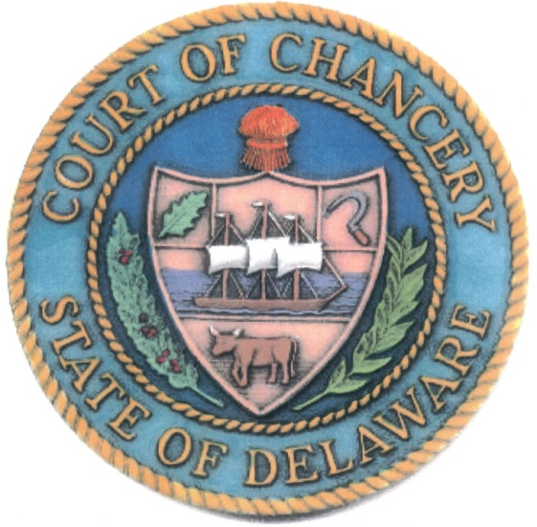
THE DELAWARE COURT OF CHANCERY
October 22, 2021

Slide 2
When was the Delaware Court of Chancery formed?
1787
1792
1899
1776

Slide 3
When was the Delaware Court of Chancery formed?
1787 A. Delaware Day
1792 B. Court of Chancery
1899 C. Corporation Law
1776 D. Separation Day

Slide 4
The Delaware Court of Chancery and Corporation Law Historical Highlights
1792 – Creation of the Delaware Court of Chancery
1897 – Article IX of the Constitution of 1897
1899 – General corporation law (DGCL) enacted to compete with New Jersey
1913 – NJ enacts the “Seven Sisters Act” effectively outlawing trusts and holding companies – an opening for Delaware.
1917 – Delaware begins ascendancy in entity formation
1967 – Significant revision of DGCL; annual review
1980s – The Court’s unique role in takeover litigation
1982 Enactment of the Delaware Revised Uniform Limited Partnership Act; substantial revisions of DRULPA in 1985
1992 – Enactment of LLC Act
2017 – 225th/50th/25th Anniversaries

Slide 5
How many entities have been formed in Delaware?
250,000,000
1,700,000
990,000
100,000

Slide 6
How many entities have been formed in Delaware?
250,000,000 A.
1,700,000 B.
990,000 C.
100,000 D.

Slide 7
Entity Formation
1.7 million entities
Largely publicly traded corporations and subsidiaries
Stand alone small corporations
Growth in alternative entities (LLC’s, LP’s)
Delaware incorporations include:
67.6% of Fortune 500 companies

Slide 8
Entity formation accounts for what percentage of the state’s revenue?
17%
22%
27%
32%

Slide 9
Entity formation accounts for what percentage of the state’s revenue?
17%
22%
27%
32%

Slide 10
Caseload 38% of New Filings Include Motions to Expedite

Slide 11
Jurisdiction
Trial court that hears and determines all matters in equity.
Three sources of jurisdiction
Equitable claims-fiduciary relationships
Equitable relief-TROs, injunctions, specific performance
Statutory grants of authority
Notes:
Per Pat, the presentation should be a high level overview and not overly detailed. Important to include general information for those who are unfamiliar with Chancery

Slide 12
Evolution of the Court
1792 – 1939 – The Court consisted of only a single Chancellor
1939 – A Vice Chancellor is established by statute
1946 – Vice Chancellor becomes a constitutional office
1961 – A second Vice Chancellor is added
1984 – A third Vice Chancellor is added
1989 – A fourth Vice Chancellor is added
2018 – Two more Vice Chancellors are added
Notes:
Per Pat, the presentation should be a high level overview and not overly detailed. Important to include general information for those who are unfamiliar with Chancery

Slide 13
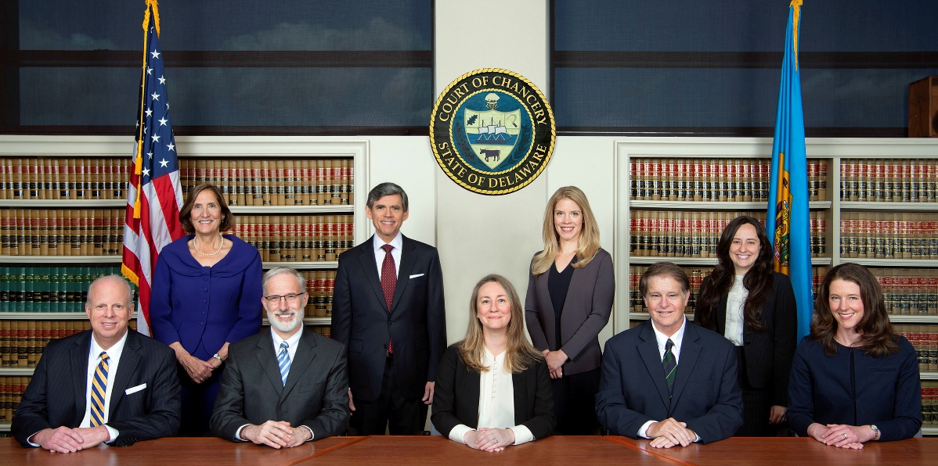
Officers of the Court
Seven Constitutional officers nominated by the Governor and confirmed by the Senate: the Chancellor and six Vice Chancellors.
Two Masters.

Slide 14
What is the Chancellor unable to do?
Authorize a blood transfusion
Recommend a pardon for a crime
Set aside a jury verdict
Declare someone to be dead

Slide 15
What is the Chancellor unable to do?
Authorize a blood transfusion
Recommend a pardon for a crime
Set aside a jury verdict
Declare someone to be dead

Slide 16
The Human Side of Chancery
Guardianships – adult, property
Unusual remedies
Blood transfusion
DNR Order
Presumption of death
Board of Pardons

Slide 17
Why Chancery?
No juries, no punitives
Over a century of well-developed precedent
The enabling nature of the DGCL with overlay of common law review
Ability to fashion equitable remedies
Experience and expertise of judicial officers
A commitment to prompt dispositions and excellence

Slide 18
CURRENT ISSUES FOR THE COURT OF CHANCERY AND DELAWARE CORPORATE LAW
Workload
1. Growing Dockets
More corporations and alternative entities means more litigation
Statutory jurisdiction steadily expanded
Chancery is the court companies want to be in
2. Market expectations
3. Books and records actions
The use of the tools at hand approach is more prevalent because of higher pleading standards and lead counsel disputes
The function of Section 220 has changed in the era of increased SEC disclosure and the internet

Slide 19
CURRENT ISSUES FOR THE COURT OF CHANCERY AND DELAWARE CORPORATE LAW
B. The Contractualization of Entity Law and the Court of Chancery
Altering the corporate “contract”
Bylaws
Certificate provisions
Statutory amendments
Case law adapting equitable principles

Slide 20
CURRENT ISSUES FOR THE COURT OF CHANCERY AND DELAWARE CORPORATE LAW
C. Potential Threats to Delaware’s Dominance
Federal encroachment
State Competition
Arbitration
Fee shifting

